Slide 1
To Tweet or Not to Tweet Eek Is that the time?
Overcoming Social Media Procrastination

Slide 2
Aim of Session
Understand procrastination
The challenge of social media
Strategies to overcome procrastination
Goal setting
Notes:
I am here to study!
Why do I need to think about wellbeing?

Slide 3
Social Media is everywhere!

Slide 4
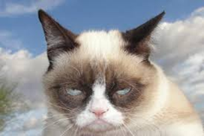
What is Procrastination?
“The action of delaying or delaying something”
OED
Procrastination is caused by the inner conflict between the want (Or need) to do something and the corresponding resistance to doing it.
Leads to stress

Slide 5
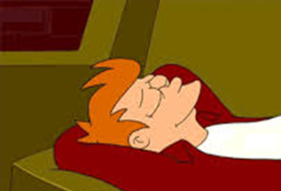
Stress Performance bell-curve
Notes:
Stress leads to inaction
Thoseof you with the rule I work well with a deadline : is that helpful / true

Slide 6
Evidence about feeling happy
Increase creativity
Global visual processing “see the bigger picture” (Fredrickson 2001)
Cognitive flexibility (Able to shift attention)
Better physical and mental health
Increases sense of affiliation (Islen 2000)
Focus on rewards (Tamer and Robinson 2007)

Slide 7
Activity: Why do we Procrastinate
In small groups/partners discuss
The reason you are attending the workshop
What your experience of procrastination is
Reasons behind your procrastination

Slide 8
Why we Procrastinate
Perfectionism
Confusion
Interest in completing task
Task difficulty
Difficulty concentrating
Fear of losing autonomy
Impulsiveness

Slide 9
Why we Procrastinate
Fear of being alone or disconnected
Prioritisation skills
Negative self belief,
To avoid something unpleasant, task or emotion such as shame or guilt
Stress
Habit and routine

Slide 10
Why we Procrastinate
Temporal Motivation Theory: Steel & Konig (2007)
Notes:
Expectancy of success and value of goal achievement
Diveded by time
self-efficacy, need for achievement, proneness to boredom, distractibility, impulsiveness, self-control and organization.
we are more likely to do things at which we expect to succeed (E) and we value (V), and
2. we typically discount future rewards in favor of immediate rewards (D) which is moderated by our tolerance for or sensitivity to delay (Γ).

Slide 11
Challenges of Social Media
Integrated social media learning: forums, blogs, emails etc
24 hour response expectation
Accessibility
Fear of missing out
Balancing multiple demands
Information overload – work, rest, news and play
Notes:
Domizi (2013) utilised Twitter in a graduate seminar requiring students to post weekly tweets to extend classroom discussions. Students reportedly used Twitter to connect with content and other students. Additionally, students found it "to be useful professionally and personally

Slide 12
Habit!
How much time is spent
Baylor university 2014 study suggested female students spent 10 hours on their phones and men spent 8 hours!
Cowen and Company social user survey found 18-29 year olds each day spent:
51 min on facebook,
50.9 min on Tumblr
23.5 min on twitter

Slide 13
Guilt
“A feeling of having committed wrong or failed in an obligation”
Oxford English Dictionary
Liked with Shame / anxiety
Can be useful to help problem solve and resolve
Can be unhelpful

Slide 14
Activity:
In your groups discuss the scenario.
Can you relate to it?
Is this person procrastinating?
If this was your friend what advice would you give?

Slide 15
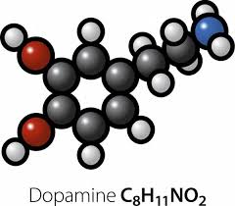
Create something
Tangible achievements=
Notes:
Dopamine functions as a neurotransmitter—a chemical released by neurons (nerve cells) to send signals to other nerve cells. The brain includes several distinct dopamine pathways, one of which plays a major role in reward-motivated behavior. Most types of reward increase the level of dopamine in the brain
Dopamine not only give the reward resonse but plays a part in regulating movement and the control of attention

Slide 16
Use the temporal motivation theory
Reduce the instant gratification by looking at how big your goals are!

Slide 17
Making changes

Slide 18
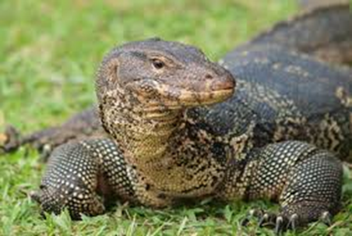
Recognise and Monitor
What timeframe will you monitor for.
How will you monitor?
An app such as Rescue time?
Make a note each time you go on social media

Slide 19
Look at what you have monitored
Be honest – Is this a problem? Do you want to change?
What are the benefits of changing?
What will change look like?

Slide 20
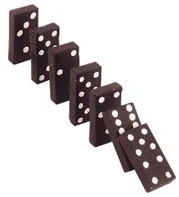
Commit to a Goal
One goal at a time
Break the goal into small manageable chunks.
Be clear about what you want to achieve.
Get a second opinion about it being realistic.
Give yourself a timescale
It’s ok to have an off day

Slide 21
Top Tips
Buy an alarm clock – does your phone really need to be the first thing you see in the morning?
Self edit: What are you posting? Why? What click bait do you end up distracted by?

Slide 22
Overcoming Procrastination
Habits form through ‘context-dependent repetition’
Choose a strategy and repeat.
If it doesn’t work on day 1,2, 6 or 48 that’s ok!
An expectation that there is a perfect solution can be a barrier to starting, just try something out it doesn’t need to be perfect

Slide 23
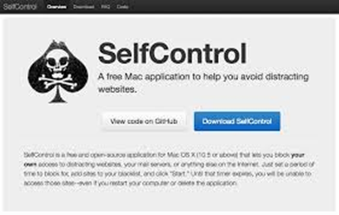
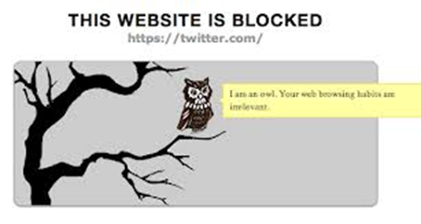
Remove the distractions.
Leave the phone at home/ turn the PC off and handwrite!
Apps
Self control/ productivity owl
Notes:
Those with willpower are shown to control their environment so that there is less temptation in their way

Slide 24
Designate clear break times or time to be on social media
Set boundaries with others
Have reminders in your environment as to what you want to achieve.

Slide 25
Change mindset: Rather than thinking about what you “should stop doing” action something you would like to start.
Is the task you are avoiding really that bad?
Try it to see if your anticipation is matched to reality
If it is overwhelming seek support!

Slide 26
Be compassionate to yourself – an off day is allowed
Give yourself regular breaks but trust yourself to be strict enough with yourself to return to work
If its hard starting a task then do half an action towards the goal or “just 1 minute”

Slide 27
Specific and achievable
Write lit review by next Tuesday:
1) Search Athens for articles using key word
2) Make list of articles
3)Read abstract of one article and make a record of one learning point
4)Choose 4 more articles to prioritise reading
5) Repeat step 3
6) Cluster ideas….
Notes:
Example of activity breakdown

Slide 28
Top tips
TO DO NOW
TO DO LATER
Notes:
Decision points.
Research re bag of popcorn we are not good at knowing when to end a task or move on unless there is a decision point. Create decision points by breaking tasks down into small chunke
Be mindful about what you are doing right now. Car park everything else for laters or make an active decision to switch to a task of higher priority.

Slide 29
We all need social contact, leisure time, movement away from a desk and good food. Ensure that during your studies you allow times to prioritise these things.
One hour of a meaningful break is better then 2 hours staring at books and not being productive. But be clear with yourself about what is leisure and what is procrastination

Slide 30
With a partner discuss
How do you schedule your day?
How do you monitor what needs doing?
How do you give yourself credit for what you have achieved?
Does this need tweaking?

Slide 31
Now discuss
What are you going to do differently today?
Try writing a smart goal, swap it with someone to see if they think it is achievable

Slide 32
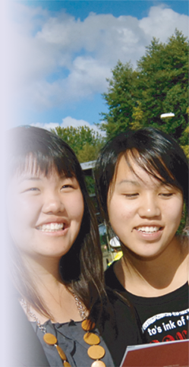
Student Support
www.warwick.ac.uk/studentsupport
Notes:
Professionals offering wide range of services- each service is in communication with the others where relevant to ensure a comprehensive support package for students. Warwick offers a supportive environment, recognising that they are all adults, who need to take responsibility for their own actions, and should they need support, will need to engage with us, and poss. other statutory support services (acknowledging the limits of what can be expected of an educational establishment).
If they do so, then we will offer the support we can.

Slide 33
Ted Talks worth watching
Tim Urban Inside the mind of a master procrastinator
Adam Grant :Surprising habits of original thinkers
Nigel Marsh: How to make work life balance work

Slide 34
Ted Talks worth watching
Martin Antony: When perfect isn’t good enough
Shawn Anchor: The happy secret to better work
Andy Puddicombe: All it takes is 10 mindful minutes

Slide 35
Websites:
Action for happiness
Wellbeing 5
Centre for greater good
CCI
NTW

