Slide 1
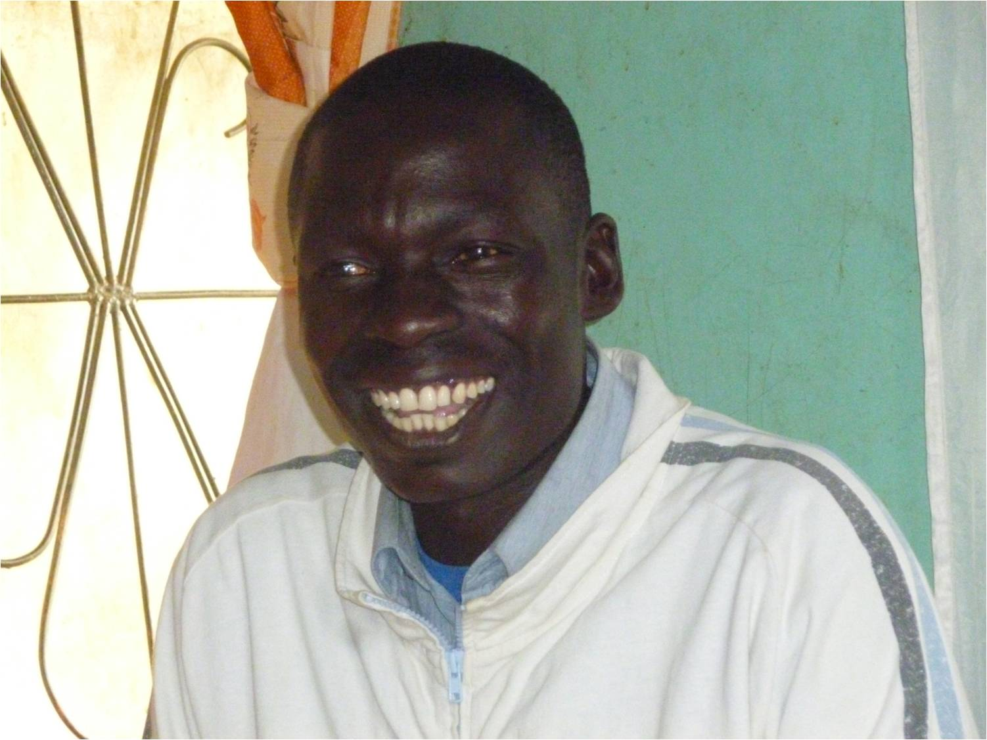
Changed Mindset
Bible Reflections
Part 3
Tanzania June 2017 - Zachary

Slide 2
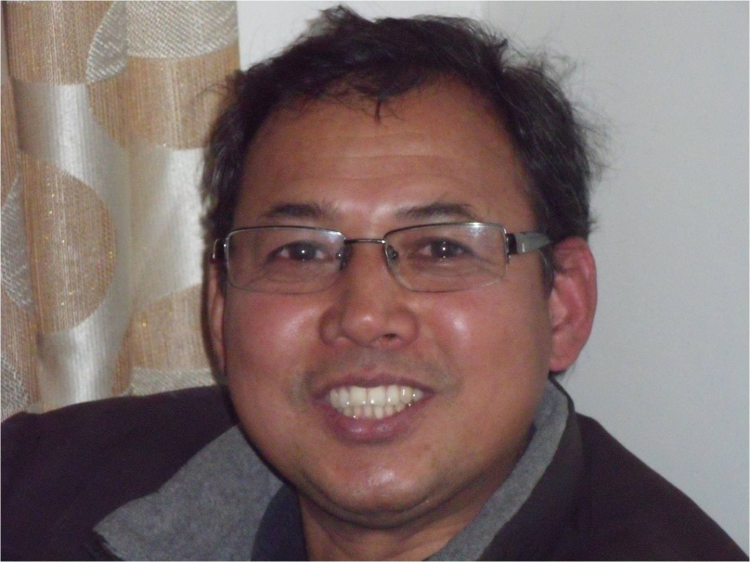
Knowing God and Hearing His Voice:
Jesus our example
Only did what he saw the
Father doing.
Only spoke what he heard.

Slide 3
Faith filled prayer
Mk 6:41 Taking the five loaves and the two fish and looking up to heaven, he gave thanks and broke the loaves.
Prayer that’s relational – listens as well as speaks

Slide 4
Prayer marked by:
Surrender
Faith
Sees the problem
Sees the little resource
Chooses to look heavenward
Standing on God’s Promises
Stepping out in obedience
and risk taking

Slide 5
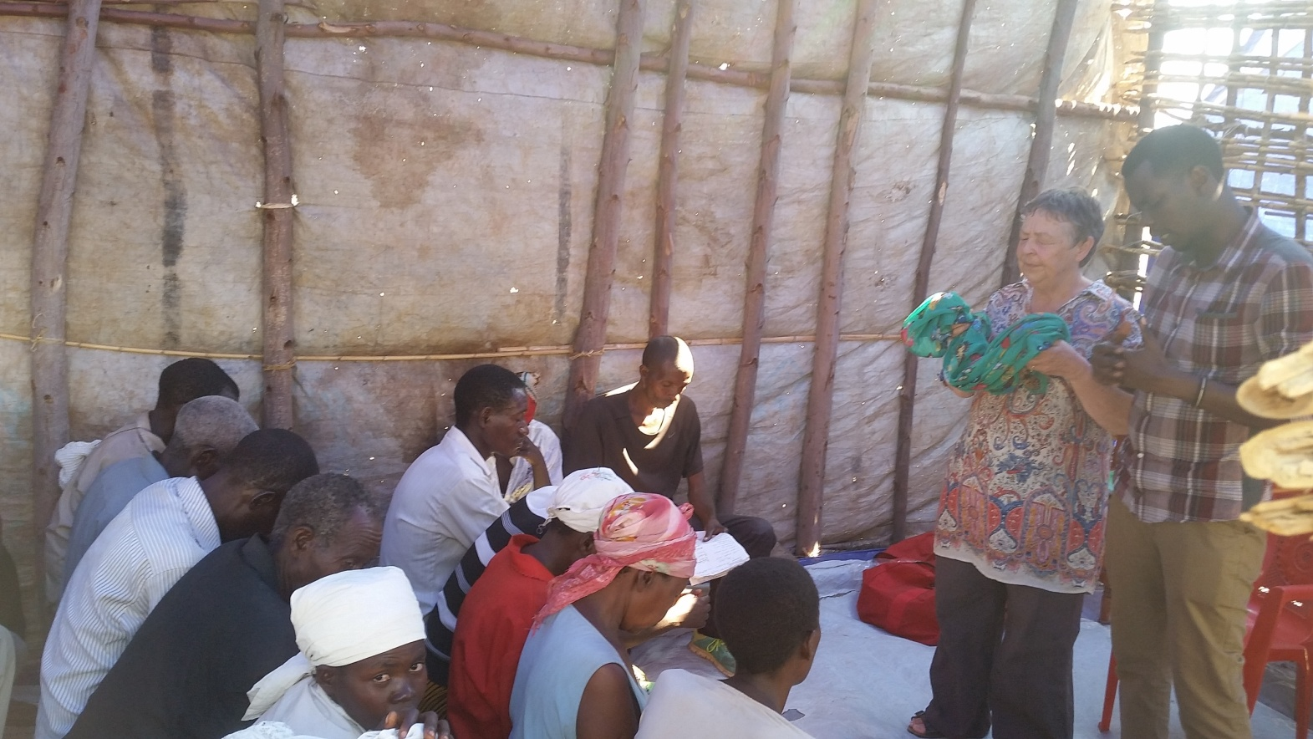
Impartation and Blessing

Slide 6
For Reflection and Discussion
Have you any experiences of
hearing God’s voice?
Share about any promises on
which you have stood or are
standing?
In the ministry or situations you
are involved in:
What are the mindsets that you
are challenging – your own or
others?
How can you bring God’s word
to the situation and the people?

Slide 7
Contacts for Rob and Jane
fivethousandplus@yahoo.co.uk
enq@5000plus.org
www.5000plus.org
Rob: 07806 760 446
Jane: 07905 754342
33 Hoyle Court Ave Baildon Shipley BD17 6EY

