Slide 1
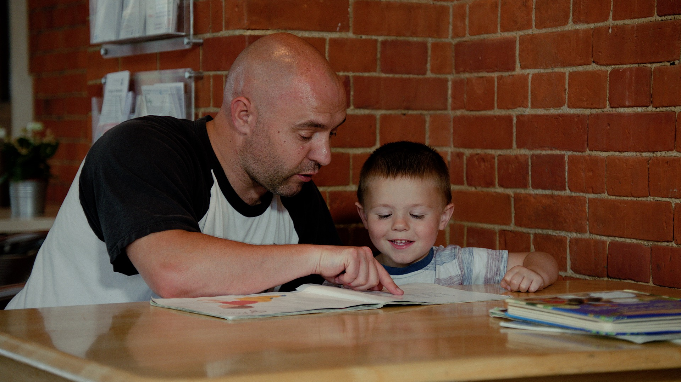
How does a child learn to read?

Slide 2
There are 6 main skills
Learn 44 different sounds – how to say them and write them
Spot those 44 sounds in words
‘Sound out’ – say the sounds one by one
‘Blend’ the sounds together
Read the words
Understand what the words mean

Slide 3
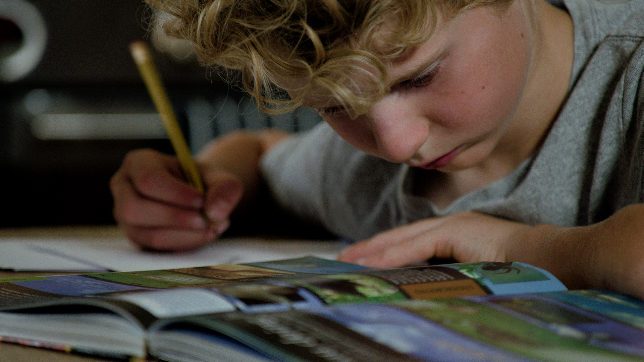
Skills 1 to 5 require phonics knowledge

Slide 4
Phonics is all about sounds
26 letters in the alphabet but 44 sounds
Some sounds are written using 2 or 3 letters working together

Slide 5
Skill 1
1. Learn 44 different sounds
how to say them and write them grapheme = written form of a sound phoneme = spoken form of a sound
Schools must teach using a validated phonics programme. Our schools use Little Wandle Letters and Sounds or Read Write Inc.
Sounds are introduced in a fixed order – grouped in phases – phase 2 and 3 in Reception, phase 5 in Year 1

Slide 6
s
a
t
p
i
n
m
d
g
o
c
k
ck
e
u
r
h
b
f
ff
l
ll
ss
j
v
w
x
y
z
zz
qu
ch
sh
th
ng
ai
ee
igh
oa
oo
ar
or
ur
ow
oi
ear
air
er
nk
ay
ou
ie
ea
oy
ir
ue
aw
wh
ph
ew
oe
au
a-e
e-e
i-e
o-e
u-e

Slide 7
Phonics schemes use images and rhymes to teach the individual sounds

Slide 8
Skill 2
3. ‘Sound out’ – say the sounds one by one
Accurate pronunciation of each sound is vital to allow the child to ‘blend’
Pronunciation video
https://www.youtube.com/watch?v=IwJx1NSineE

Slide 9
Skill 3
2. Spot those 44 sounds in words
Children must identify individual sounds and also spot the sounds represented by more than one letter
Digraph 2 letters making 1 sound
Trigraph 3 letters making 1 sound
We also use the explanation ‘special friends’

Slide 10
Sound buttons
d o g c r i s p
s h o p b r o w n

Slide 11
s
a
t
p
i
n
m
d
g
o
c
k
ck
e
u
r
h
b
f
ff
l
ll
ss
j
v
w
x
y
z
zz
qu
ch
sh
th
ng
ai
ee
igh
oa
oo
ar
or
ur
ow
oi
ear
air
er
nk
ay
ou
ie
ea
oy
ir
ue
aw
wh
ph
ew
oe
au
a-e
e-e
i-e
o-e
u-e
ship
mop stamp
spoon duck night
singing date time

Slide 12
Skills 4 and 5
4. ‘Blend’ the sounds together
Children can sometimes find this tricky
5. Read the words

Slide 13
Tricks if blending is hard
Sound out in ‘Fred Talk’ - point to your ‘h-ea-d’
Don’t rush them as they’re trying to blend. This skill needs concentration; show you’ve got time for them to figure it out.
Whispering can help as it can encourage them to focus on the shape their mouth should make when saying a sound.
Use sound games to develop the child’s ability to retain sounds in their memory and work with them – next slide

Slide 14
Sound games – no written words
Ask the child to tell you the sounds they hear in certain words, or sound them out + ask them to blend: swim or ‘s’ ‘w’ ‘i ‘m’
If you change the ‘h’ in hat to ‘ch’ what do you get? ‘i’ in sit to ‘a’? ‘b’ in bin to ‘ch’? ‘i’ in ship to ‘o’?
Think of some words that rhyme with: cat top make
Mat and man start with the same sound – what sound? Chat and chips, sister and silly, first and fun?

Slide 15
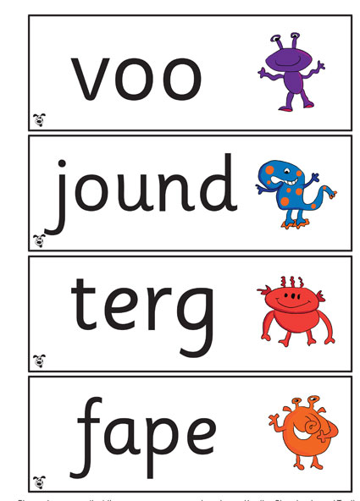
Year 1 phonics tests

Slide 16
Tricky / red / high frequency words
Is I The Put Pull Full As And Has His Her Go No To | Into She Push He Of We Me Be Was You They My By All | Are Sure Pure Said So Have Like Some Come Love Do Were Here Little | Says There When What One Out Today Their People Oh Your Mr Mrs Ms | Ask Could Would Should Our House Mouse Water Want Any Many Again Who Whole
Some words you cannot sound out. Others occur very frequently. Children need to learn to recognize these by sight.

Slide 17
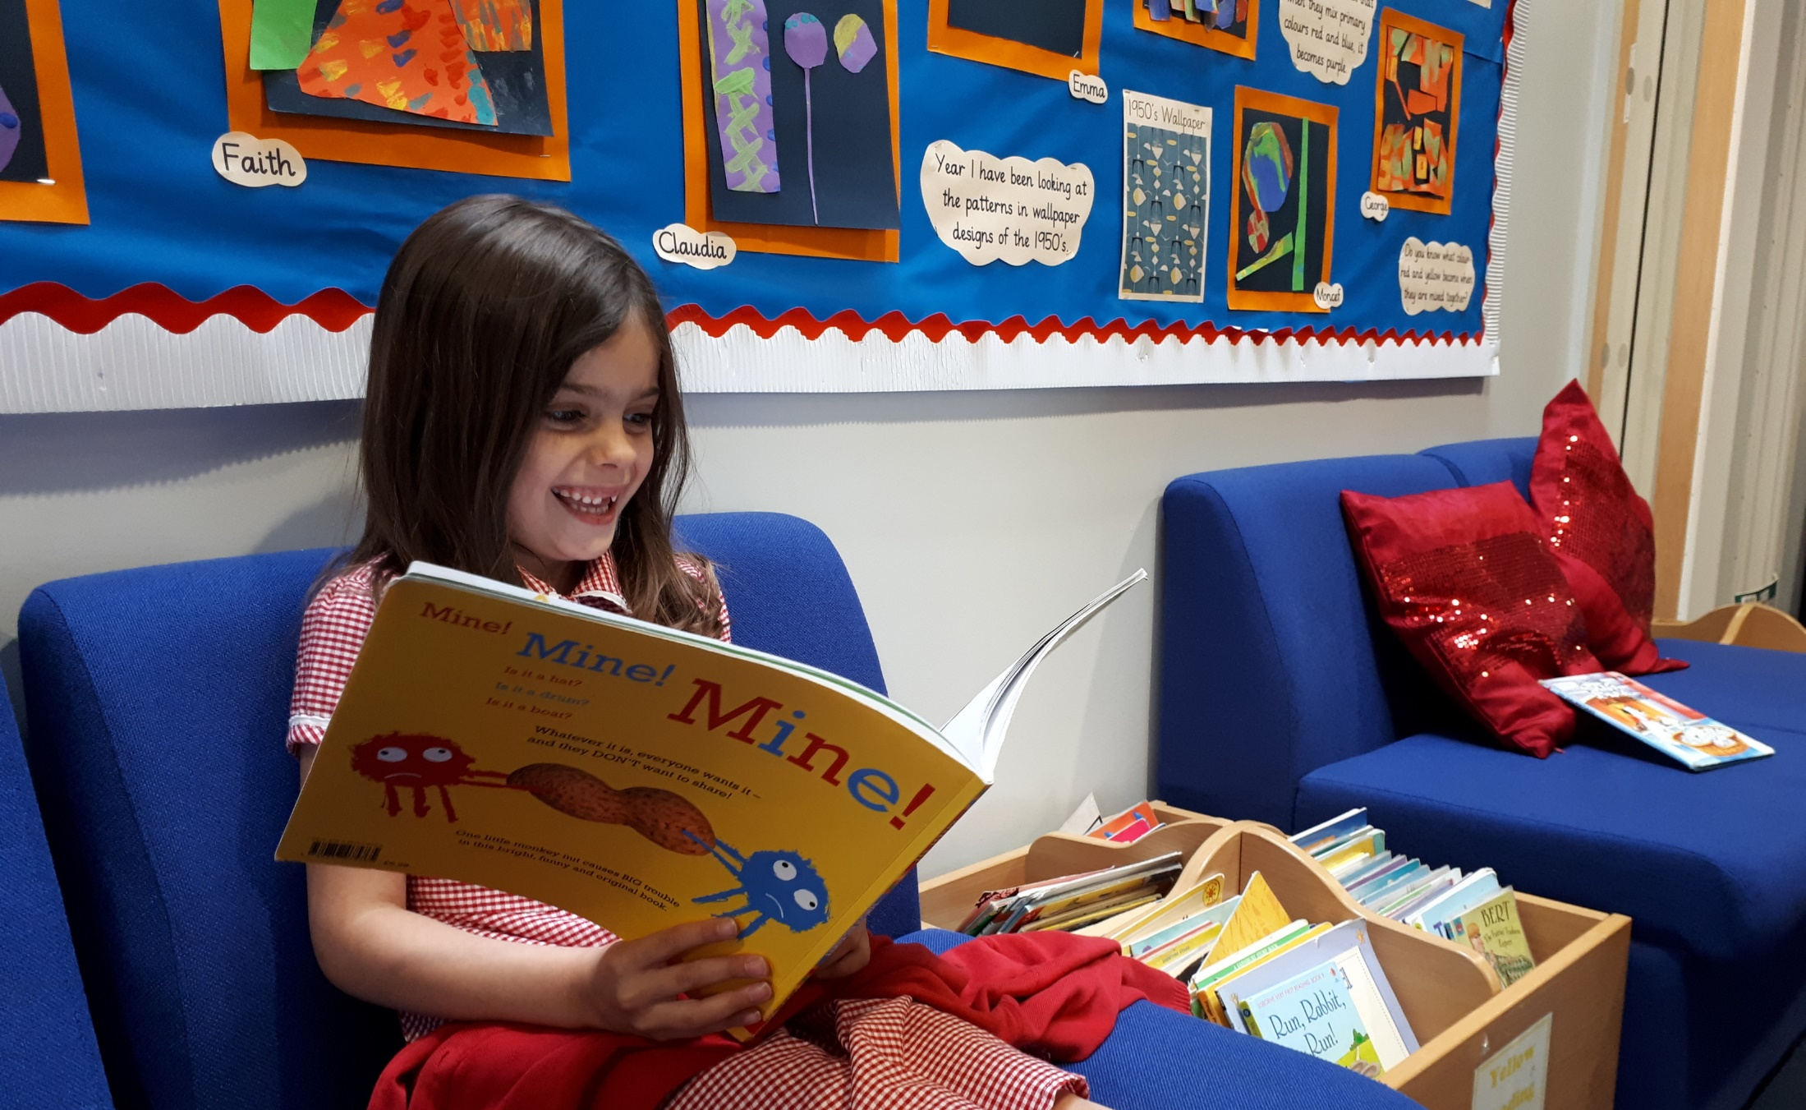
Phonics is a vital skill when children first start to read It is also useful later when they come across words they do not know

Slide 18
Skill 6
6. Understand what the words mean
We read to learn information or enjoy a story – reading aloud fluently is pointless if there is no understanding
Remember at all times as a volunteer to chat, question and check for comprehension – never assume!

Slide 19
What book should we use?
It is very important to make sure your child is reading books at the correct level.
Children who are still learning their sounds should read fully decodable books where all words can be sounded out using the phonics sounds they know.
Children will be encouraged to read a book 3 times – once to decipher the words, once to add expression, and again to check comprehension.

Slide 20
What book should we use?
While we do not want to rush children ahead, it is important to keep them moving forward.
In school children should bring out a book of the correct level; virtual volunteers will need to select carefully.
After hearing a child read their school book, take time to share a more challenging book – higher level ebook or a book from the L2L2R box in school.

Slide 21
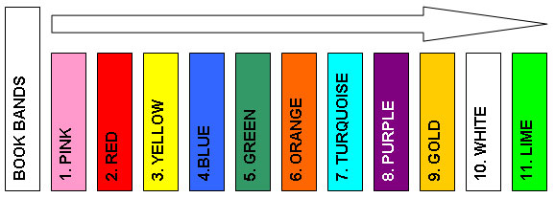
In the early stages choose books based on the sounds they know. Once they know most of their sounds, you can be guided by book band colours.

Slide 22
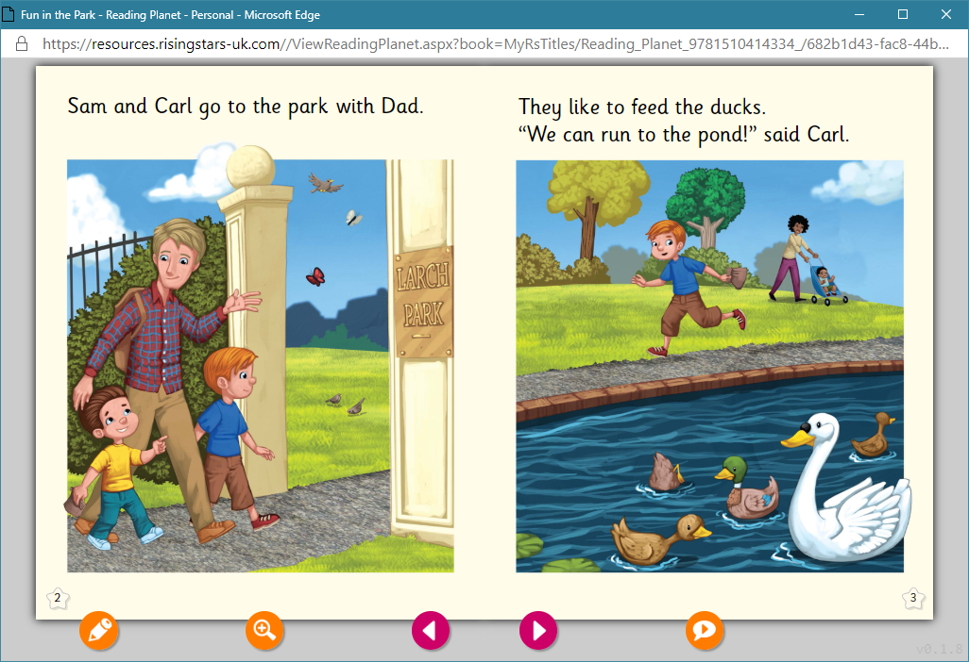
Hearing a child read
Sound out and blend if necessary
Spot digraphs and trigraphs
Look out for tricky or high frequency words (and repetitive words)
Demonstrate expression for the child to copy and explain how it adds meaning
Chat and ask questions to check understanding

Slide 23
Asking Questions
3. Check understanding and vocabulary
“Do you know what the white bird is called?”
Factual question
“Where did Dad take Sam and Carl?”
2. Make it personal
“What do you like doing at the park?”

Slide 24
Have fun!

