Slide 1
Phonics Training 2020

Slide 2
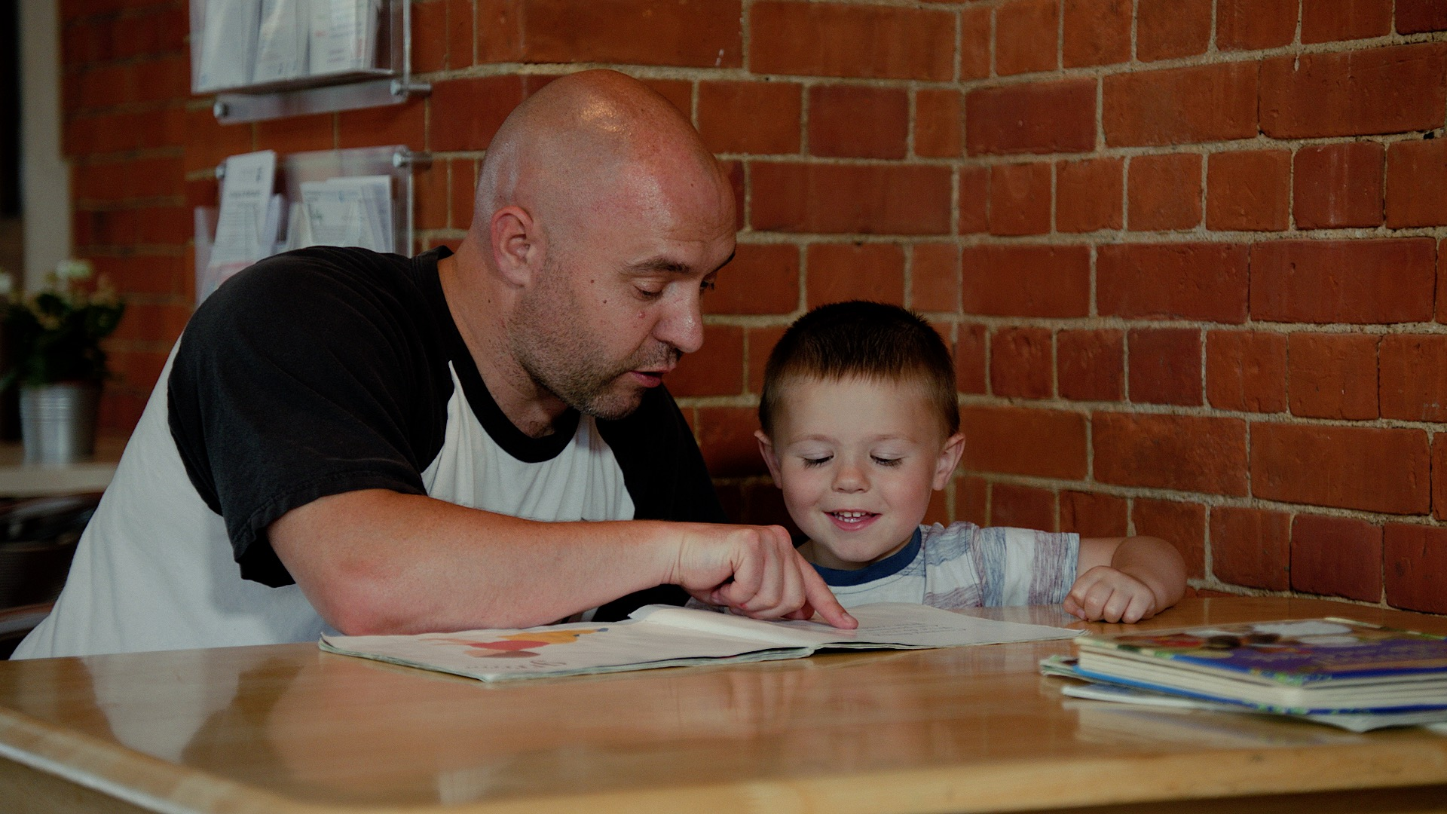
How does a child learn to read?

Slide 3
There are 6 main skills
Learn 44 different sounds – how to say them and write them
Spot those 44 sounds in words
‘Sound out’ – say the sounds one by one
‘Blend’ the sounds together
Read the words
Understand what the words mean

Slide 4
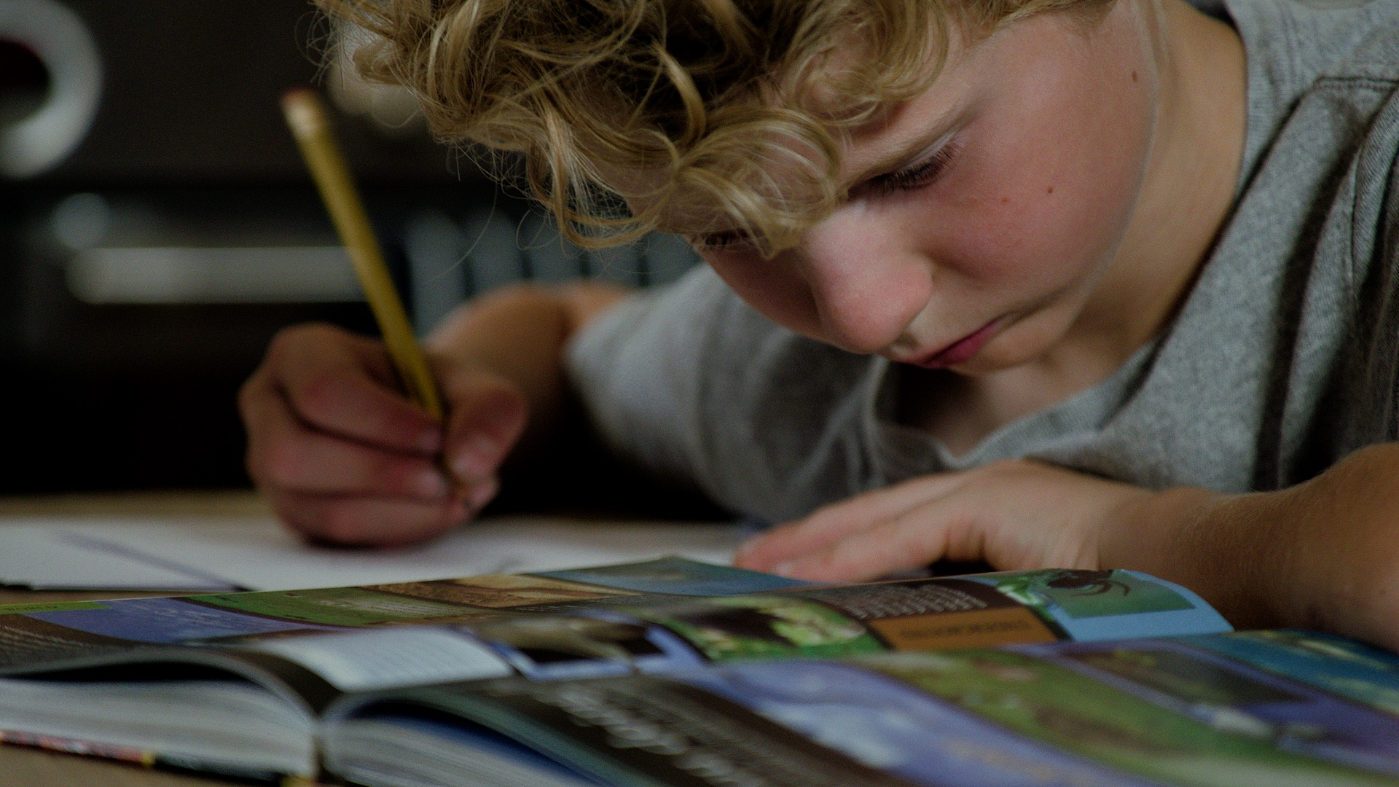
Skills 1 to 5 require phonics knowledge

Slide 5
Phonics is all about sounds
26 letters in the alphabet but 44 sounds
Some sounds are written using 2 or 3 letters working together

Slide 6
Skill 1
1. Learn 44 different sounds – how to say them and write them grapheme = written form of a sound phoneme = spoken form of a sound
Schools teach the sounds using various phonics schemes - e.g. Read Write Inc, Letters and Sounds, Jolly Phonics
Each scheme introduces the sounds in a fixed order – they are grouped in phases – see next slide

Slide 7
PHASE 2
PHASE 3
PHASE 5
s
a
t
p
i
n
m
d
g
o
c
k
ck
e
u
r
h
b
f
ff
l
ll
ss
j
v
w
x
y
z
zz
qu
ch
sh
th
ng
ai
ee
igh
oa
oo
ar
or
ur
ow
oi
ear
air
ure
er
ay
ou
ie
ea
oy
ir
ue
aw
wh
ph
ew
oe
au
a-e
e-e
i-e
o-e
u-e

Slide 8
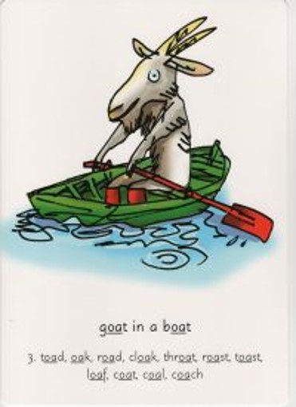
Some schemes use actions to help children remember Some use images and rhymes Some use games and quizzes

Slide 9
To practise a specific grapheme:
FOR IN-SCHOOL VOLUNTEERS
write in the back of your notebook
FOR VIRTUAL VOLUNTEERS
highlight the grapheme in the book

Slide 10
Skill 2
2. Spot those 44 sounds in words
Children must identify individual sounds and also spot the sounds represented by more than one letter
Digraph 2 letters making 1 sound
Trigraph 3 letters making 1 sound
We also use the explanation ‘special friends’

Slide 11
Sound buttons
d o g c r i s p
s h o p b r o w n

Slide 12
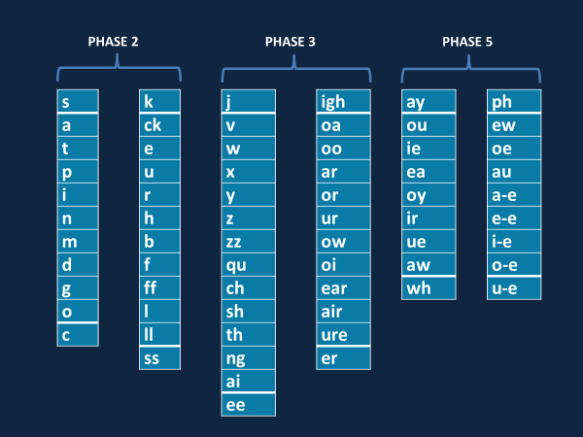
mop ship stamp
spoon duck night
singing date time

Slide 13
Skill 3
3. ‘Sound out’ – say the sounds one by one
Accurate pronunciation of each sound is vital to allow the child to ‘blend’
Pronunciation video
https://www.youtube.com/watch?v=IwJx1NSineE

Slide 14
Skills 4 and 5
4. ‘Blend’ the sounds together
Children can sometimes find this tricky
5. Read the words

Slide 15
Tricks if blending is hard
Sound out in ‘Robot Talk’ – easier to hear the individual sounds and blend them together.
Don’t rush them as they’re trying to blend. This skill needs concentration; show you’ve got time for them to figure it out.
Whispering can help as it can encourage them to focus on the shape their mouth should make when saying a sound.
Use sound games to develop the child’s ability to retain sounds in their memory and work with them – next slide

Slide 16
Sound games – no written words
Ask the child to tell you the sounds they hear in certain words, or sound them out + ask them to blend: swim or ‘s’ ‘w’ ‘i ‘m’
If you change the ‘h’ in hat to ‘ch’ what do you get? ‘i’ in sit to ‘a’? ‘b’ in bin to ‘ch’? ‘i’ in ship to ‘o’?
Think of some words that rhyme with: cat top make
Mat and man start with the same sound – what sound? Chat and chips, sister and silly, first and fun?

Slide 17
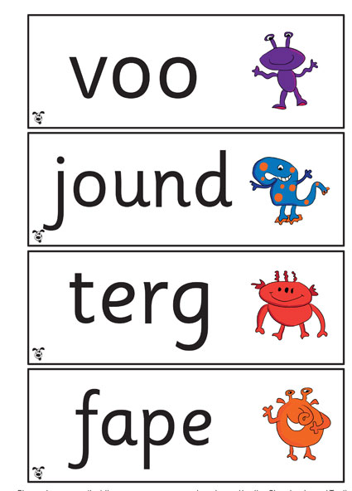
Year 1 phonics tests

Slide 18
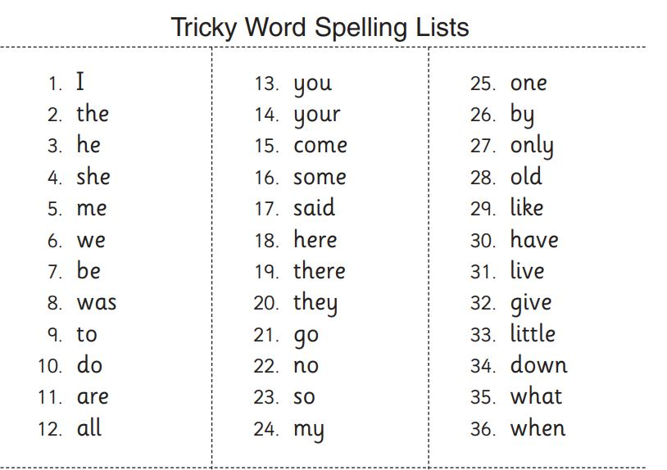
tricky words / red words
There are some words you cannot sound out Children need to learn them by sight

Slide 19
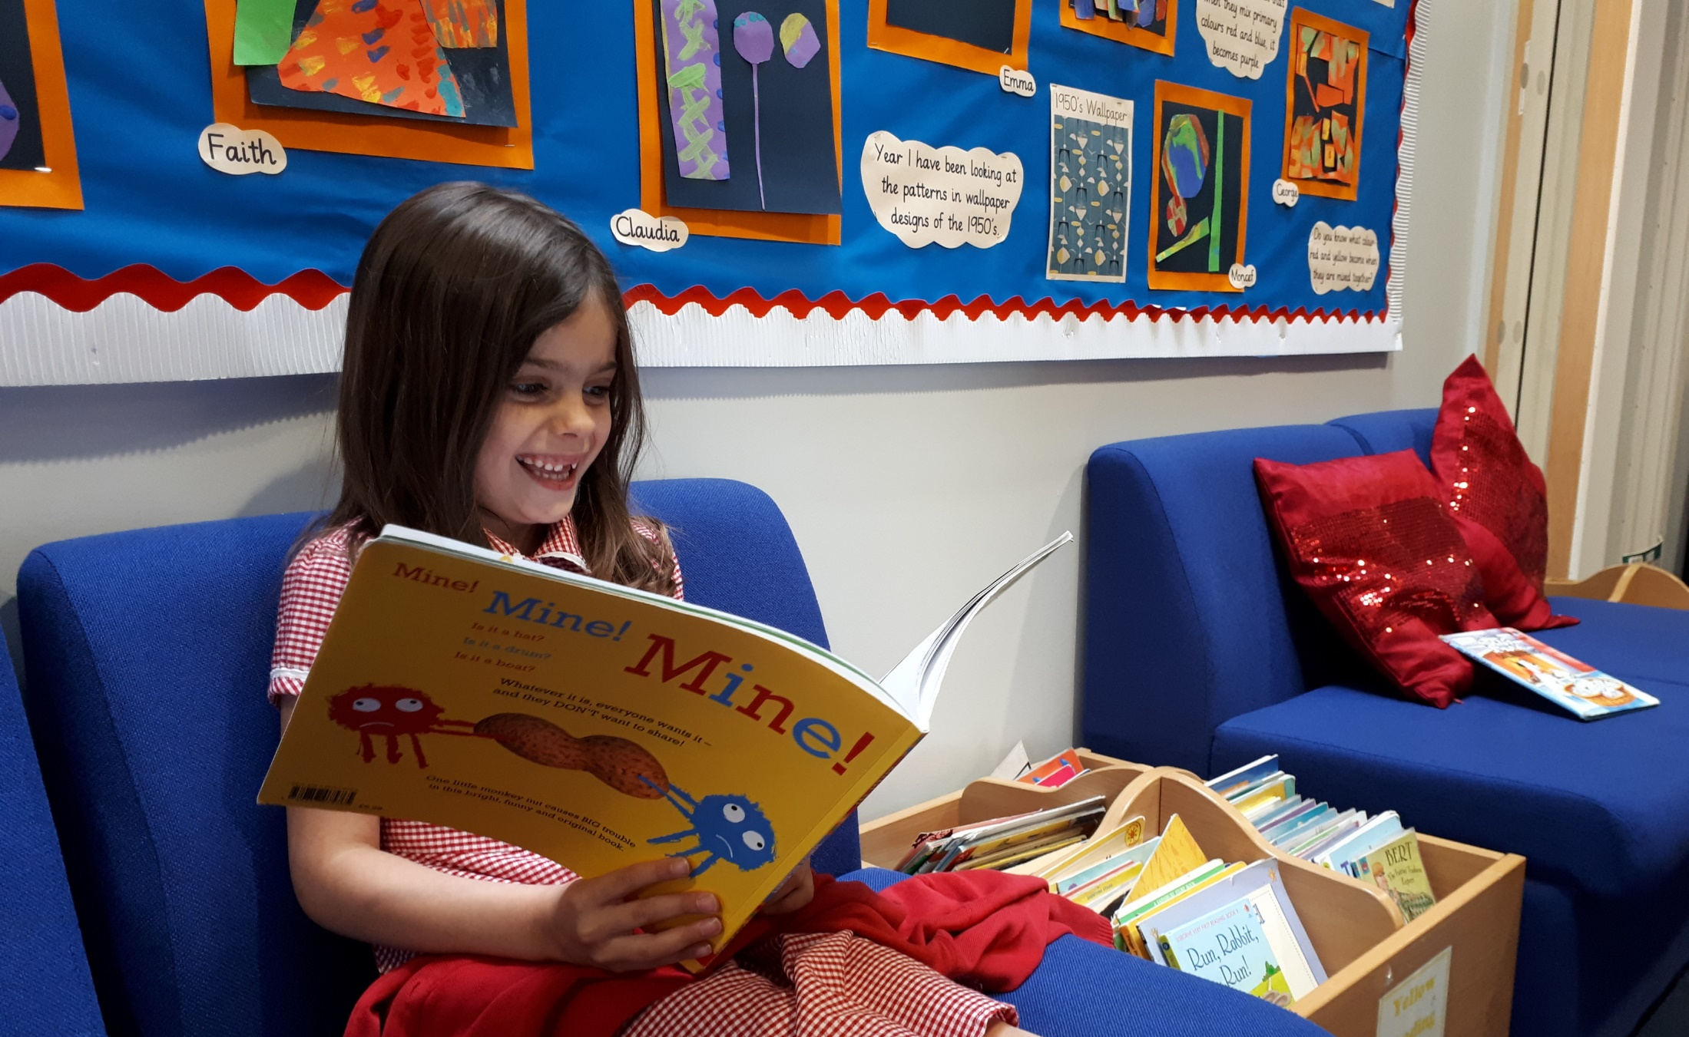
Phonics is an vital skill when children first start to read It is also useful later when they come across words they do not know

Slide 20
Skill 6
6. Understand what the words mean
We read to learn information or enjoy a story – reading aloud fluently is pointless if there is no understanding
Remember at all times as a volunteer to chat, question and check for comprehension – never assume!

Slide 21
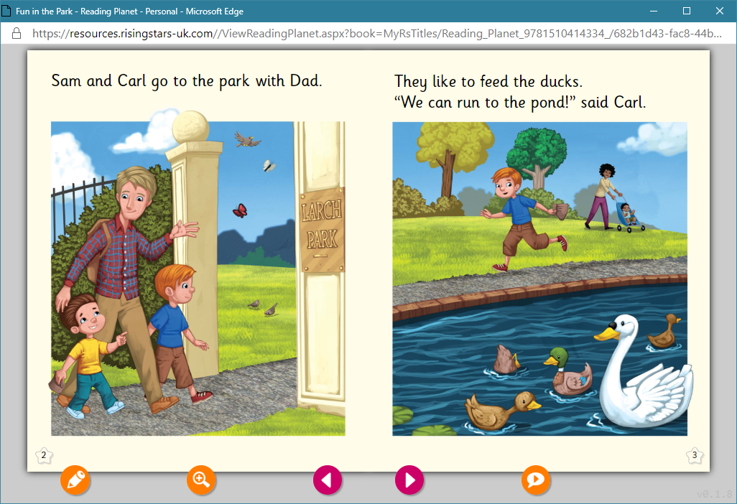
Let’s have a go

Slide 22
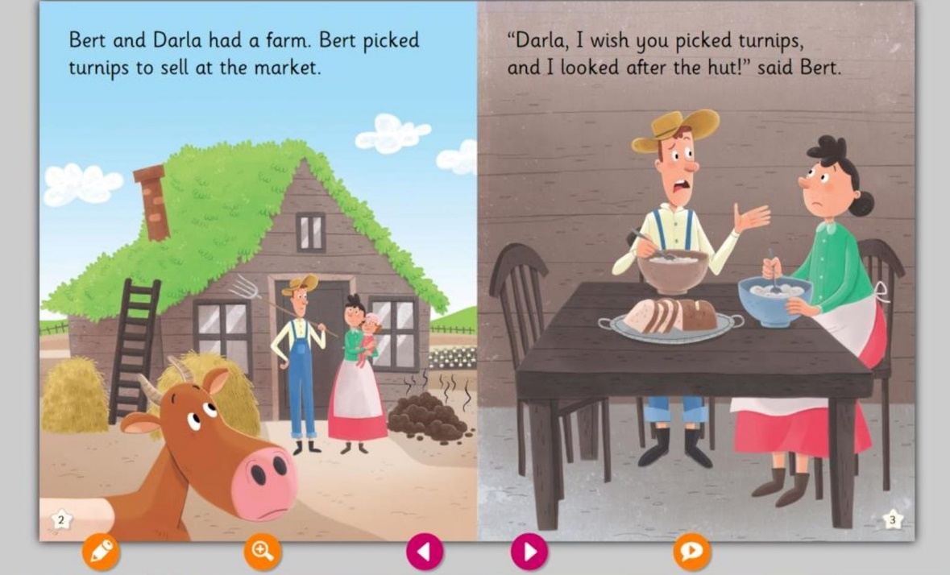
Let’s have a go

Slide 23
Questions?

Slide 24
Learn to Love to Read L2L2R
www.learn2love2read.org.uk
anna@learn2love2read

