Slide 1
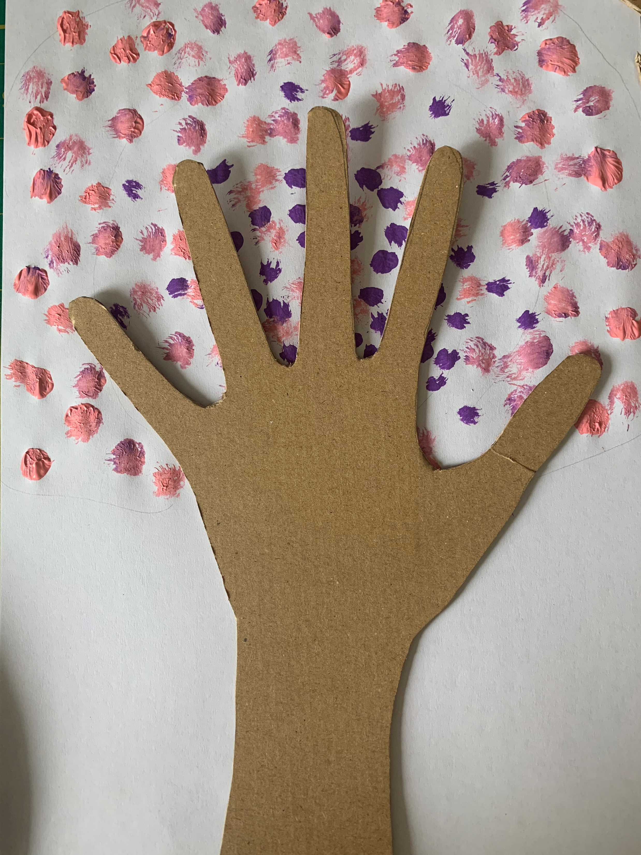
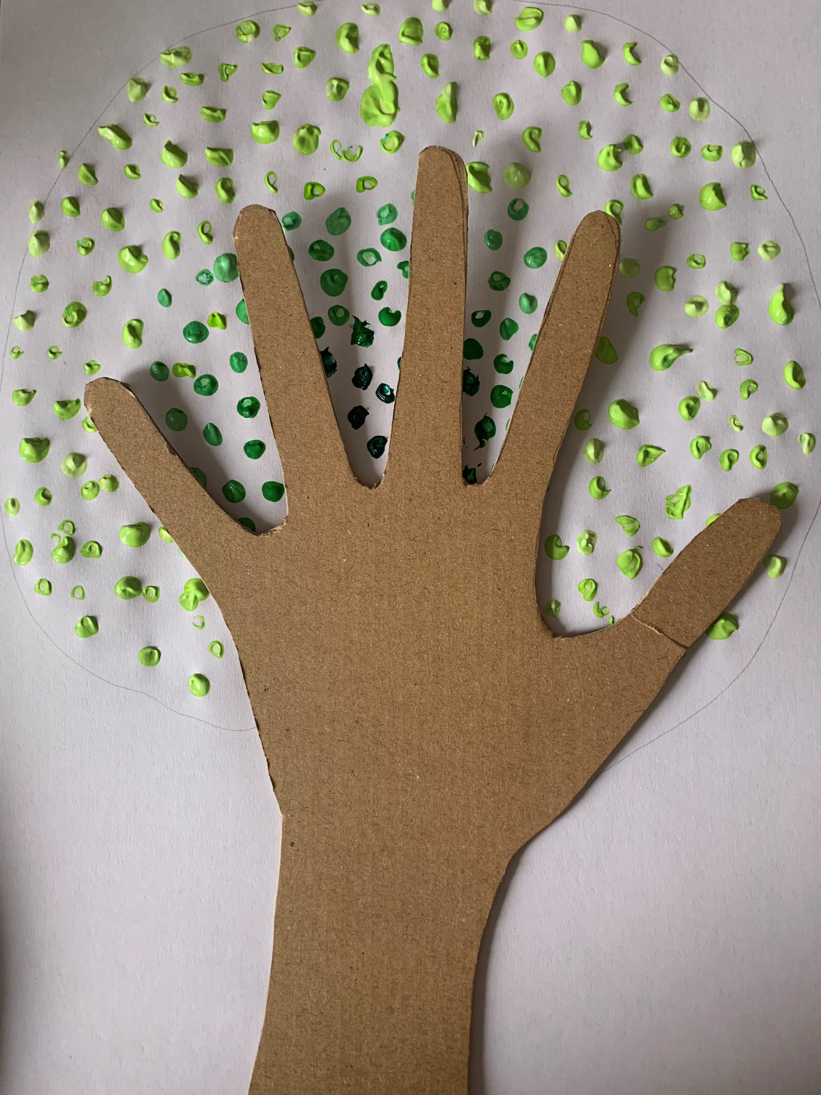
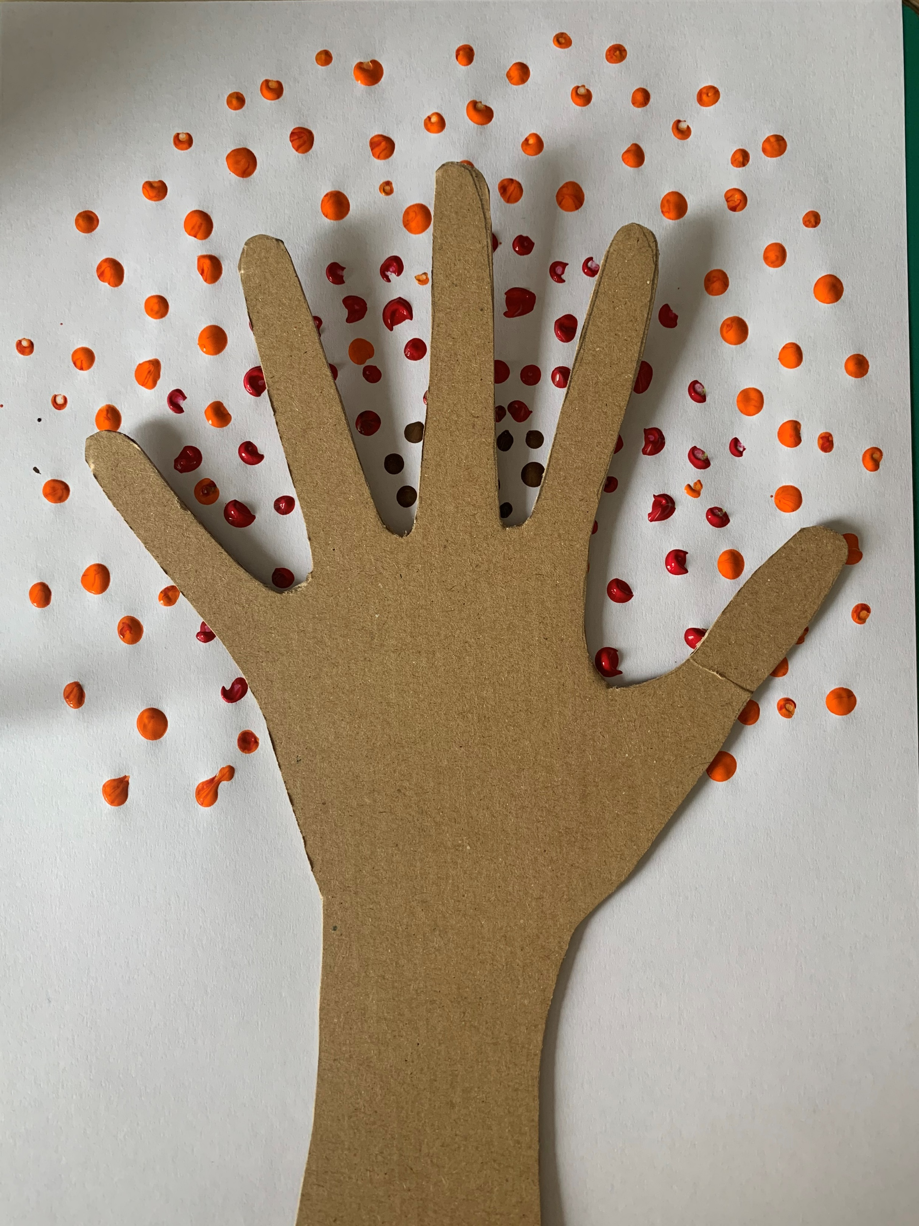
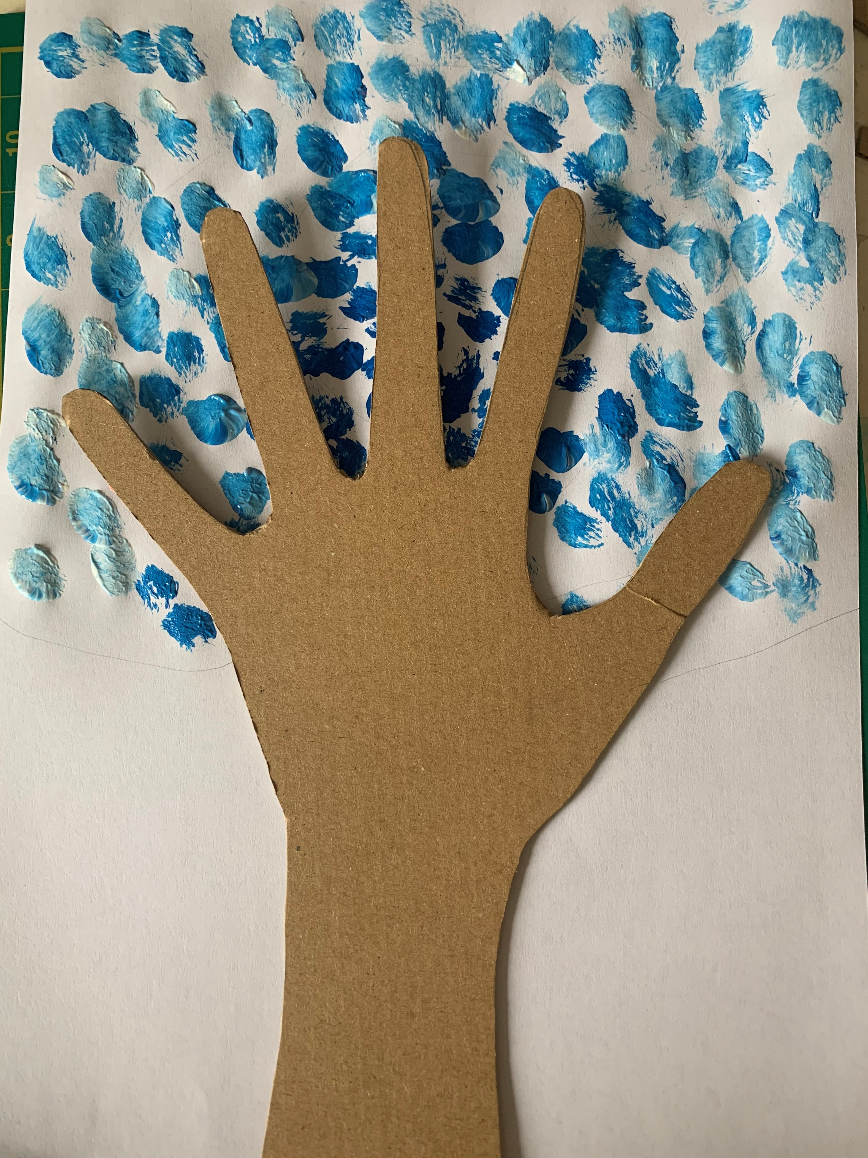
Make hand print trees

Slide 2
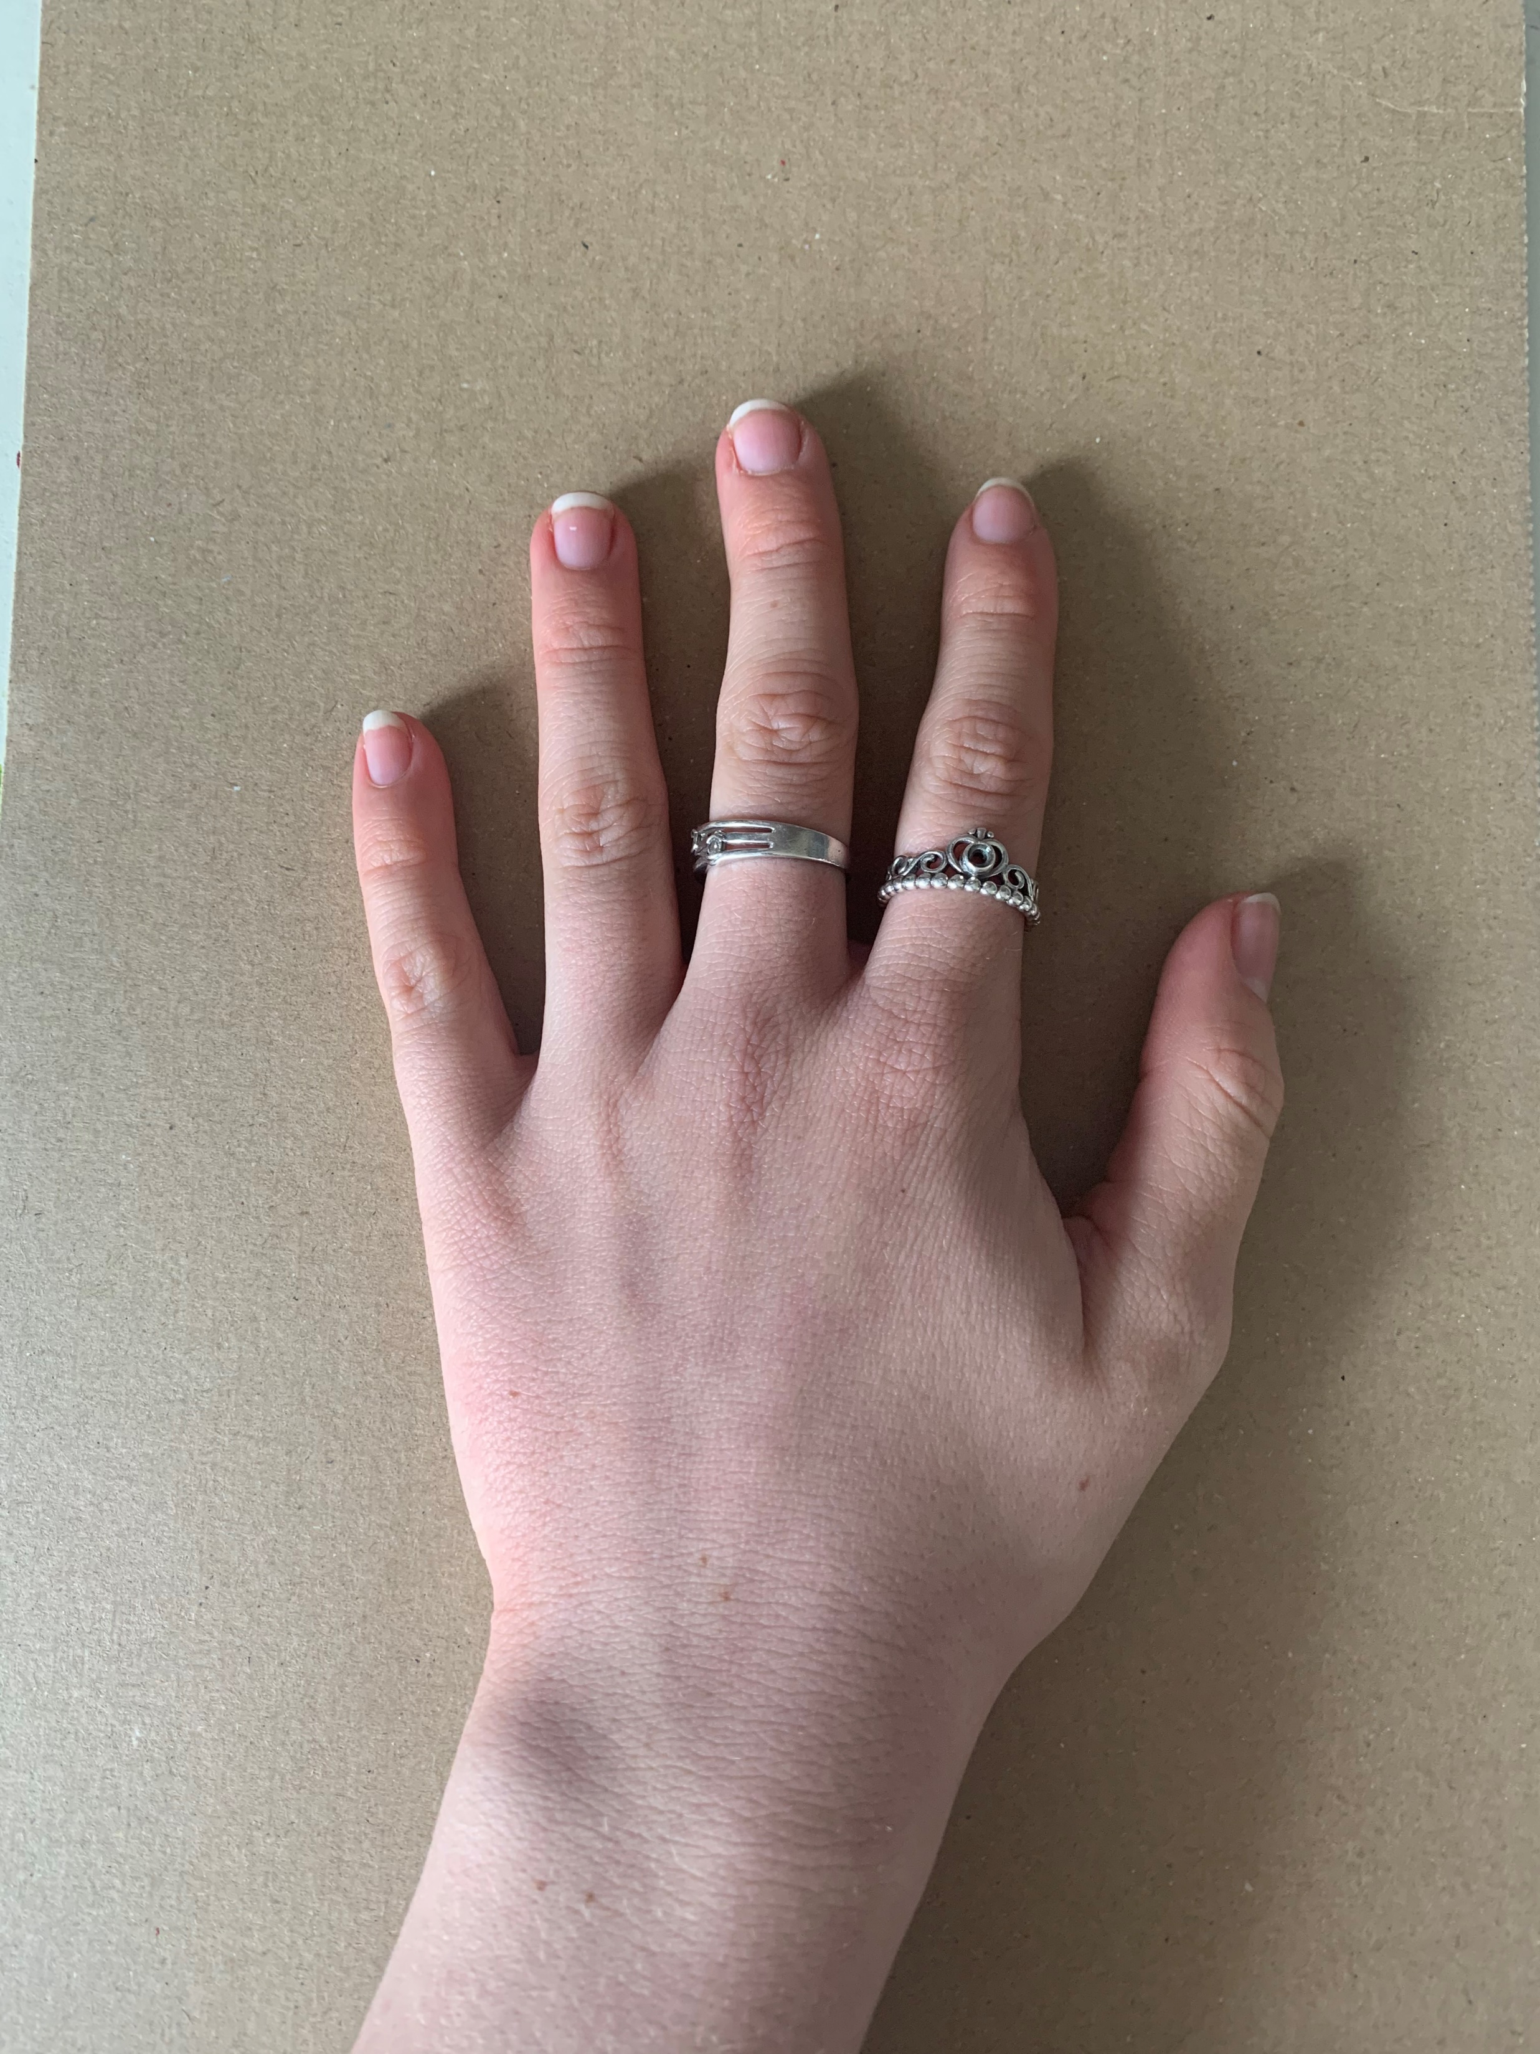
First draw around your hand onto some cardboard or brown card
Or you could paint some white card

Slide 3
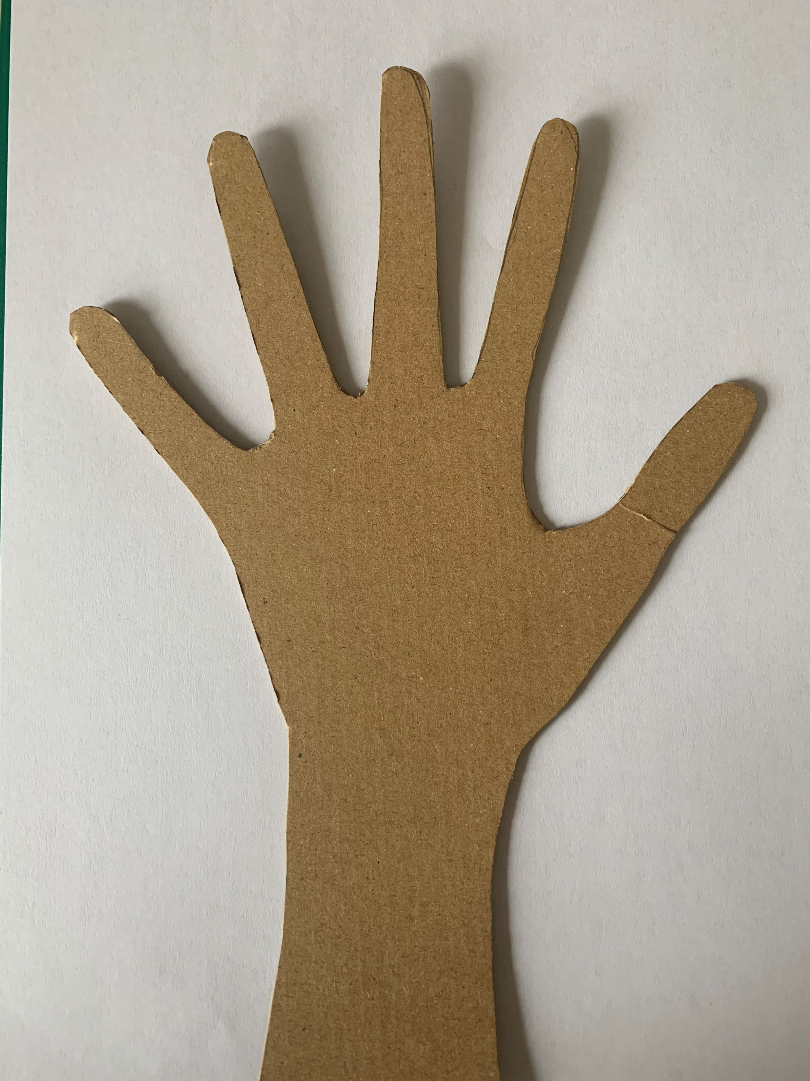
Now cut it out, you may need an adults help

Slide 4
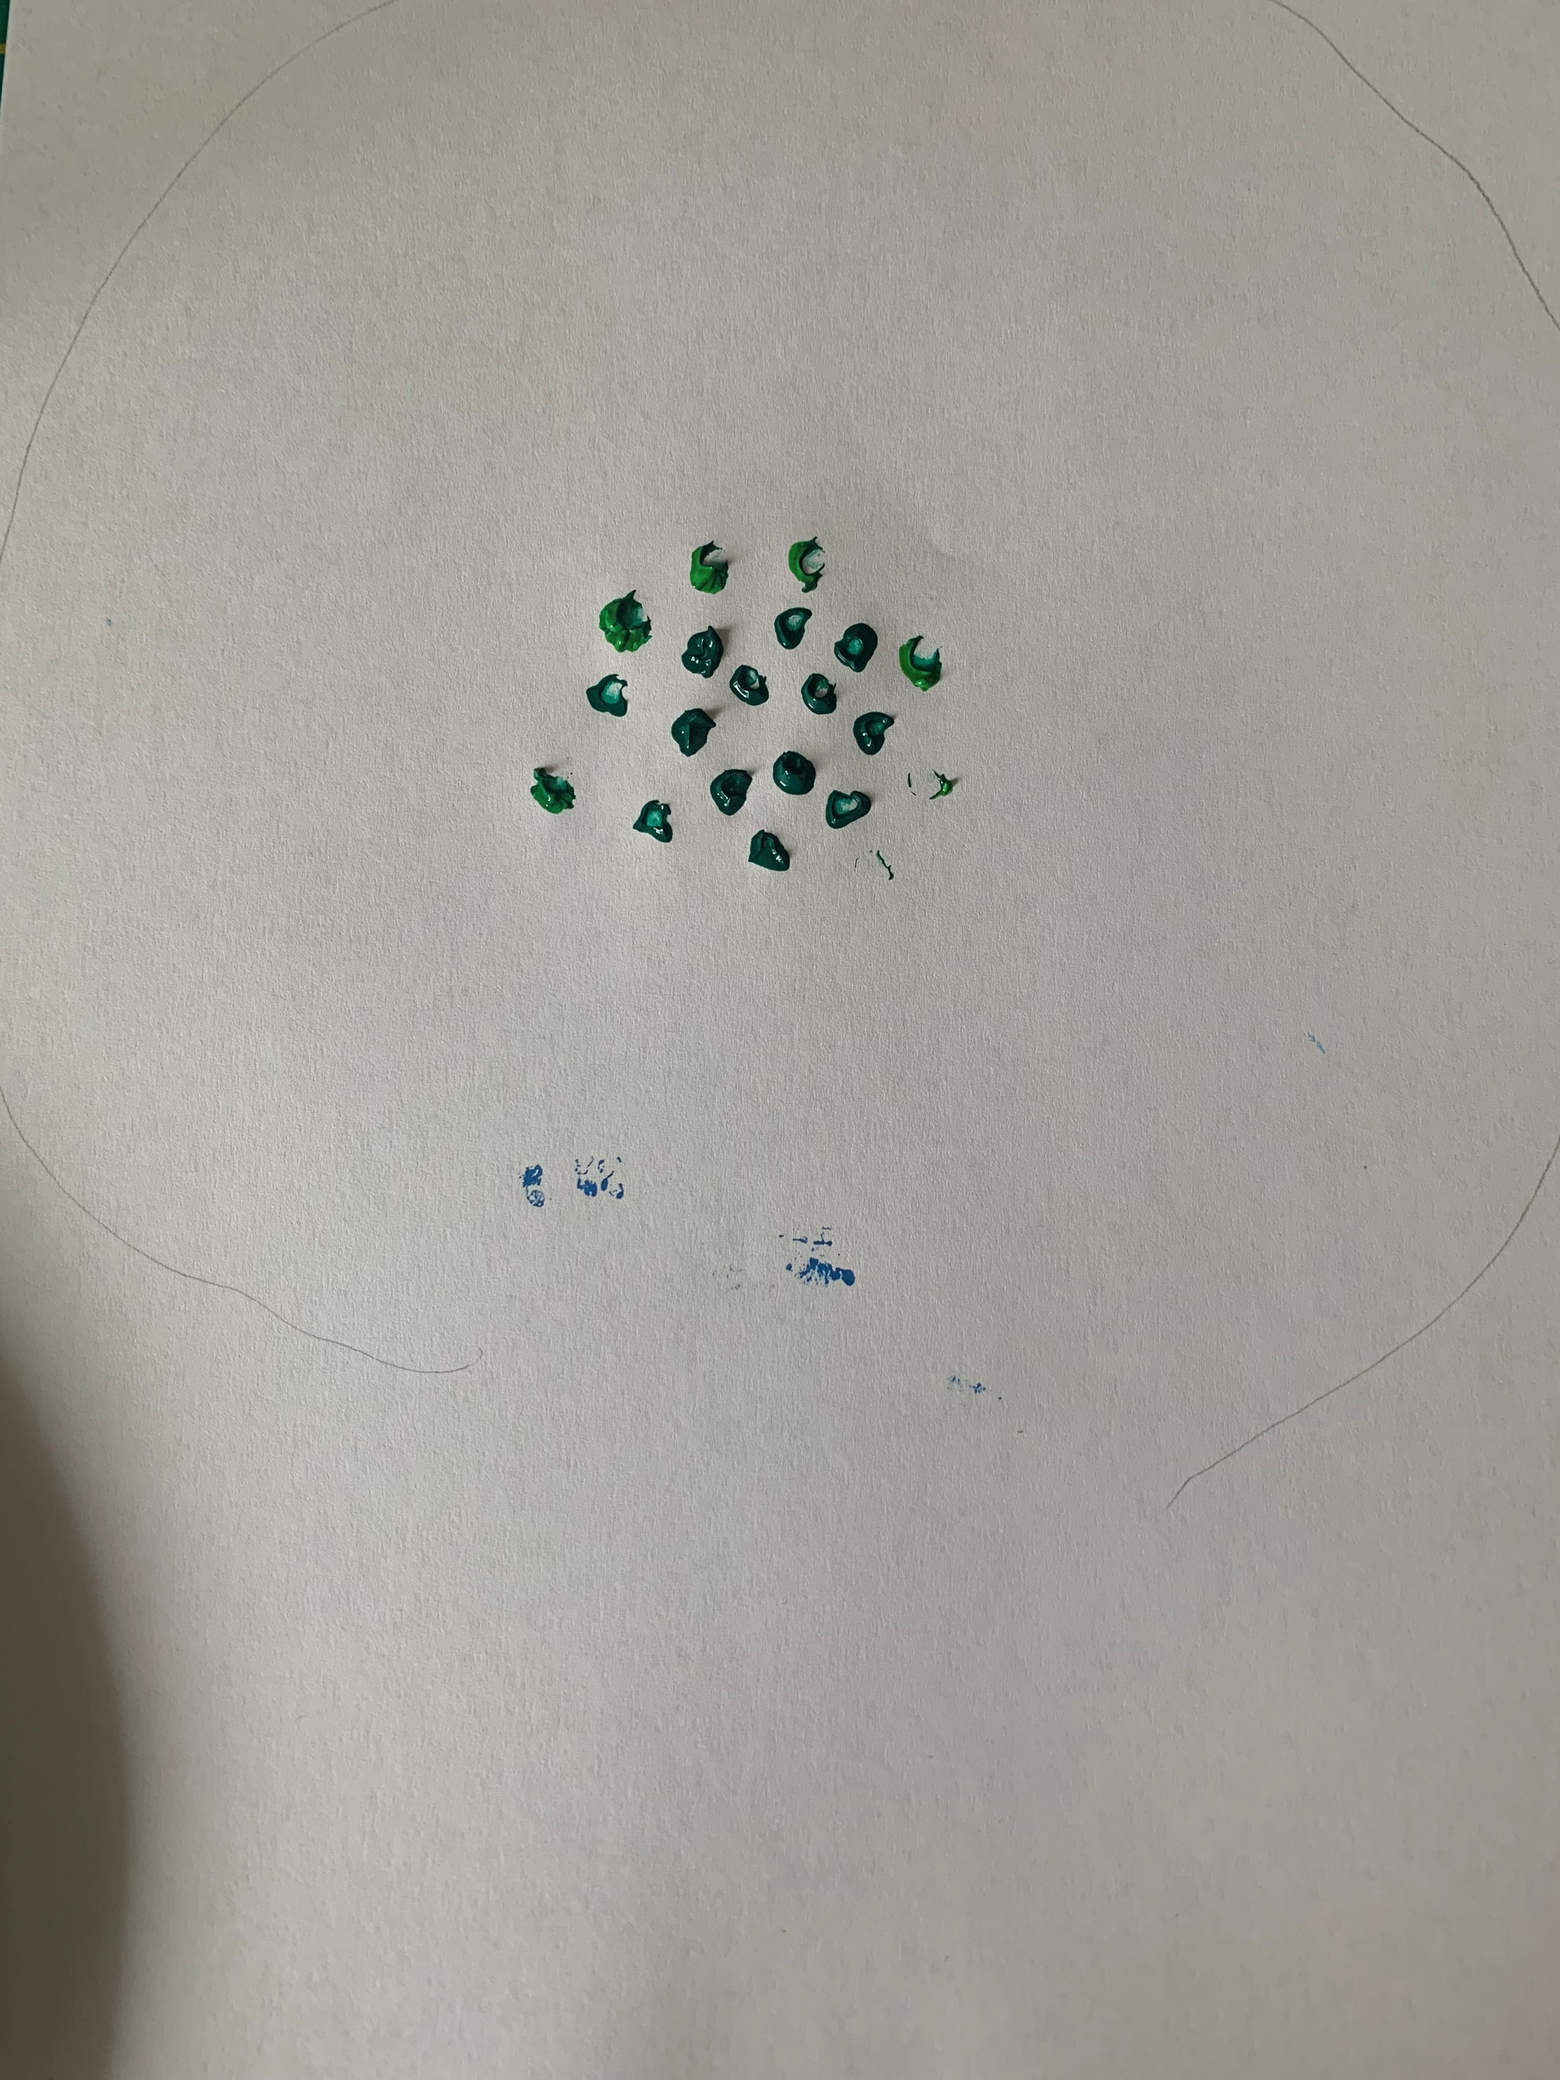
Use the end of an old pencil and make some dots with dark green paint in the centre of a piece of paper

Slide 5
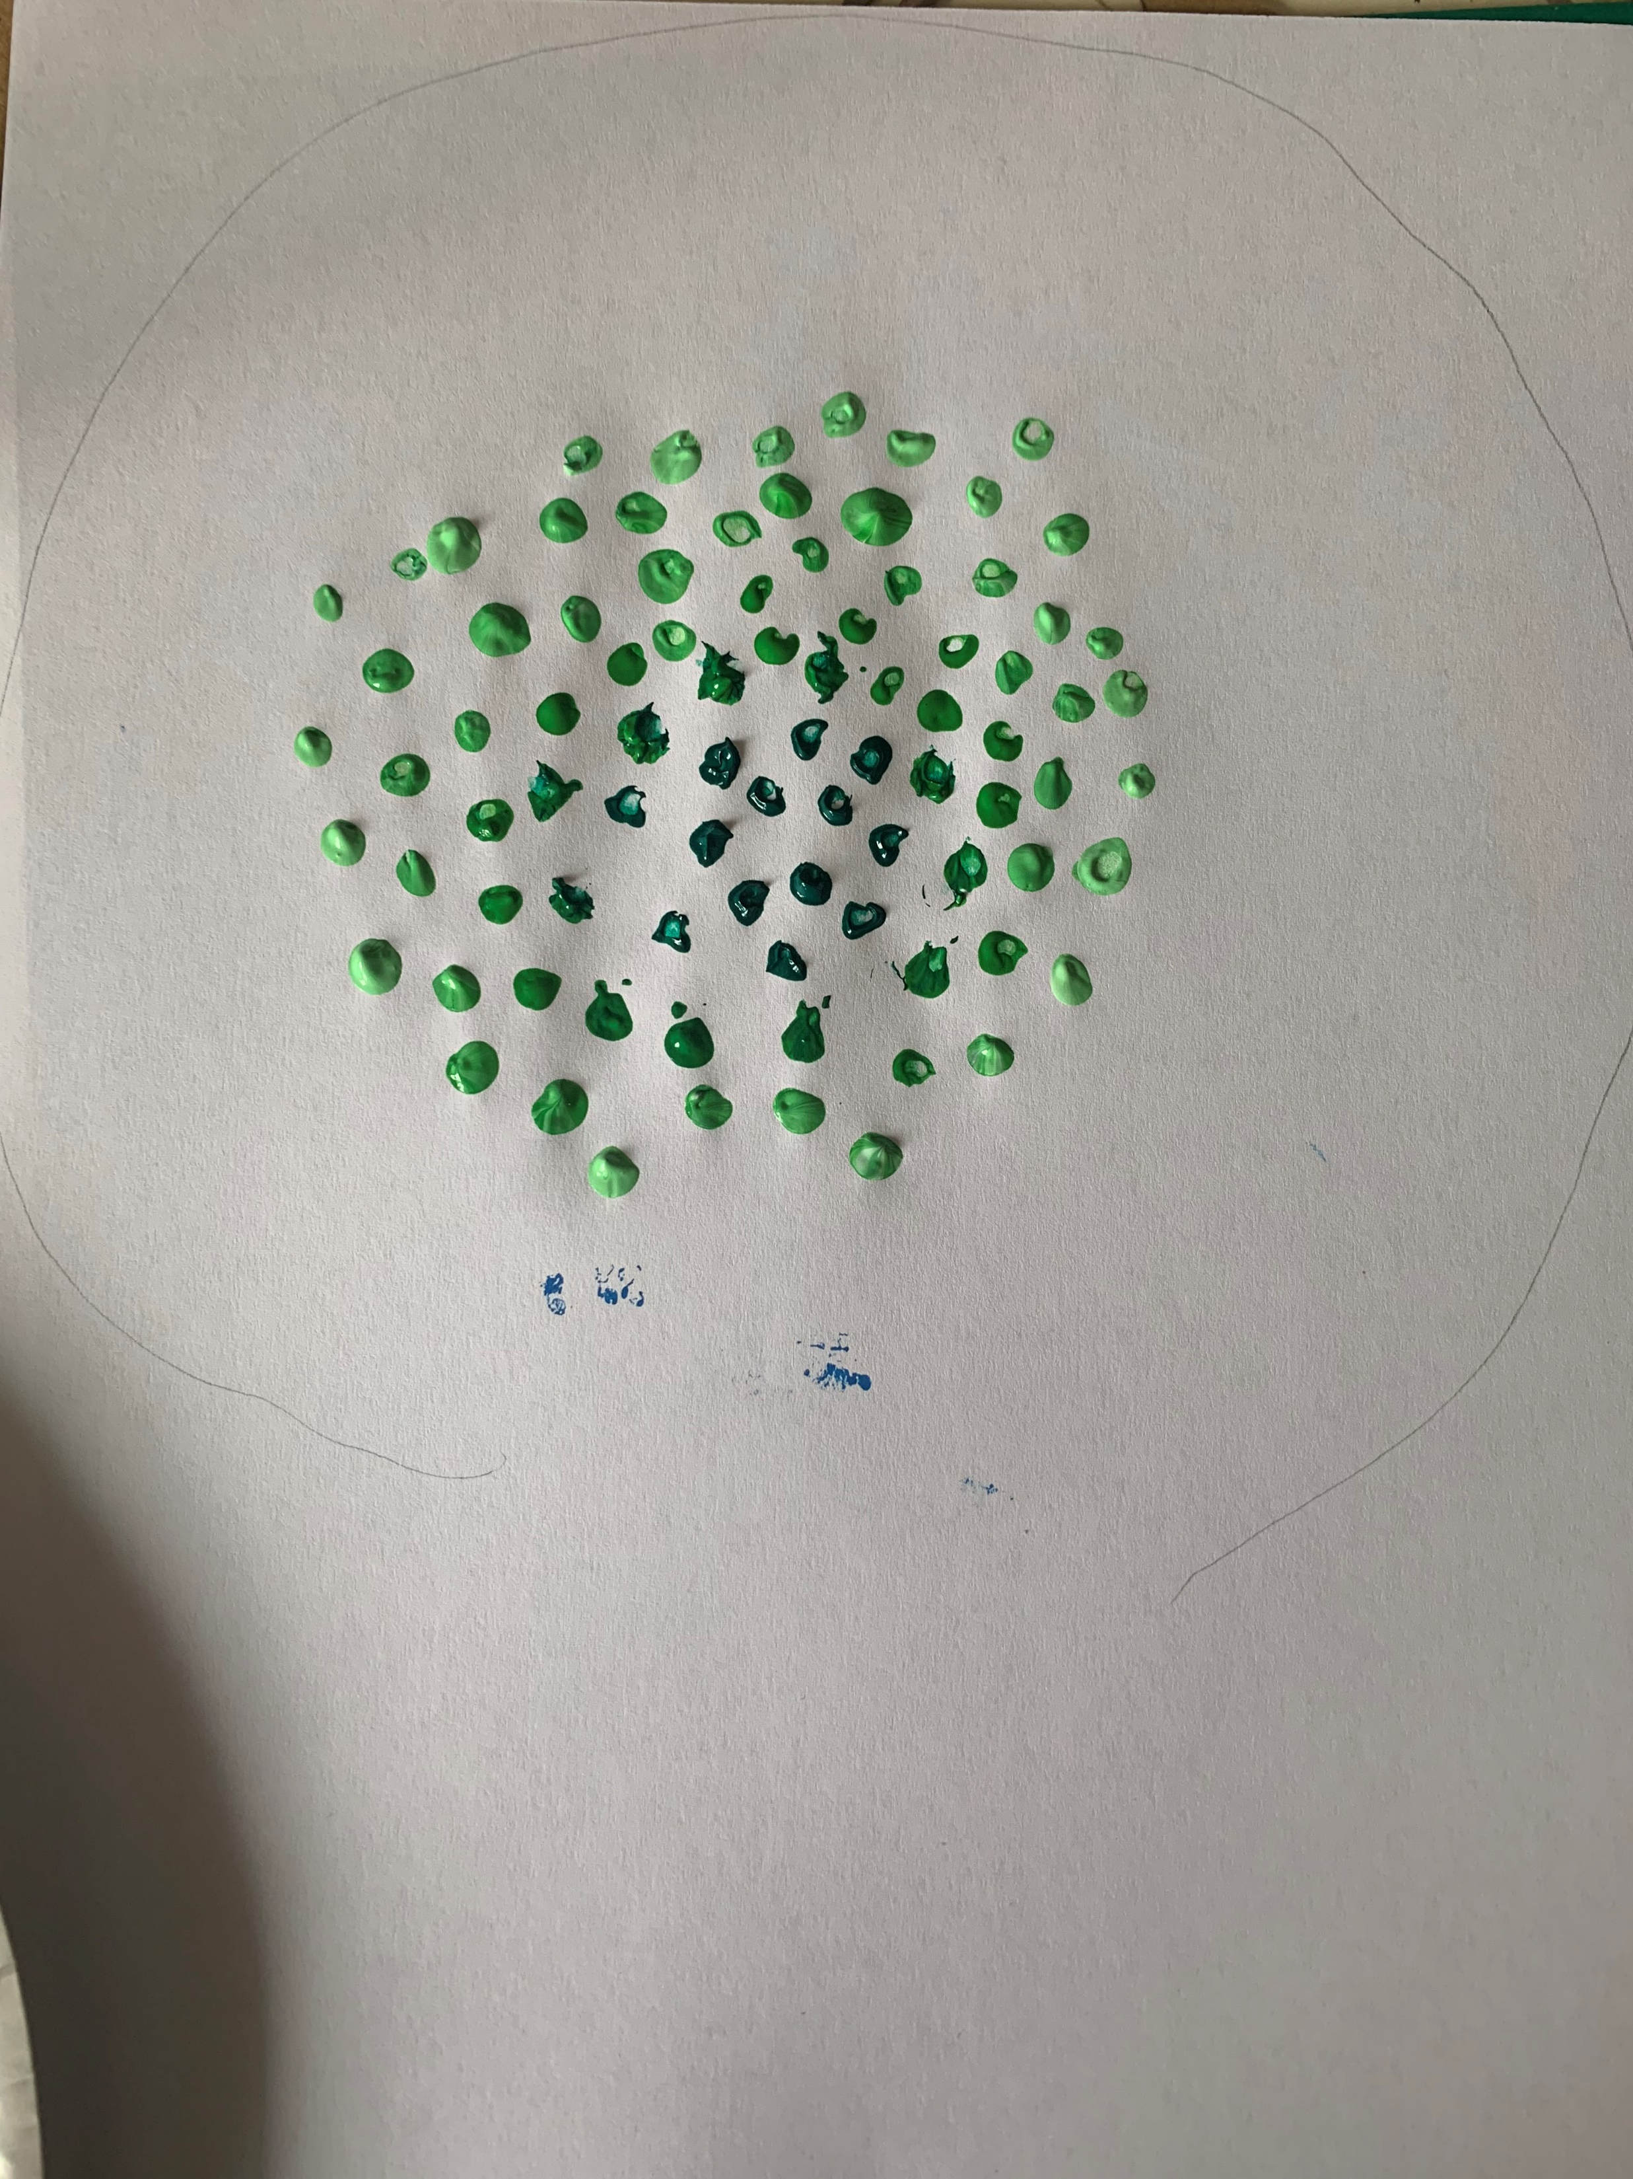
Now add some lighter green on the outside

Slide 6
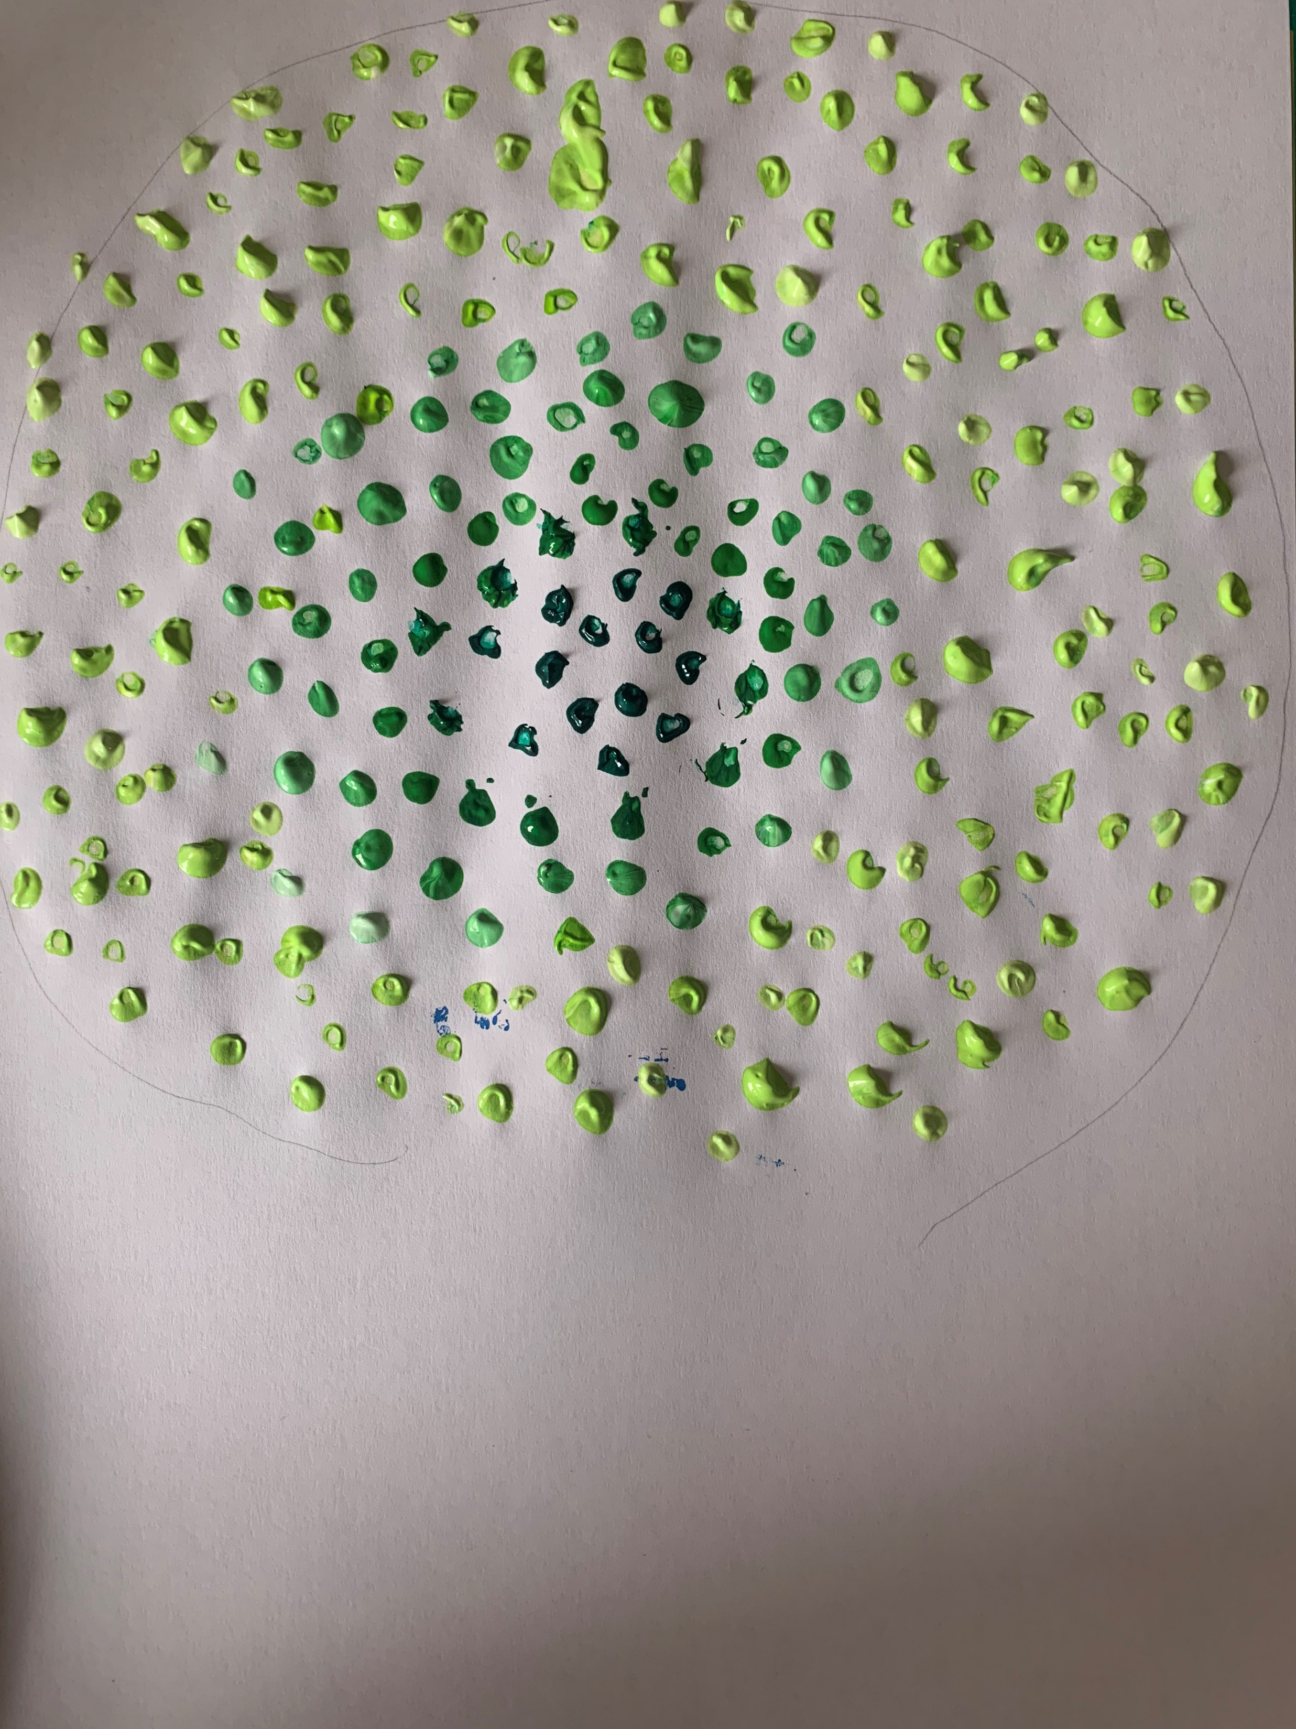
And some even lighter green outside that

Slide 7
Now place your hand print over the paint
And you have a hand print tree
This one is for summer

Slide 8
For autumn you could use red, yellow and orange

Slide 9
For winter you could use blue or have no leaves at all

Slide 10
And for spring you could have pink and purple

