Slide 1
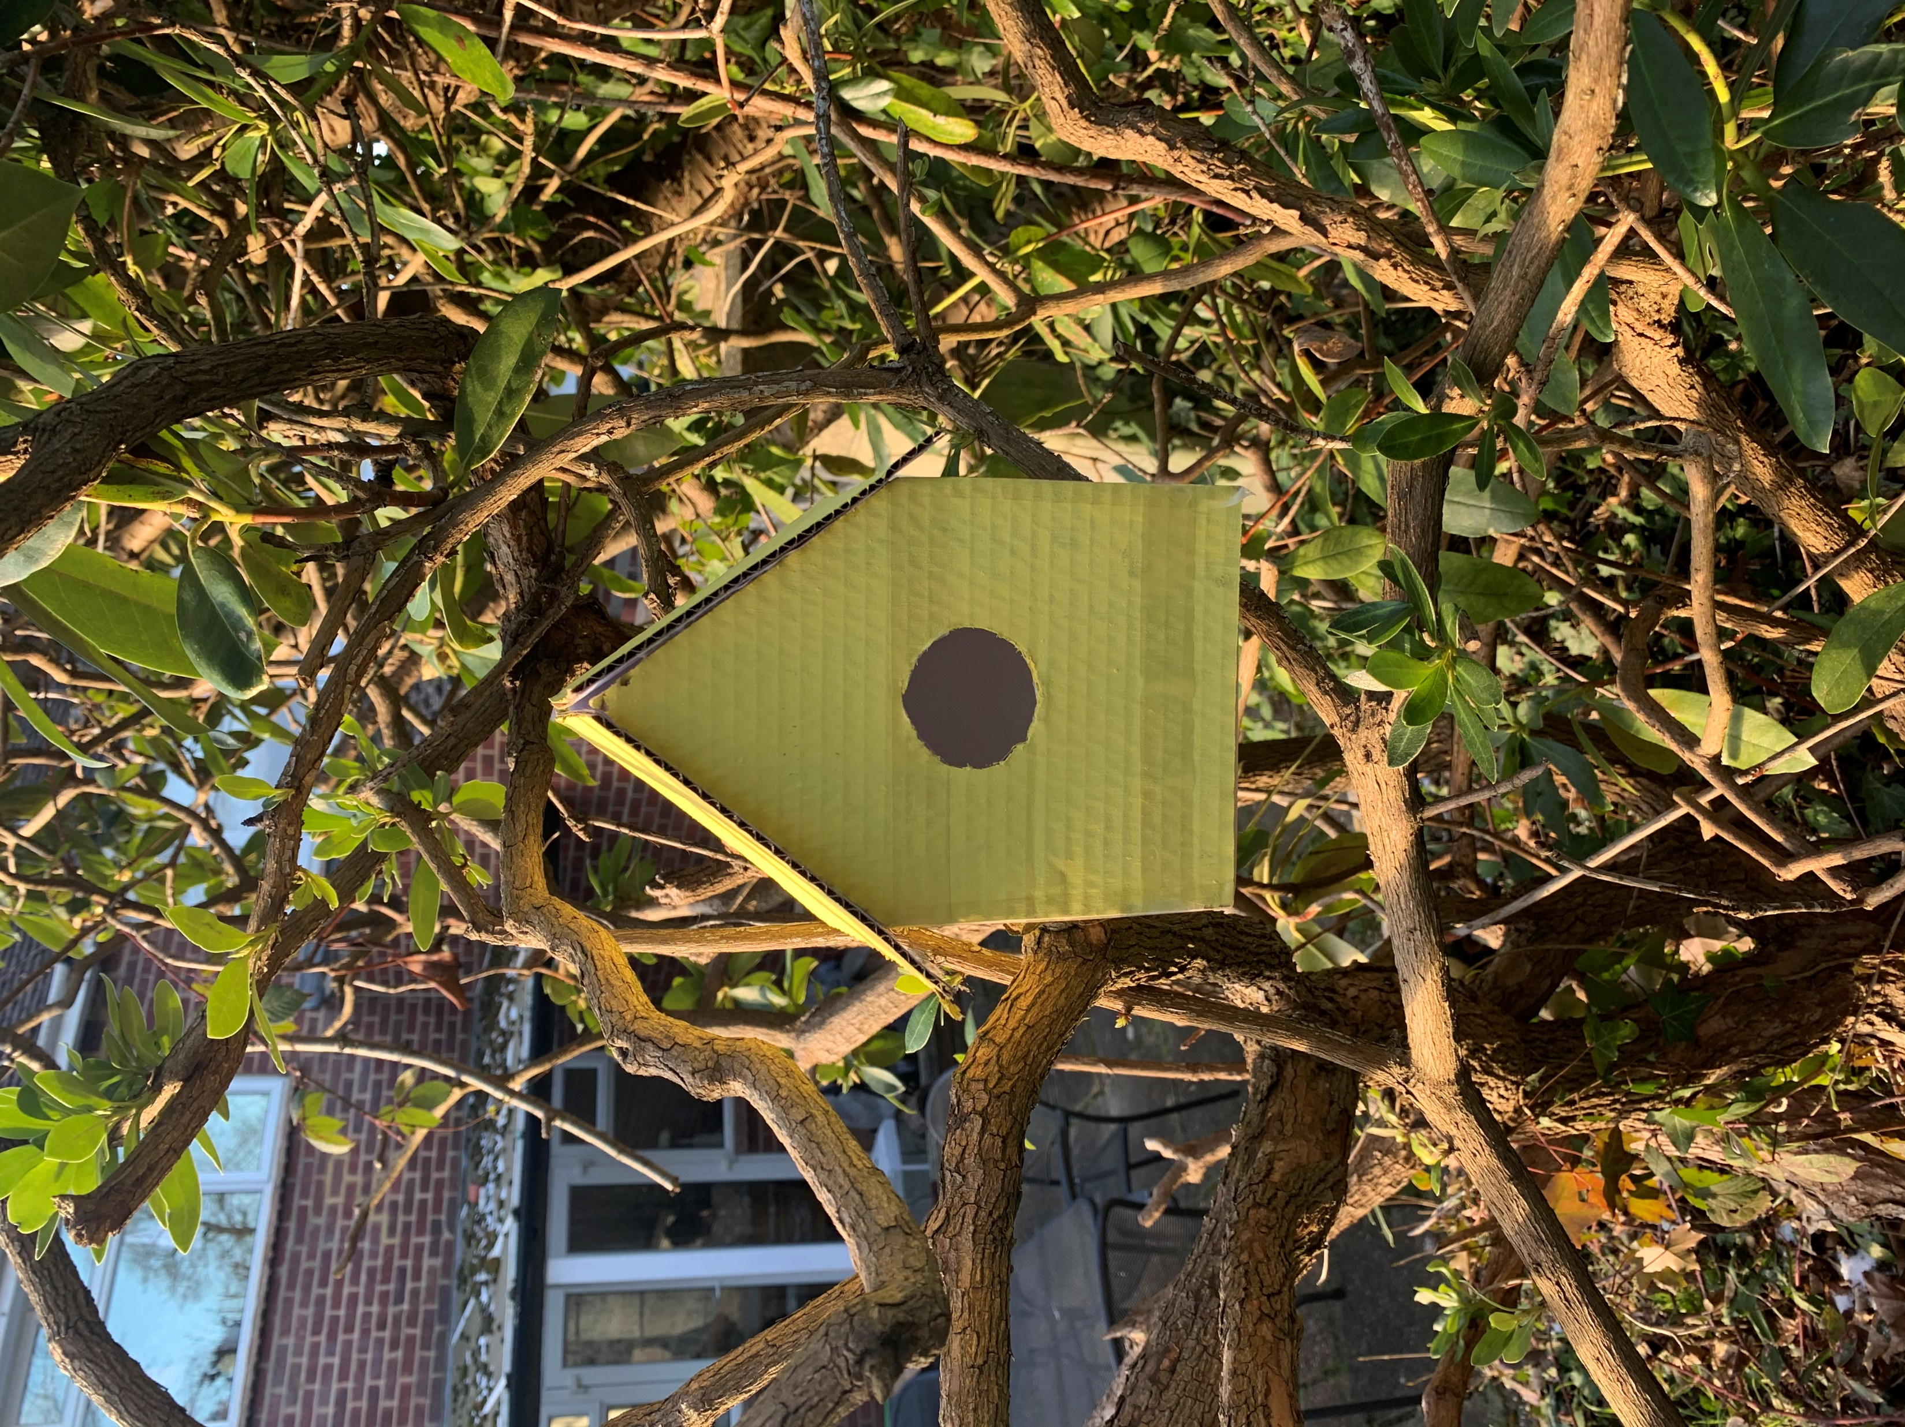
Make a bird house

Slide 2
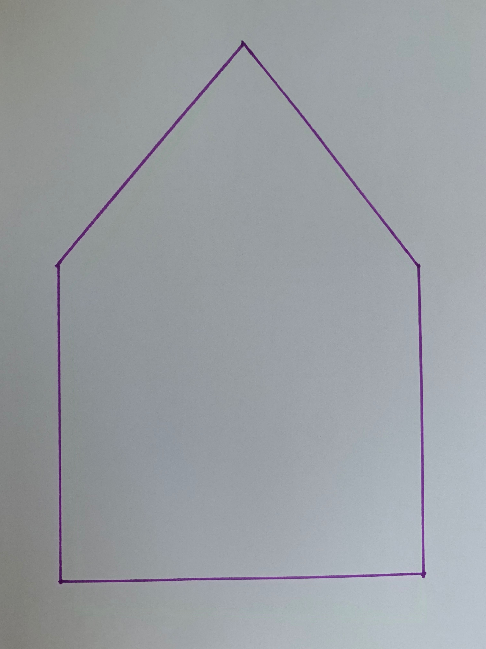
First draw the front of your bird house onto some paper

Slide 3
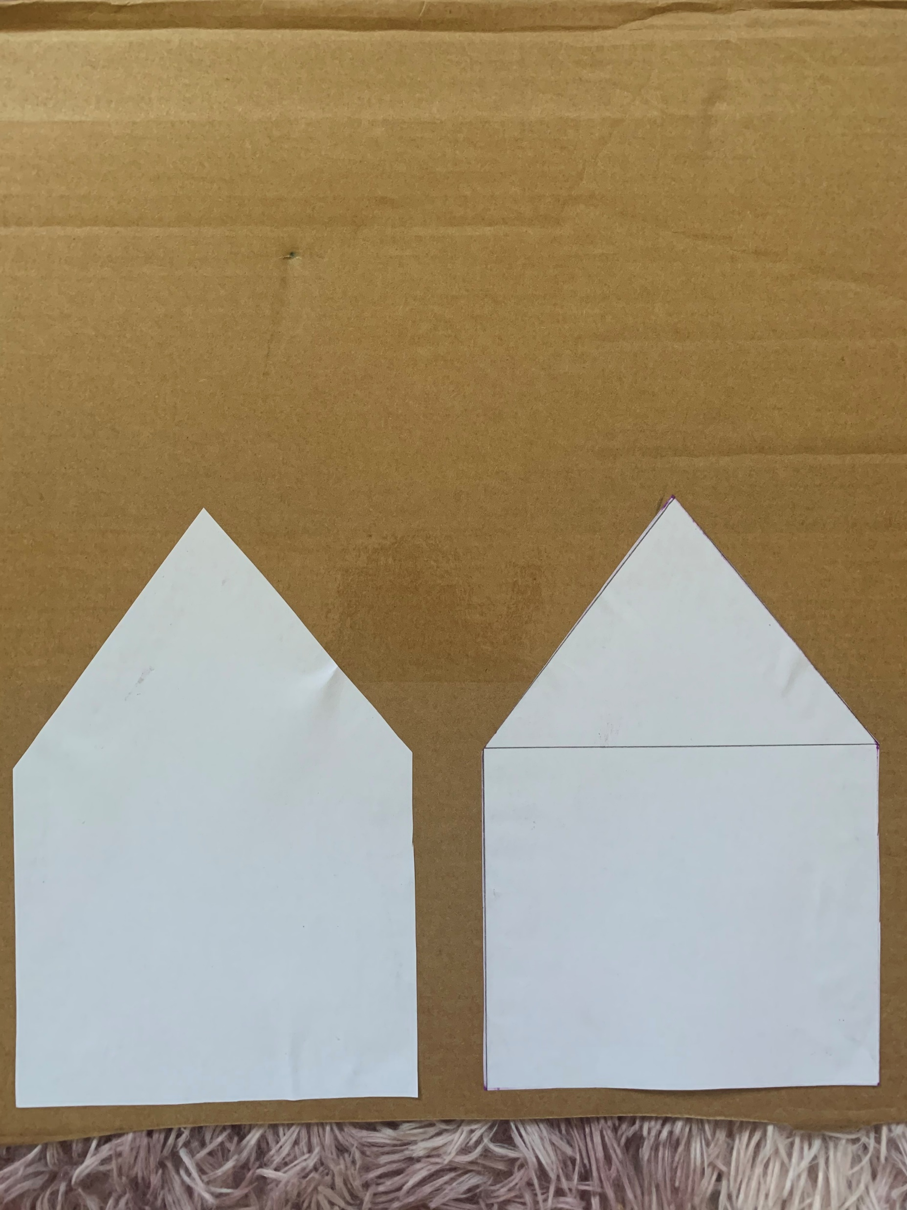
Now trace this or stick it onto some card board.
You will need to do it twice

Slide 4
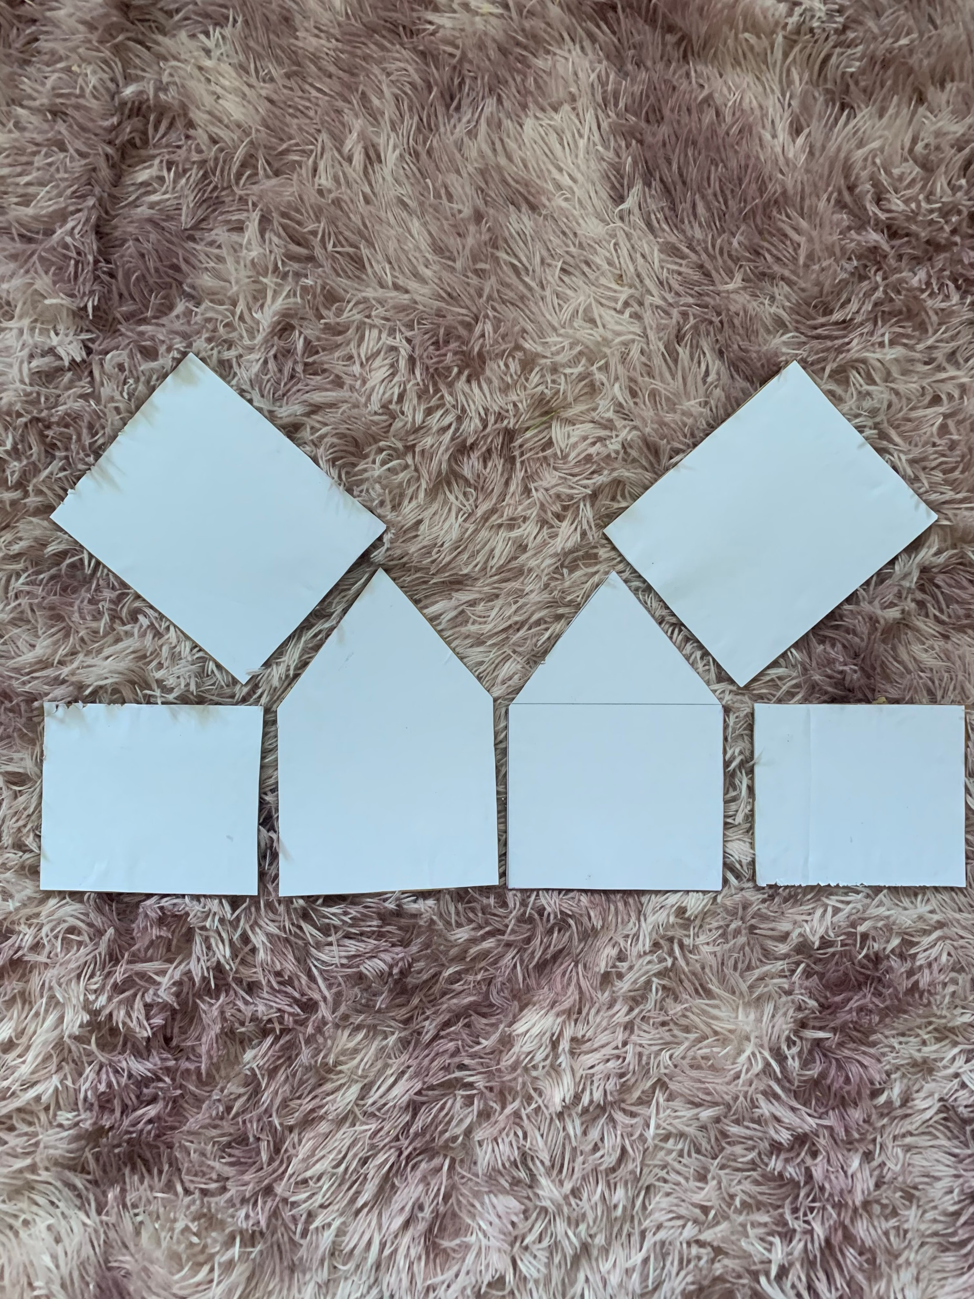
Do the same for the sides, bottom and the roof
Measurements are at the end

Slide 5
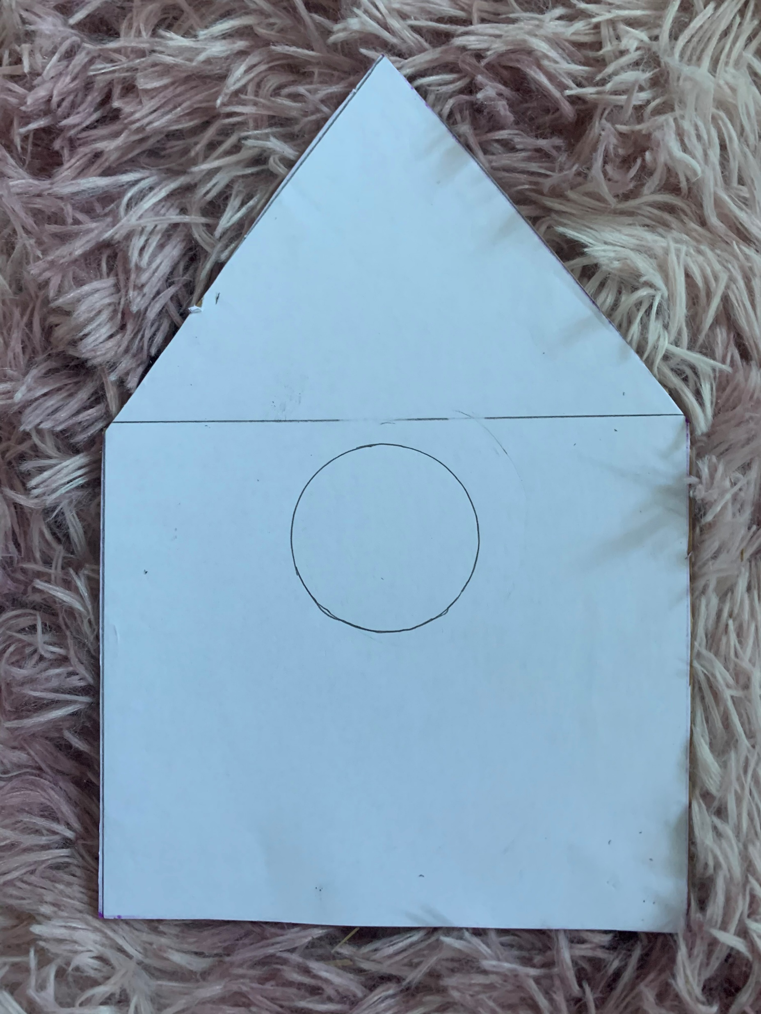
Draw a circle in the middle of the front piece

Slide 6
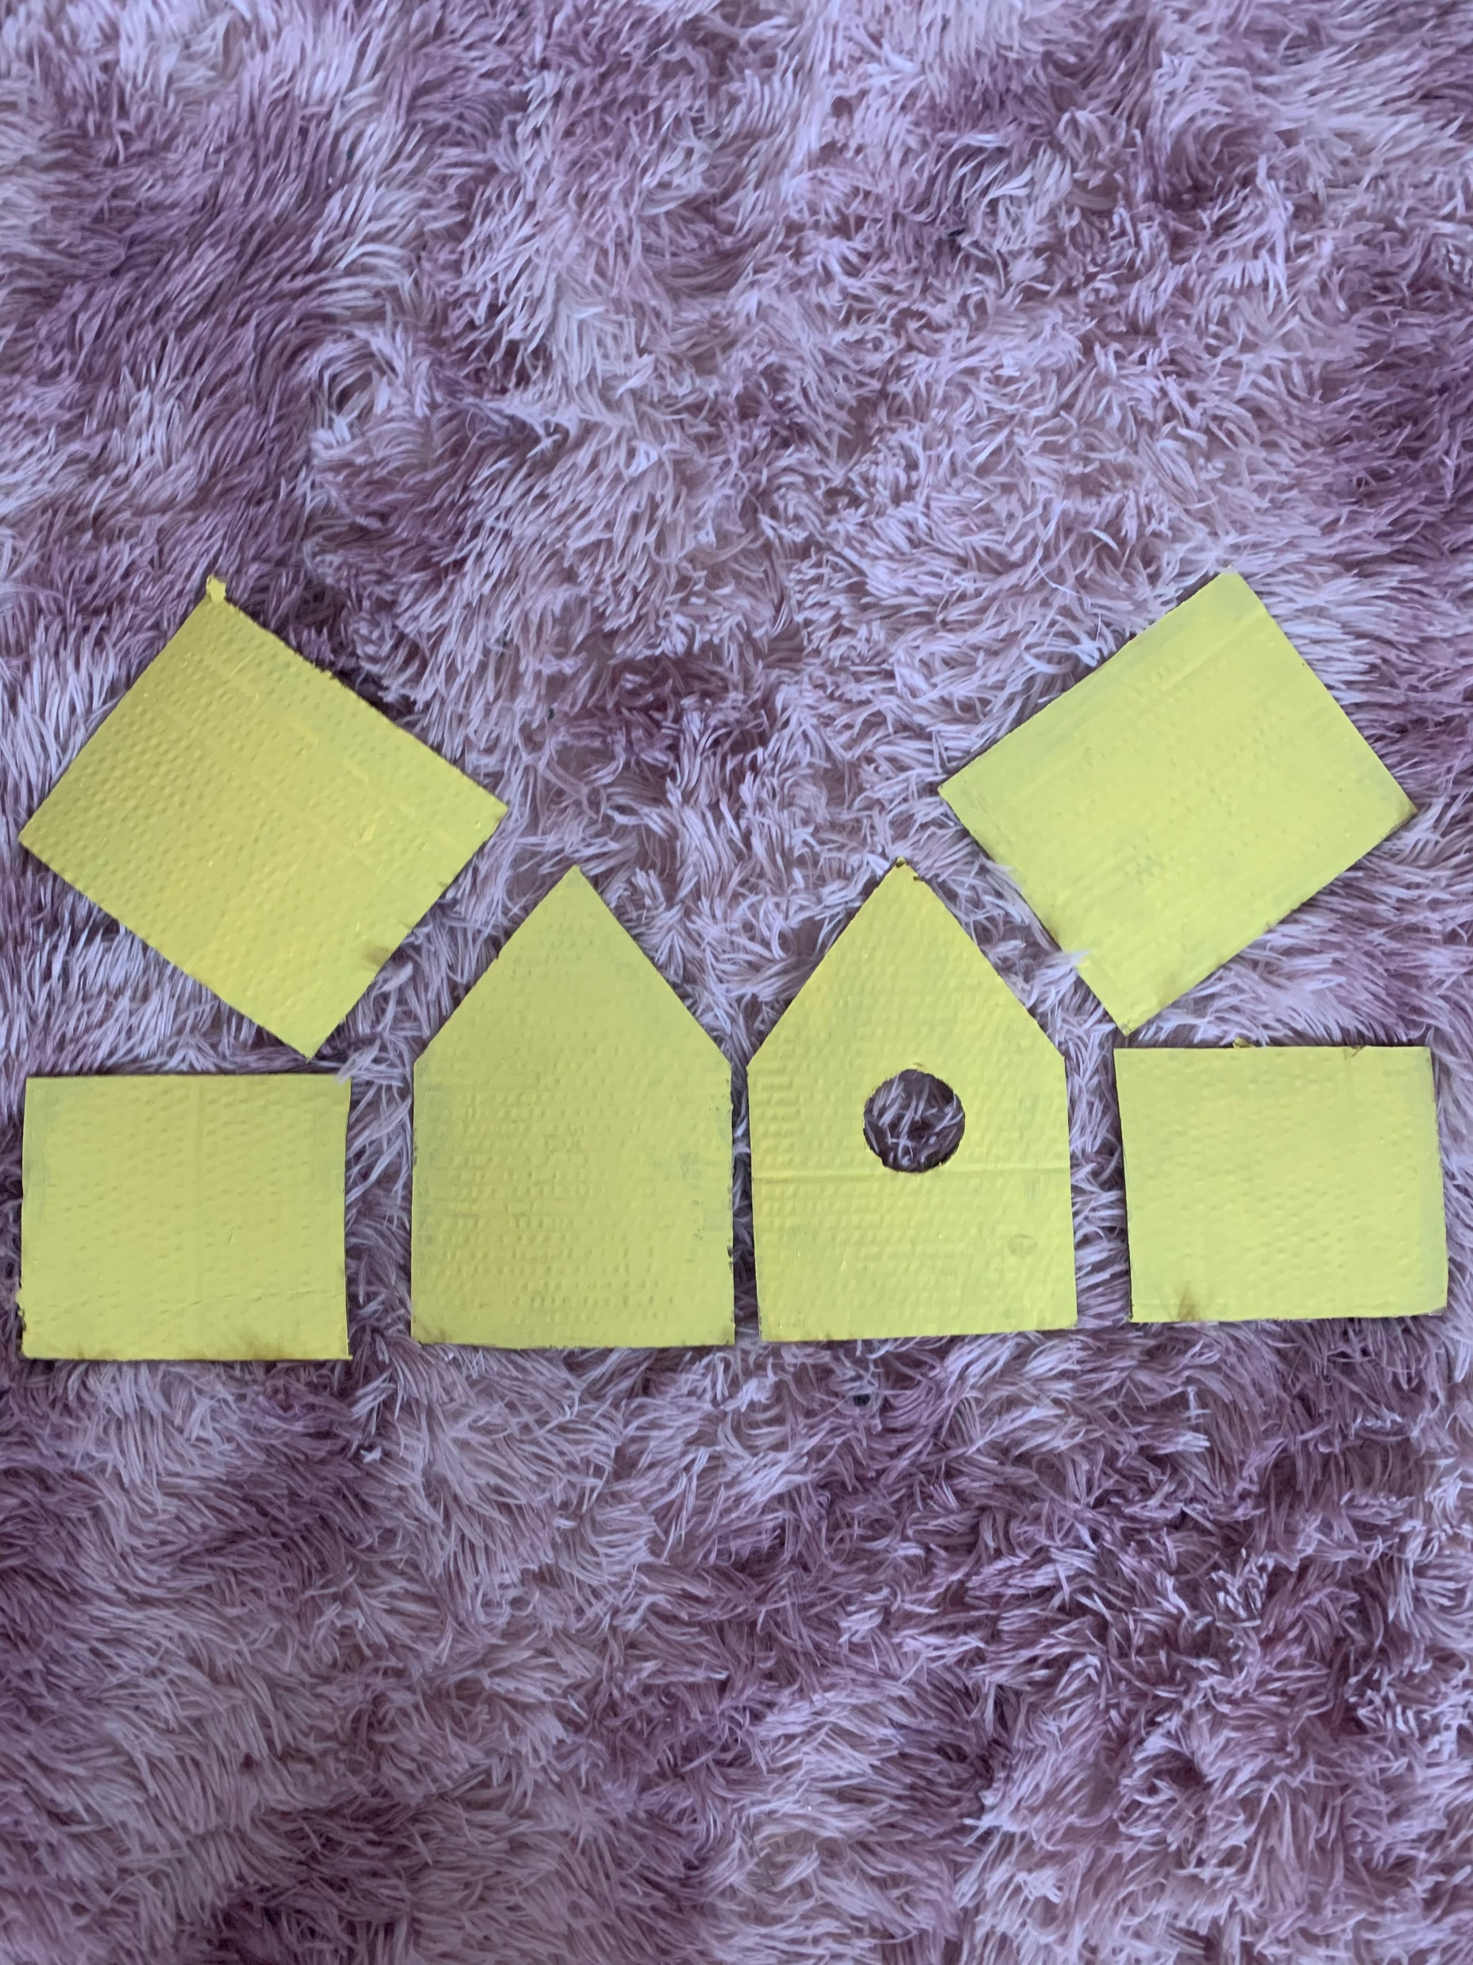
Now paint the pieces any way you want.
You could even add a pattern

Slide 7
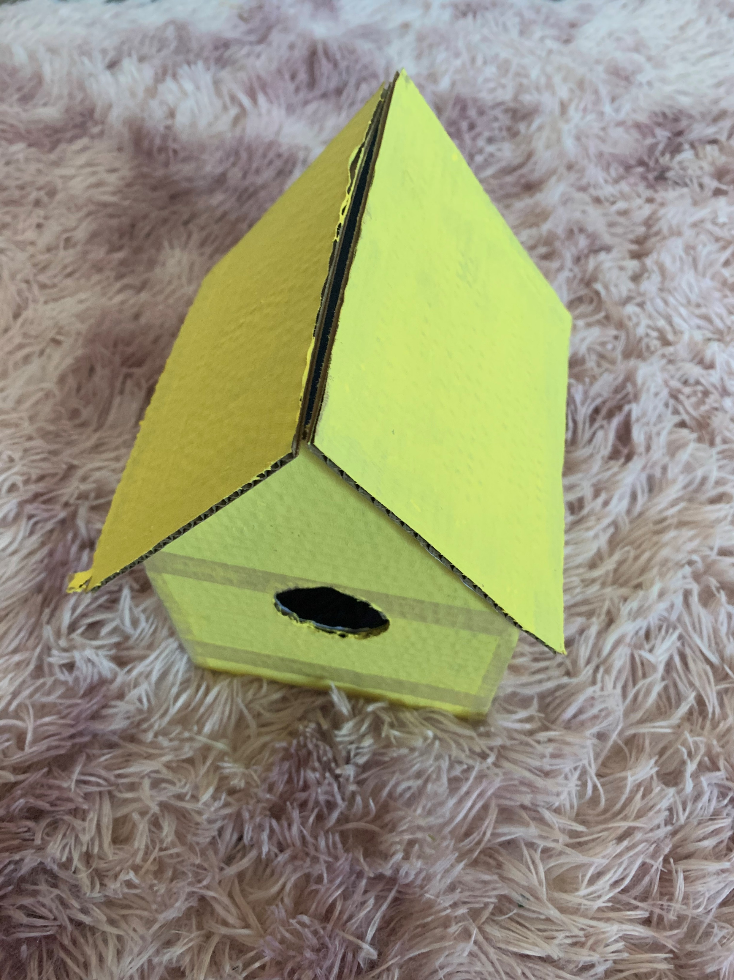
Stick all your pieces together,
I used PVA glue and selotape

Slide 8
Now find a fun place to put your bird house

Slide 9
9cm
9cm
14cm
Roof 1
Front
Back
11cm
10cm
10cm
10cm
10cm
12cm
Side 1
Side 2
Roof 2
10cm
10cm
11cm
12cm
14cm

