Slide 1
Consultancy Project Charter
Charity or Not-for-Profit Organisation
Cranfield Trust Volunteer Consultant
Project Deliverables
Outcomes
Impact
Cranfield Trust Projects Manager
Revised May 2019

Slide 2
A Cranfield Trust Consultancy Project aims to make a positive, measureable difference to the Charity or Not for Profit (“Organisation”). This Charter outlines how a project works and includes guidance on roles and responsibilities.
The positive difference is measured through deliverables and outcomes. It’s recorded using Cranfield Trust’s “Journey 2 Excellence” evaluation tool.
Inputs
Resources (Organisation time, Volunteer Consultant time and Cranfield Trust time)
Processes
Concrete actions (Specified project as outlined in Project Brief)
Deliverables
Tangible products from the activities (Project deliverables as identified in the Project Brief & agreed between Consultant and Organisation)
Outcomes
Changes resulting from the activity (effects on the organisation, its people and beneficiaries)
Impact
Outcomes broader and longer-term outcomes
(adjusted for what would have happened without consultancy support)
Revised May 2019

Slide 3
Organisation, Trust Volunteer Consultant and Trust Projects Manager Consultancy Charter
Your Time is Valued - we take the time to ensure that yours is used productively
Cranfield Trust volunteer consultants are placed in projects with organisations to help trustees and staff accomplish the deliverables as agreed in the relevant Project Brief. Each volunteer consultant has their own way of working and their approach can be to act as advisors, facilitators, critical friends, coaches or mentors. Some volunteer consultants will work in more detail than others, but their approach will not be to ‘do’ all the work as an additional organisation resource.
Cranfield Trust expects each organisation to provide a designated person or persons to take accountability for and work with the volunteer consultant throughout the project. Joint ways of working should be agreed by the volunteer consultant and the organisation’s accountable person (the Project Lead) at their first meeting. Whatever approach is decided upon, the accountable person should actively engage and seek to learn from the process to aid future sustainability and help build resilience in their organisation.
Each consultancy project is approved centrally by Cranfield Trust. Cranfield Trust Projects Manager and the Organisation Project Lead have produced a project brief and this has been viewed by The Trust’s Volunteer Consultant before accepting the project. This brief has also been approved and signed off by The Organisation’s Board before being offered to a Volunteer Consultant for consideration.
Resources (Organisation time, Volunteer Consultant time and Cranfield Trust time)
Inputs
Charity or Not-for-Profit Organisation
Cranfield Trust Volunteer Consultant
Project Deliverables and Outcomes
Cranfield Trust Projects Manager
During their initial exploratory meeting, The Trust’s Volunteer Consultant and the Organisation Project Lead will review this project brief and establish that both can support one another in producing the deliverables within the timeframe specified. After the meeting both parties will report back to The Trust Projects Manager to confirm the start of the consultancy process.
The Volunteer Consultant and the Organisation Project Lead will keep The Cranfield Trust Projects Manager updated on progress and promptly respond to the Trust PMs follow-up requests.
All parties will communicate in a timely and courteous manner.
The project lead and volunteer consultant should contact the Trust projects manager if problems arise. If needed, the projects manager will escalate to the Trust’s Head of Consultancy.

Slide 4
Organisation, Trust Volunteer Consultant and Trust Projects Manager Consultancy Charter
The overall process is summarised below. Key to success is good communication between all three parties The Cranfield Trust (Volunteer Consultant and Project Manager) and The Organisation Project Lead.
The Project Manager will support the Organisation Project Lead to complete a Journey to Excellence form (J2E) before the project starts and again when the project is complete. The J2E has two purposes: (1) for the charity to assess its own performance at the beginning and then again at the end of the project, to see their own development, and (2) for Cranfield Trust to use the scores to evidence the impact we have on organisations by carrying out our projects.
In addition On-line post project feedback will be sent to the Consultant and Organisation Project Lead and both Consultant and Organisation Project Lead agree to complete and submit this at the end of the project.
Concrete actions (Specified project as outlined in Project Brief)
Processes
Organisation enquires about management consultancy support from The Cranfield Trust
Organisation approved for Cranfield Trust Consultancy Support
Organisation completes an application for consultancy support
Cranfield Trust Project Manager meets with Organisation to scope the work & complete baseline Journey to Excellence (J2E)
Cranfield Trust Project Manager produces a Project Brief for Organisation review
Organisation approves the brief and obtains sign off from the Chair of Trustees or Director
The Cranfield Trust Project Manager invites a Volunteer Consultant to work on the project
Volunteer Consultant agrees to support the Organisation
Trust Project Manager introduces Volunteer Consultant and Organisation via e-mail
Volunteer Consultant and Organisation set date for their first meeting and inform Trust Project Manager
Volunteer Consultant and Organisation complete their exploratory meeting and report back to Trust Project Manager
Volunteer Consultant and Organisation work towards deliverable - outlined in the Project Brief – focussing on the outcomes and timeline
Trust Project Manager, keeps in touch with Volunteer Consultant Organisation Project Lead through short, regular progress messages
Organisation informs Trust Project Manager on completion of project. Both discuss project deliverables and outcomes. Post Project J2E is completed
Trust Project Manager closes off project, sending a feedback request to Organisation and Consultant

Slide 5
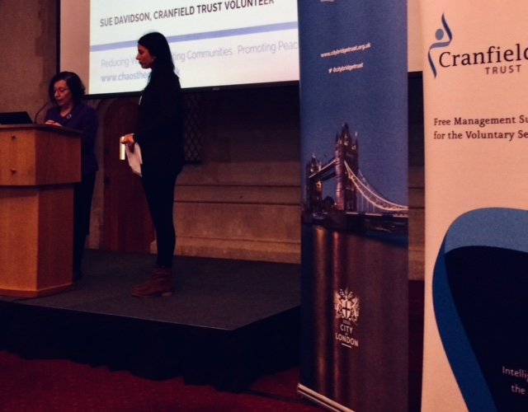
Organisation, Trust Volunteer Consultant and Trust Projects Manager Consultancy Charter
We understand that all charities are not the same and face their own individual challenges
Concrete actions (Specified project as outlined in Project Brief)
It’s expected that once the Cranfield Trust Volunteer Consultant has met the organisation and agreed to provide pro-bono support, this Charter will become an integral part of the process and serve as a reminder of key project roles and responsibilities.
Processes
Should the organisation or Cranfield Trust wish to conclude the project early before the objectives have been achieved, or should the organisation’s priorities change it is important that this is agreed and discussed between the organisation, the Volunteer Consultant and Cranfield Trust Projects Manager. In some cases it may be appropriate to put the project on hold, or change direction and draw up a new project brief.
Cranfield Trust Projects Manager should always be kept informed of any unplanned events, delays to schedule or changes in personnel.
Everyone agrees to maintain prompt and efficient lines of communication as agreed at the start of the consultancy project.

Slide 6
Organisation, Trust Volunteer Consultant and Trust Projects Manager Consultancy Charter
We provide free business skills to build successful charities
Ownership of Intellectual Property
All intellectual property and related material, including any trade secrets, moral rights, goodwill, relevant registrations or applications for registration, and rights in any patent, copyright, trademark, trade dress, industrial design and trade name (the "Intellectual Property") that is developed or produced during this project, will be the sole property of the Organisation. The use of the Intellectual Property by the Organisation will not be restricted in any manner.
Tangible products from the activities (Project deliverables as identified in the Project Brief & agreed between Consultant and Organisation)
Deliverables
Return of Property
Once the project has concluded, Cranfield Trust and the Volunteer Consultant will return to the Organisation any documentation, records, or confidential information which is their property which is requested by the Organisation.

Slide 7
Organisation, Trust Volunteer Consultant and Trust Projects Manager Consultancy Charter
Confidentiality
Confidential information refers to any data or information relating to the business of the Organisation which would reasonably be considered to be proprietary to the Organisation including, but not limited to, accounting records, business processes, and organisation records and that is not generally known in the industry of the Organisation and where the release of that confidential information could reasonably be expected to cause harm to the Organisation.
Cranfield Trust agrees that they will not disclose, divulge, reveal, report or use, for any purpose, any confidential information which Cranfield Trust has obtained from the Organisation or the Volunteer Consultant, except as authorised by the Organisation or as required by law. The obligations of confidentiality will apply during the term of the project and beyond.
Cranfield Trust Volunteer Consultant Expenses
Cranfield Trust Volunteer Consultants give their time free to charity organisations, although charities are asked to meet reasonable travel expenses. The nature and level of these expenses and how they should be claimed must be agreed at the start of the project between the Organisation Project Lead and the Volunteer Consultant.
Publicity
Cranfield Trust uses general write-ups of projects carried out by its Volunteer Consultants for publicity purposes in fundraising and recruiting new volunteers. Detailed descriptions of organisations or the content of projects are not made public without the prior consent of the Organisation and the Volunteer. Please let us know if you would prefer your organisation or project not to be mentioned in our “Organisation list” or other material (e.g. newsletters).

Slide 8
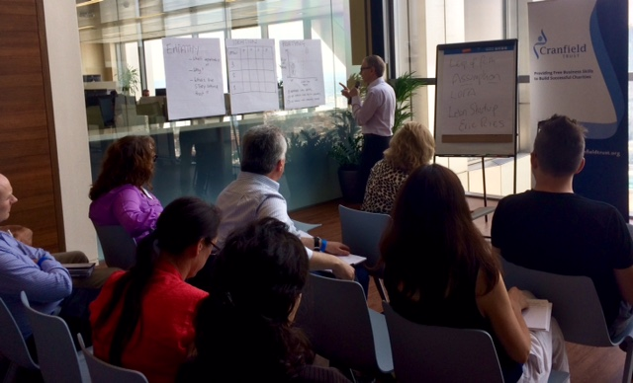
Organisation, Trust Volunteer Consultant and Trust Projects Manager Consultancy Charter
Our funding depends on your feedback
Organisation and Volunteer Consultant’s Feedback
Cranfield Trust’s vision is for all voluntary organisations to have the management expertise they need to help them thrive. As a charity we rely solely on income generated from our fundraising activities, completion of the Journey to Excellence forms and the on-line feedback you provide at the end of your project is vital to our sustainability.
Without the J2E and your feedback, we are unable to monitor and evaluate our services for funders, putting our valuable services in jeopardy. Taking time to complete and return your feedback survey means other charities, like yours, will be able to benefit from our free services in the future.
Your feedback really is invaluable to us, we hope you can help us to achieve our vision to help you and other small but vital charities and not for profit organisations.
.
Changes resulting from the activity (effects on the organisation, its people and beneficiaries)
Outcomes
Cranfield Trust works with Volunteer Consultants to put their skills to work for charities as pro bono consultants, to help these non-profit organisations become more successful

Slide 9
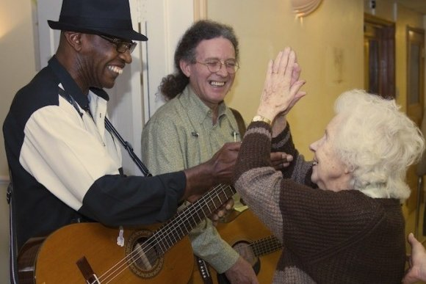
Organisation, Trust Volunteer Consultant and Trust Projects Manager Consultancy Charter
Charity or Not-for-Profit Organisation
Cranfield Trust Volunteer Consultant
Project Deliverables and Outcomes
Cranfield Trust Projects Manager
Cranfield Trust works with Volunteer Consultants to help non-profit organisations be successful
Journey to Excellence
CRANFIELD TRUST PROVIDING FREE BUSINESS SKILLS TO BUILD SUCCESSFUL CHARITIES
9

