Slide 1
Consultancy Project Charter
Charity or Not-for-Profit Organisation
Cranfield Trust Volunteer Consultant
Project Deliverables
Outcomes
Impact
Cranfield Trust Projects Manager
Revised Feb 2021

Slide 2
A Cranfield Trust Consultancy Project aims to make a positive, measureable difference to the Charity or Not for Profit (“Organisation”). This Charter outlines how a project works and includes guidance on roles and responsibilities.
The positive difference is measured through deliverables and outcomes. It’s recorded using Cranfield Trust’s “Journey to Excellence” (J2E) evaluation tool.
Inputs
Resources (Organisation time, Volunteer Consultant time and Cranfield Trust time)
Processes
Concrete actions (Specified project as outlined in Project Application/ Brief)
Deliverables
Tangible products from the activities (Project deliverables as identified in the Brief & agreed between Consultant and Organisation)
Outcomes
Changes resulting from the activity (effects on the organisation, its people and beneficiaries)
Impact
Outcomes broader and longer-term outcomes
(adjusted for what would have happened without consultancy support)

Slide 3
Organisation, Trust Volunteer Consultant and Trust Project Manager Consultancy Charter
Your Time is Valued - we take the time to ensure that yours is used productively
Cranfield Trust volunteer consultants are placed in projects with organisations to help trustees and staff accomplish the deliverables as agreed in the Application/Project Brief. Each volunteer consultant has their own way of working and their approach can be to act as advisors, facilitators, critical friends, coaches or mentors. Some volunteer consultants will work in more detail than others, but their approach will not be to ‘do’ all the work as an additional organisation resource but rather to share their skills and experience.
Cranfield Trust expects each organisation to provide a designated person or persons to take accountability for and work with the volunteer consultant throughout the project. Joint ways of working should be agreed by the volunteer consultant and the organisation’s accountable person (the Project Lead) at their first meeting. Whatever approach is decided upon, the accountable person should actively engage and seek to learn from the process to aid future sustainability and help build resilience in their organisation.
Each consultancy project is approved centrally by Cranfield Trust. Cranfield Trusts Project Manager and the Organisation Project Lead have agreed a project brief and this has been viewed by The Trust’s Volunteer Consultant before accepting the project. This brief has also been approved and signed off by The Organisation’s Board before being offered to a Volunteer Consultant for consideration.
Resources (Organisation time, Volunteer Consultant time and Cranfield Trust time)
Inputs
Charity or Not-for-Profit Organisation
Cranfield Trust Volunteer Consultant
Project Deliverables and Outcomes
Cranfield Trust Projects Manager
During their initial exploratory meeting, The Trust’s Volunteer Consultant and the Organisation Project Lead will review this project brief and establish that both can support one another in producing the deliverables within the timeframe specified. After the meeting both parties will report back to The Trust Project Manager to confirm the start of the consultancy process.
The Volunteer Consultant and the Organisation Project Lead will keep The Cranfield Trust Project Manager updated on progress and promptly respond to the Trust PMs follow-up requests.
All parties will communicate in a timely and courteous manner.
The project lead and volunteer consultant should contact the Trust project manager if problems arise. If needed, the project manager will escalate to the Trust’s Head of Consultancy.

Slide 4
Organisation, Trust Volunteer Consultant and Trust Project Manager Project Charter
Cranfield Trust volunteer consultants are placed in projects with organisations to help trustees and staff accomplish the deliverables as agreed in the Project Application/Brief. Each organisation is expected to provide a designated person or persons to take accountability for and work with the volunteer consultant throughout the project. During their initial exploratory meeting, The Trust’s Volunteer Consultant and the Organisation Project Lead will review the project brief and establish that both can support one another in producing the deliverables within the timeframe specified.
The overall process is summarised below. Key to success is good communication between all three parties The Cranfield Trust (Volunteer Consultant and Project Manager) and The Organisation Project Lead. The Project Manager should always be kept informed of any unplanned events, delays to schedule or changes in personnel.
Organisation enquires about management consultancy support from the Cranfield Trust
Organisation approved for Cranfield Trust Consultancy Support
Organisation completes an application for consultancy support
Cranfield Trust Project Manager meets with Organisation to scope the work & complete baseline Journey to Excellence (J2E)
Cranfield Trust Project Manager confirms project details for Organisation review
Organisation approves the details and obtains relevant sign off
The Cranfield Trust Project Manager invites a Volunteer Consultant to work on the project
Volunteer Consultant agrees to support the Organisation
Trust Project Manager introduces Volunteer Consultant and Organisation
Volunteer Consultant and Organisation set date for their first meeting and inform Trust Project Manager
Volunteer Consultant and Organisation complete their exploratory meeting and report back to Trust Project Manager
Volunteer Consultant and Organisation work towards deliverable - outlined in the Project Brief – focussing on the outcomes and timeline
Trust Project Manager, keeps in touch with Volunteer Consultant Organisation Project Lead through short, regular progress messages
Organisation informs Trust Project Manager on completion of project. Both discuss project deliverables and outcomes. Post Project J2E is completed
Trust Project Manager closes off project, sending a feedback request to Organisation and Consultant

Slide 5
Organisation, Trust Volunteer Consultant and Trust Project Manager Consultancy Charter
We understand that all charities are not the same and face their own individual challenges
Concrete actions (Specified project as outlined in Project Brief)
It’s expected that once the Cranfield Trust Volunteer Consultant has met the organisation and agreed to provide pro-bono support, this Charter will become an integral part of the process and serve as a reminder of key project roles and responsibilities.
Processes
Should the organisation or Cranfield Trust wish to conclude the project early before the objectives have been achieved, or should the organisation’s priorities change it is important that this is agreed and discussed between the organisation, the Volunteer Consultant and Cranfield Trust Project Manager. In some cases it may be appropriate to put the project on hold, or change direction and draw up a new project brief.
The Cranfield Trust Project Manager should always be kept informed of any unplanned events, delays to schedule or changes in personnel.
Everyone agrees to maintain prompt and efficient lines of communication as agreed at the start of the consultancy project.
Tangible products from the activities (Project deliverables as identified in the Project Brief & agreed between Consultant and Organisation)
Deliverables

Slide 6
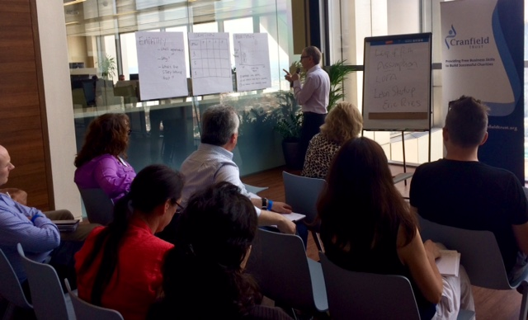
Organisation, Trust Volunteer Consultant and Trust Project Manager Consultancy Charter
Our funding depends on your feedback
Organisation and Volunteer Consultant’s Feedback
Cranfield Trust’s vision is for all voluntary organisations to have the management expertise they need to help them thrive. As a charity we rely solely on income generated from our fundraising activities, completion of the Journey to Excellence forms and the on-line feedback you provide at the end of your project is vital to our sustainability.
Without the J2E and your feedback, we are unable to monitor and evaluate our services for funders, putting our valuable services in jeopardy. Taking time to complete and return your feedback survey means other charities, like yours, will be able to benefit from our free services in the future.
Your feedback really is invaluable to us, we hope you can help us to achieve our vision to help you and other small but vital charities and not for profit organisations.
.
Changes resulting from the activity (effects on the organisation, its people and beneficiaries)
Outcomes
Cranfield Trust works with Volunteer Consultants to put their skills to work for charities as pro bono consultants, to help these non-profit organisations become more successful

Slide 7
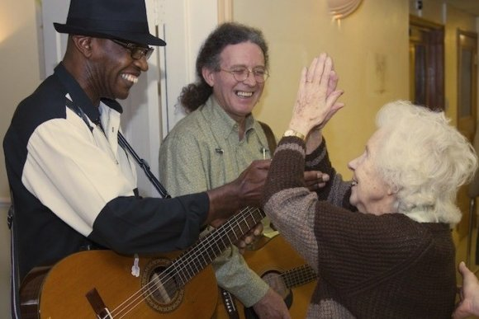
Organisation, Trust Volunteer Consultant and Trust Project Manager Consultancy Charter
Charity or Not-for-Profit Organisation
Cranfield Trust Volunteer Consultant
Project Deliverables and Outcomes
Cranfield Trust Projects Manager
Cranfield Trust works with Volunteer Consultants to help non-profit organisations be successful
Journey to Excellence
CRANFIELD TRUST PROVIDING FREE BUSINESS SKILLS TO BUILD SUCCESSFUL CHARITIES
7

