Slide 1
Schizophrenia as a biological systems illness.
Dr Julia a Piper. BM BS BMedSci, DFFP, FRCGP, DipOccMed, DipMedAcc, AFMCP
www.privategp.com

Slide 2
Contents of lecture
Laboratories used have been indicated on the slides throughout the lecture.
Incidence of schizophrenia
Correlation with Lyme disease geographically
Case presentation
History
Treatment
Summary of biological systems supported
Plans for the future
Positive investigation results shown in more detail
Pathway to illness
Discussion including CIRS; i.e. chronic inflammatory response syndrome, neuroimmunology, the genetics of schizophrenia immunity, schizophrenia as an autoimmune illness, schizophrenia and gluten, infection homology.
Take Home points

Slide 3
Incidence of schizophrenia
Worldwide about 1 percent of the population is diagnosed with schizophrenia
Approximately 1.2% of Americans (3.2 million) have the disorder.
About 1.5 million people will be diagnosed with schizophrenia this year around the world.
In the United States, this means about 100,000 people will be diagnosed, which translates to 7.2 people per 1,000 or about 21,000 people within a city of 3 million who are likely to be suffering from schizophrenia.

Slide 4
What exactly is schizophrenia
A long-term mental disorder of a type involving a breakdown in the relation between thought, emotion, and behaviour, leading to faulty perception, inappropriate actions and feelings, withdrawal from reality and personal relationships into fantasy and delusion, and a sense of mental fragmentation.

Slide 5
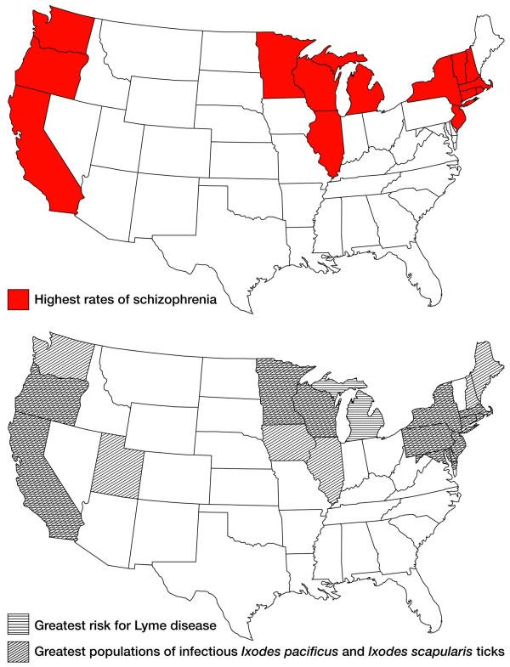
USA Schizophrenia & Lyme Distribution

Slide 6
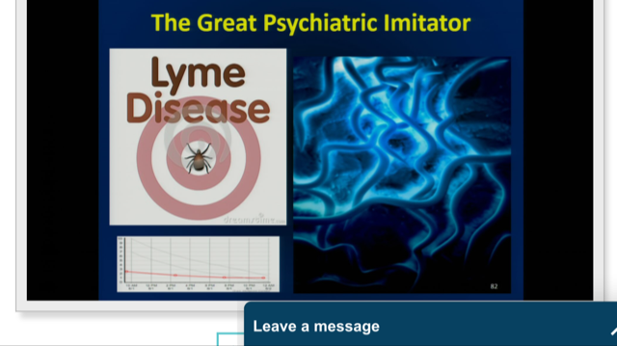

Slide 7
1994 !! BA Fallon
Lyme ubiquitous
Great mimicker of psychiactric illness
In endemic areas, psychiactric symptoms should be screened for lyme
New test required to detect Lyme Disease
More information on how to treat neurological Lyme is required

Slide 8
Integrative Physiology
 Examine multiple organ systems simultaneously
 Seeks primary causative factors driving complex
biochemical abnormalities
 Utilizes treatment strategies aimed at restoring
allostasis and reducing allostatic load
 Emphasizes treatments that improves physiologic
function while avoiding risk or harm
 Ecological model of medicine

Slide 9
CASE PRESENTATION

Slide 10
Early medical history
Male aged 32
Full term, mother on antibiotics for throat infection during pregnancy.
Delayed stage 2 I.e. head stuck in canal for prolonged periods of time. Duration uncertain.
With effect from the age of six weeks, had a six-week bout of extreme diarrhoea every evening for between four and six hours. He would scream constantly. Cause unknown. Settled with weaning.
During early childhood, hyperactive, discrepancy between emotional and intellectual development.

Slide 11
Puberty
Puberty, became very depressed, moved from a straight A student to getting grades E and F. Wished to work with his socialisation as he felt he was not good at this.
Episodes of paranoia during his teenage years, with occasional features of OCD and fixation on the Bible.
Eventually, got grade ABB in A levels and went to university To study computer software programming.

Slide 12
Early management before and just after diagnosis
He adopted alkaline diet and became extremely thin, psychosis, full blown, aged 21 in 2006 at about the time of his university graduation.
Attendance at university was sporadic but he achieved a First Class degree despite this.
2007 Psychosis diagnosed
Patient was invited to Africa. Significant improvement in health. Returned to UK condition worsened again
Extremely ill, low weight, diahrroea, dermatitis. 3 Ds ? Pellagra. Treated with high dose vit B3, VIT C dairy free, felt much better.

Slide 13
Naturopathic misunderstanding of schizophrenia led to wrong management
Visit to Naturopath in London
High-dose methylated folate, methylated B12, methionine, and P6P which unfortunately drove him into psychosis. Thereafter for many years he was on various antipsychotic drugs. Patient declined gluten free diet changes.
Over the years, his schizophrenia was found to be unresponsive to normal antipsychotics and in 2012 he was admitted to a psychiatric unit.
Under the threat of section, he agreed voluntarily to stay and was monitored carefully, eventually settling well on CLOZAPINE, an atypical antipsychotic.
In the industry, well known to be quite a miracle drug for schizophrenia.
The main side effect is aplastic anaemia.

Slide 14
Follow-up following discharge
2012 discharged back into his OWN HOME. DIET at home poor. Weight high. Slept a lot. Cognitively slow
2015-2016 Profuse night sweats assumed medication side effects.
In May 2016, REMOVED DAIRY & reduced SUGAR. This lead to weight loss and cognitive improvement.
SUBSEQUENT GLUTEN REMOVAL gave significant benefit which subsequently reverted until he was able to remove all forms of gluten and grain.

Slide 15
Follow up
January 2017, WEEKLY INTRAVENOUS GLUTATHIONE 1200mg
ERGOCALCIFEROL 300,000 units im
Further benefits cognitively were seen with better social interaction.
Locum consultant psychiatrist in July 2017 stated he had never seen someone on Clozapine who had overcome the side effects and that if he could improve social interaction, they would very cautiously considering reduction of his clozapine dose.

Slide 16
Lyme and co-infections diagnosed
July 2017, ARMIN CHRONIC INFECTION TESTS. Low CD57; Borrelia Elispot Positive with Co-infections of Mycoplasma Pneumoniae and Chlamydia Pneumoniae.
?CAUSATIVE OR ASSOCIATIVE.
It was considered that herbal treatments might more appropriate than antibiotic.IMPORTANT TO MAINTAIN GUT WALL INTEGRITY.
November 2017 Herbal treatment with modified COWDEN protocol to include TRANSFER FACTORS and Low Dose Naltrexone. GUT PROGRAM given. At times his diet became very restricted and so he required support with this.

Slide 17
TREATMENT of Lyme disease and co-infections
Cowdens Herbal Protocol
Transfer Factors
Low Dose Naltrexone
Gut program
Liposomal Glutathione

Slide 18
Modified cowdens protocol
Supplements to continue throughout protocol | Amount | Instructions
Multimessenger | 2 Capsules | Take in the morning before breakfast | Optimizing Cellular Immune Response + Specifically targeting Chlamydia
Messenger no 1 | 2 Capsules | Before sleep
Tri Fortify | 5ml (1 teaspoon) per day | away from food | Natural Killer Cell Function - Oxidative Stress - Detoxification
BLt | Start with 2x5 drops per day | gradually increase until daily dose is 2x40 drops per day | Eradication Pathogens
Stevia | 2x2 drops per day | Gradually increasing to 2x20 per day
Herbal Protocol
For 12 Days
Banderol | 2x2 drops per day | Gradually increasing to 2x30 per day, 30 minutes before meals
Samento | 2x2 drops per day | Gradually increasing to 2x30 per day, 30 minutes before meals
Burbur-Pinella | 2x2 drops per day | Gradually increasing to 2x20 drops per day
Serrapeptase | 2x1 Capsules per day | away from meals
36 hour interruption = no Banderol/Samento

Slide 19
Modified cowdens continued
Next 12 days
Cumanda | 2x2 drops per day | Gradually increasing to 2x30 per day, 30 minutes before meals
Samento | 2x2 drops per day | Gradually increasing to 2x30 per day, 30 minutes before meals
Burbur-Pinella | 2x2 drops per day | Gradually increasing to 2x20 drops per day
Serrapaptase | 2x1 Capsules per day | away from meals
36 hour interruption = no Cumanda/Samento
Next 12 days
Tangarana | 2x2 drops per day | Gradually increasing to 2x30 per day, 30 minutes before meals
Samento | 2x2 drops per day | Gradually increasing to 2x30 per day, 30 minutes before meals
Burbur-Pinella | 2x2 drops per day | Gradually increasing to 2x20 per day
Serrapeptase | 2x1 Capsules per day | away from meals
36 hour interruption = no Tangarana/Samento |  |  | Repeat this cycle for 3 months or as advised by your clinician Please ensure that you are drinking 3 litres of water per day while taking this protocol

Slide 20
Other treatments
Liposomal melatonin at night, ( day/night switch,)
low-dose liposomal artemsin and coriandolo( parasites & metal)
MOLD IGG positive tests treated with Rizol Gamma ( Ki science)
Removal from mold source
Glutathione & phospholipids can help this ( he was on low dose via ATP fuel by researched nutritionals)
Chlorella pyroidenosa used as a binder

Slide 21
Herxheimer reaction
During lyme disease treatment, developed quite a severe Herx reaction. This involved significant slowing and sluggish feelings of his muscles in his limbs and extreme tiredness.
I recommended that he increased his IV glutathione and oral lipososomal glutathione but he did not wish to do this; Nor to take in a any other support for a herx reaction . Previously he has been playing golf and had been extremely well but took several months to recover from this reaction.

Slide 22
Abnormal heart rate variability
POTS: POSTURAL ORTHOSTATIC TACHYCARDIA SYNDROME
During his recovery period, he suffered frequent attacks of agitation and pacing. Examination findings showed his blood pressure to be low at 80/40, pulse 96. treated with ice and rest, abdominal breathing. His blood pressure would rise suddenly at this time to 158/110 approximately, pulse 110.
Methods of improving parasympathetic activity include yoga breathing, ice, the gag reflex, gargling, “ activated oxygen”.

Slide 23
Solution
Clozapine increased to previous dose 300mg; EXCELLENT RESPONSE
Returned to IV Glutathione weekly, / liposomal glutathione

Slide 24
EVIDENCE FOR Glutathione TREATMENT
There is evidence that patients with schizophrenia treated with intravenous glutathione, dose 1200 mg per week, have an improvement of negative symptoms of schizophrenia.
N acetyl cysteine 1 g twice daily. NAC is known to be an excellent precursor for the formation of glutathione in the body.
It gives excellent immune modulation and anti-inflammatory properties

Slide 25
Current treatment
clozapine 300 mg on
low dose naltrexone 4.5 mg
intravenous glutathione 1200 mg once every week
remains on a gluten-free and dairy free, sugar free diet.
RG3 nasal spray
EDTA silver spray
N acetyl cysteine nasal spray
NAC 500mg – 2gms a day
Bodybio phospholipids, Bile salts, higher fat diet, butyrate

Slide 26
Rg3 nasal spray to support neuronal health
Rg3 nasal spray contains 2% of ginsenoside Rg3, a purified, active compound from ginseng.
This spray is a researched treatment in situations with neuronal damage caused by exhaustion , burn out, post-traumatic stress disorder,…
Rg3 has neuroprotective properties-protecting neuronal cells from the damage caused prolonged exposure to cortisol and thereby reduces stress-related brain damage.
Studies show hippocampal damage and neuronal death was induced in neuronal cells of rats being exposed to dexamethasone.
Rg3 ginsenoside also inhibits stress-induced plasma cortisone levels. ^{1,2}
The nasal delivery system guarantees access through the blood-brain barrier.³
Reduced microglial activation
Sources
1Sung-Ok K, Jung-Man Y, et al. Ginsenoside Rb1 and Rg3 attenuate glucocorticoid-induced neurotoxicity. Cell mol neurobiol. 2010,857-862
2Seong SJ, Yeong MY, et al. Prevention of inflammation-Mediated Neurotoxicity by Rg3 and it’s role in microglial activation. Research Institute of veterinary medicine. 2008,156-756
3Hyeongming Kim, Jong Hyuk Lee, et al. Micro-/nano-sized delivery systems of ginsenosides for improved systemic bioavailability. J Ginseng Res. 2018, 19

Slide 27
Chronic inflammatory response syndrome?
Marcons test was also carried out and found to be positive. This was treated with a silver nose spray, also N acetyl cysteine nasal spray.
Previous nasal blockage has now settled down.
Currently the patient does not wish any more tests and therefore the markers of chronic inflammatory response syndrome have not been measured, e.g. MSH, VIP, VEGF, et cetera

Slide 28
Neuro steroids
Low normal levels of testosterone, pregnenalone and DHEA were noted and he was therefore given small doses of bioidentical hormones which he took only for a short period of time. It is also considered that progesterone has an immunomodulatory effect and for a short period of time he was treated with 50 mg per day.
Although the mechanism of action of clozapine is not fully understood, it is considered to have an immuno modulatory effect and in view of the immediacy of its actions, appears to have an immune suppression effect. ? Inhibition of NFKB? Reduction of cytokine storms.
Clozapine mainly works on neurotransmitter receptors such as serotonin, D2 and D4, thereby possibly working downstream as well as upstream?

Slide 29
Benefits from treatment 1
Initially on clozapine alone, he was zombie like, cognitively delayed, with heavy weight gain and a brown coloured face with eczema on his legs and clawing of his feet. Profuse night-time sweats.
Subsequent to his treatment for Lyme, Mold, Marcon's which admittedly was short-term, dietary change over a period of 18 months, significant intravenous anti-inflammatory treatment with glutathione, and immune modulation with low dose naltrexone his condition improved significantly.
His feet returned to normal, he no longer has night sweats, his nose has become unblocked, his eczema has settled, cognitively he is functioning and he's no longer tired. His body weight is normal, if slightly low.

Slide 30
BENEFITS FROM TREATMENT 2
He is currently extremely well, independent, playing golf; TAKING ON LINE ACCOUNTANCY 3 YEAR COURSE, HAS A SMALL BAR JOB.
HEALTH STILL BRITTLE WITH GRAIN OR GLUTEN EXPOSURE, SO WE ARE ASSESSING FATTY ACID BALANCES AND ACUMEN MITOCHONDRIAL FUNCTION TO SUPPORT MEMBRANE INTEGRITY

Slide 31
Biological systems supported 1
GUT (4R program) ( DPP4 gluten digestive enzymes, Perm Plus, Curcumin, Corebiotics)
Immune modulation ( Transfer factors, low dose naltrexone, progesterone)
Inflammation ( via Gut work & Treatment of infections; Glutathione, DHEA)
ENERGY ( mitochondria)
Chronic infection ( Borrelia & co-infections; Marcons, Parasites of gut)
Detoxification ( metals, parasites eg glutathione, Artemisi & coriandolo)
Genetic modulation & neurotransmitter production ( methylation, glutathione, neuro-hormones)

Slide 32
biological systems supported 2
Hormones: Neurosteroids (Testosterone, DHEA, pregnenalone)
Deficiencies: Daily essential Nutrition ( Dr Hardy’s) & diet
Fatty acids. EPA/DHA . Membrane medicine ( Dr Pouria ; Kane; David Horrobin’s work)
Stress: Psychodynamic therapy ( trans generational hypnotherapy has been attempted x 4 sessions); yoga; Autonomic nervous system/ heart rate variability sympathetic/ parasympathetic. (POTTS)
Blood flow & oxygenation ( activated oxygen)
Sleep ( melatonin, EMF)

Slide 33
Plans for the future 1
Consider HLA immune genetic measurement.
May require re-visitation of treatments for Lyme disease, ?antibiotics for Marcon's, further improvement to the elimination channels and detoxification regarding metal and parasites. Consider using chlorella on a regular basis.
Is this the only organic psychiatric illness. In some people does the challenge with the immune system persist despite optimising other biological systems?
Does he have chronic inflammatory response syndrome? ? Refer to my colleague Louise Carder.
Imperial: Autoimmunity noted in schizophrenia; antibody Rx being trialled now)

Slide 34
Plans for the future 2
To increase social interaction. (?Oxytocin nasal spray)
Continue current treatments.
Keep all biological systems under review.
Dr Pouria & Kane Fatty acids assessed, Membrane medicine; epigenetics being further treated. VERY high OMEGA 6; low omega 3. ? Gallbladder issues in Schizophrenia. DAVID HORROBINS work with Kirunal
In the winter possibly increase clozapine because of the increased mould challenge in damp weather.
For regular vitamin D or sunshine.

Slide 35
POSITIVE Investigation results
1. methylation ( LOW CARTININE; GENE PROFILE, MTHFR, glutathione, homocysteine LEVEL)
2. HORMONES ( TESTOSTERONE)
3. INFECTIONS (GUT, MARCONS, ARMIN)
4. NUTRITONAL DEFICIENCIES ) ACTUAL BLOOD LEVELS, FUNCTIONAL ORGANIC ACID TESTS)
5. GUT PERMEABILITY ( ADVANCED BARRIER ASSESSMENT BY INVIVO)
6. MOLD igg LEVELS ( RED LABS, INVIVO)

Slide 36
POSITIVE Investigation results
1. methylation ( LOW CARTININE; GENE PROFILE, MTHFR, glutathione, homocysteine LEVEL)

Slide 37
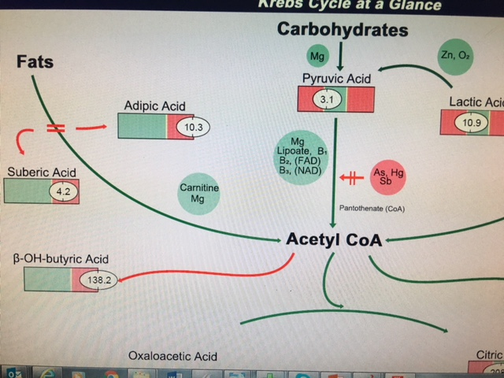
Genova one test, breakdown of fats ( CARNITINE DEFICIENCY ? DUE TO POOR METHYLATION?)

Slide 38
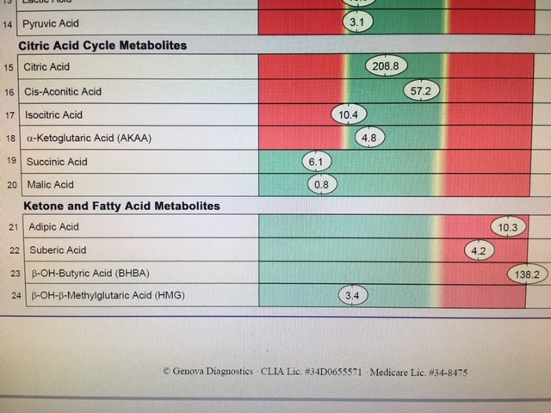
Breakdown of fats

Slide 39
High homocysteine
Homocysteine 24.5

Slide 40
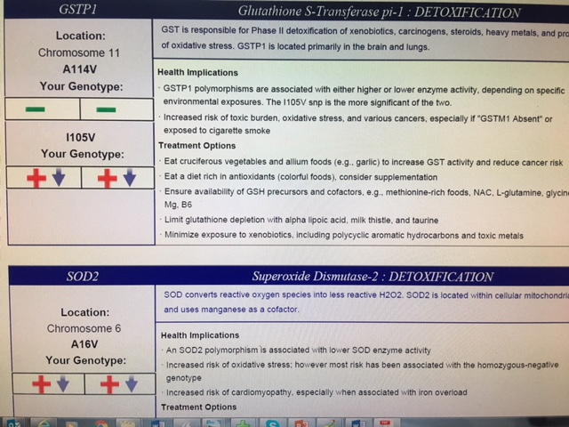
neurogenomic screen Gstp1 & sod snps

Slide 41
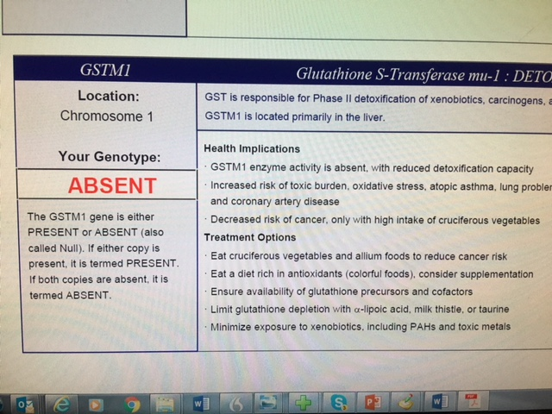
Neurogenomic absent gstm1

Slide 42
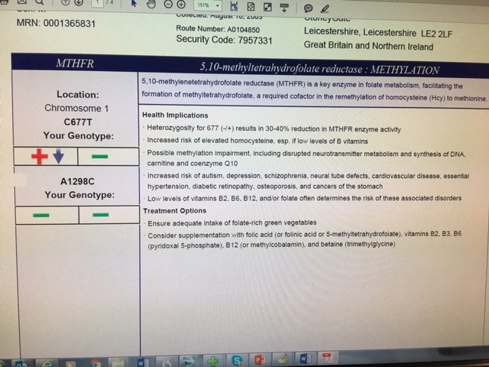
Mthfr rate limiting step for methylation snp on c677T. 30-40% reduction in enzyme activity

Slide 43
What is methylation

Slide 44
Mthfr mutations may lead to low glutathione

Slide 45
High homocysteine noted in this patient, treated with Dr Hardys Daily essential nutrition ( includes methyl folate B12 & much more)

Slide 46
Nutrients to support methylation

Slide 47
Investigation results
2. hormones
Low testosterone 6.4 ( 7.4-22)
Vit D 9mmol/l ( vitamin or hormone?)

Slide 48
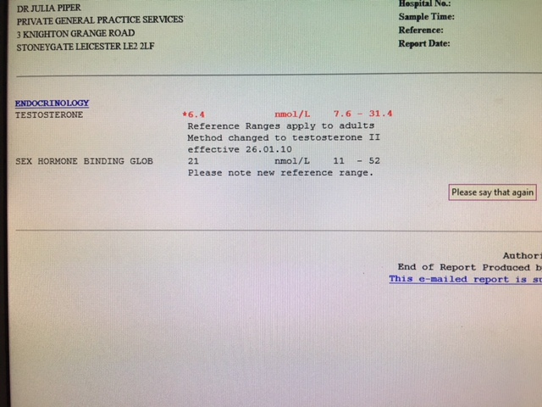
Anti psychotic side effects low testosterone ( chemical castration)

Slide 49
POSITIVE Investigation results
3. infections
Stool test. CDSA 2.0 (Genova)
Marcons ( Invivo) other chronic infections (armin)

Slide 50
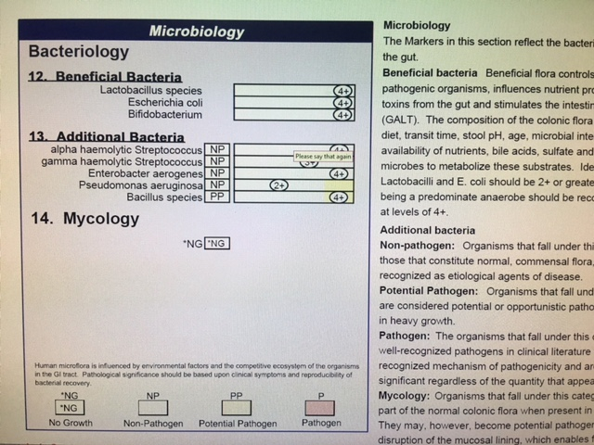
Comprehensive stool analysis 2010, bacillus species; lower grade pseudomonas

Slide 51
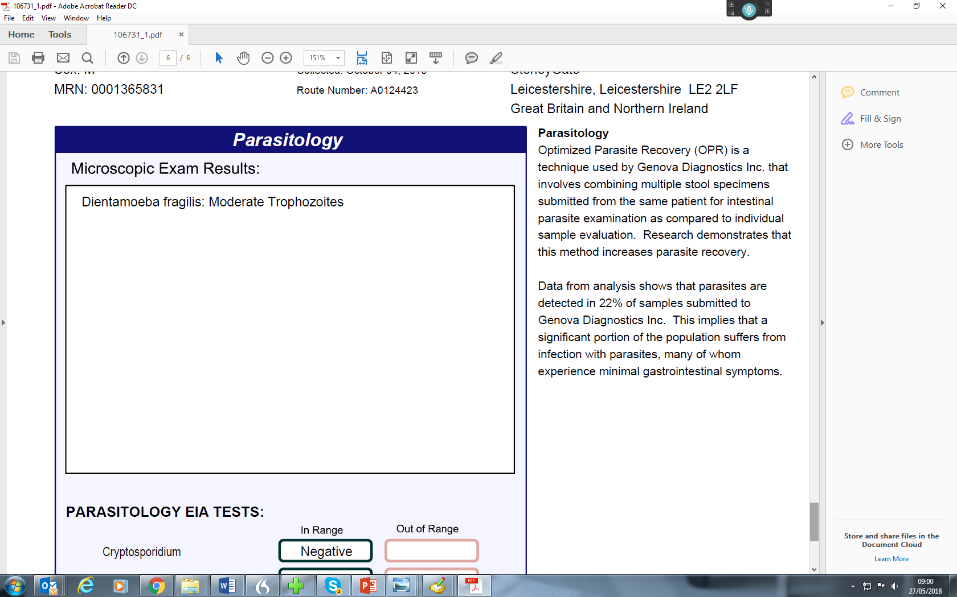
Dientamoeba fragilis ( Rx diet, hygiene, gut 4R program, low sugar diet; garlic etc)

Slide 52
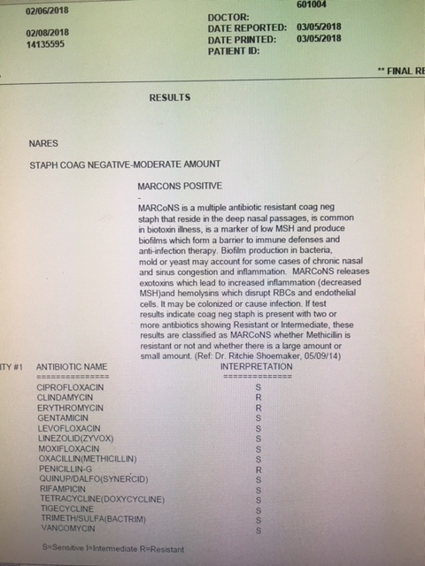
Marcons positive ( tested via INVIVO)

Slide 53
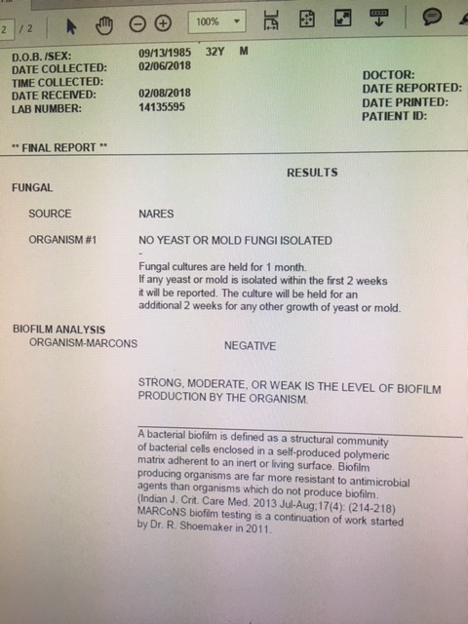
No Biofilms, no fungal growth/mold

Slide 54
Armin labs, positive borrelia elispot
Borrelia:
Full antigen 4SI b OSP Mix 5 SI

Slide 55
UK does not recognise research labs of functional medicine.
Patients will only be treated who have positive humoral immunity

Slide 56
Armin: low CD57, only 26/ul

Slide 57
Humoral responses to chlamydia pneumoniae and mycoplasma pneumoniae.

Slide 58
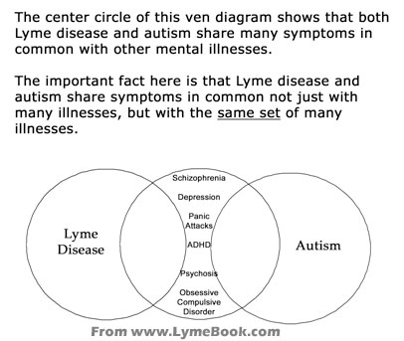
Lyme disease & schizophrenia similar symptoms

Slide 59
Symptoms of lyme

Slide 60
POSITIVE Investigation results
4.Nutrient deficiencies

Slide 61
Nutritional & toxic metals test results ( biolab London)
Low caeruloplasmin ( copper binder)
Low copper ( formation of noradrenalin)
Low Magnesium ( anxiety)
Low selenium ( glutathione formation, thyroid function)
Low Omega 3, omega 6
Low vitamin E ( Genova test showed high lipid peroxidase)
High SOD activity
Low lutein
Normal toxic metal screen ( no chelation challenge)
Normal Kryptopyroles
High Lipid peroxidase

Slide 62
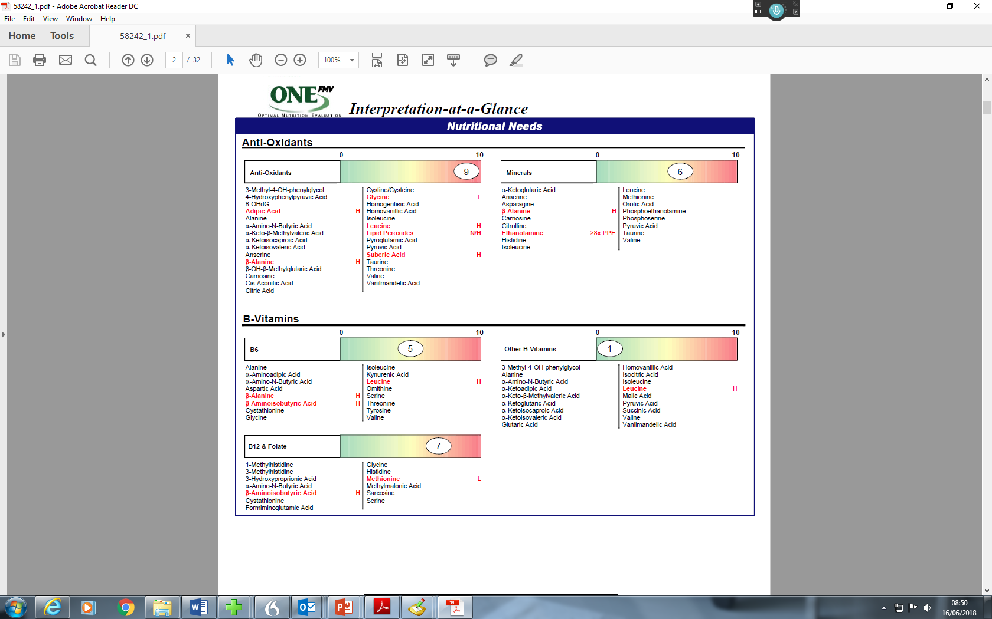

Slide 63
Toxic metals

Slide 64
POSITIVE INVESTIGATION RESULTS
5. GUT PERMEABILITY ( ADVANCED INTESTINAL BARRIER ASSESSMENT, INVIVO)
LPS, HISTAMINE DAO, ZONULIN

Slide 65
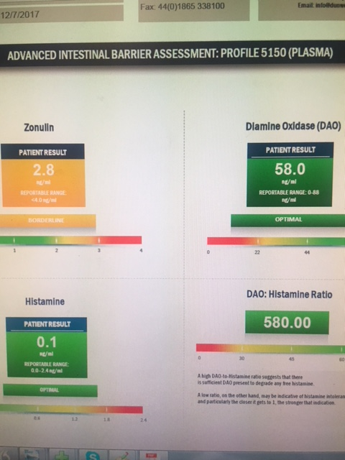
Advanced intestinal barrier assessment
(Dunwoody lab). Marginally elevated zonulin

Slide 66
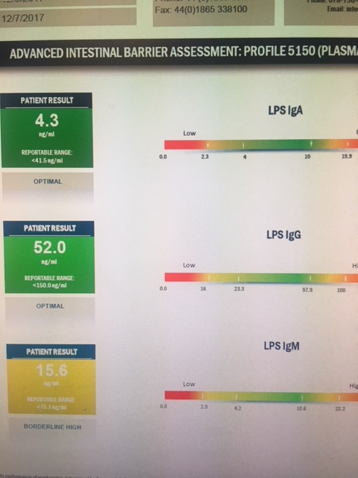
Advanced intestinal barrier assessment borderline high LPS igm ( Rx glutathione, Dhea, anti-microbials, curcumin)

Slide 67
POSITIVE INVESTIGATION RESULTS
6. MOLD POSITIVE ( RED LABS, INVIVO)

Slide 68
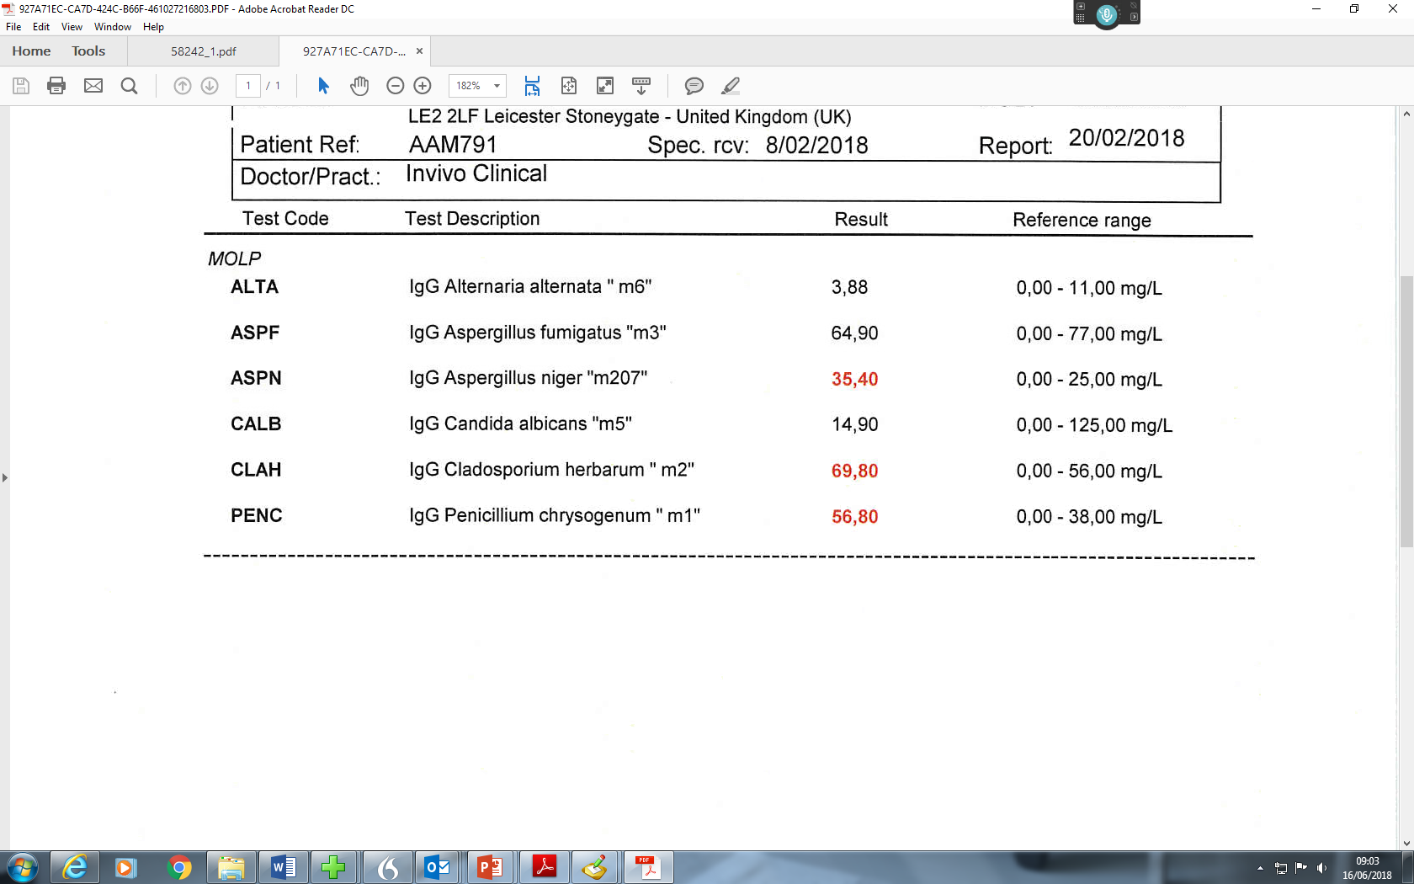

Slide 69
Post treatment Mitochondrial tests almost normal
Low ATP related magnesium
High Mercury
No DNA adducts
Cardiolipin normal
NO MOLD FOUND

Slide 70
POSSIBLE Pathway to illness 1
Head injury at birth. Can lead to the formation of anti-neuronal antibodies. Early onset autoimmune trigger.
Causes molecular mimicry and increased cytokine production
SNPs on glutathione; absent glutathione gene, SNP on MTHFR 677 gene, leading to poor methylation and altered gene expression.
Genetic compromise to detoxification pathways; accumulation of Mercury and Biotoxins
Likely FATTY ACID digestion problem; poor availability for membrane building ( + brain 60% fat) David horobins work.
Possible reaction to GLUTEN and CASEIN soon after birth leading to gut permeability. Mother also has dientamoeba fragilis so parasites present at birth; which MAY sensitise gut wall to CASEIN & gut permeability
Possible early infection with Lyme disease or other chronic infections.

Slide 71
Possible pathways to illness 2
Stress of life and altered perceptions through development; INCREASING RISK OF AUTOIMMUNITY & OTHER IMMUNE CHALLENGE
Long latency period for the expression of Lyme, eventually full blown neurological; NEUROINFLAMMATORY LYME aged 21
Possible genetic predisposition for altered epigenetic's surrounding genes relating to the HLA immune system?
Downstream effects on MITOCHONDRIA, neurotransmitters and hormones; EPIGENETICS
Development of deficiencies.
POSSIBLE CHRONIC INFLAMMATORY RESPONSE SYNDROME ( POSITIVE MOLD & MARCONS )

Slide 72
DISCUSSION
1. chronic inflammatory response syndrome
2. NEUROIMMUNOLGY AND EARLY SIGNS OF SCHIZOPHRENIA & DEPRESSION RISK
3. Genetic immune challenges in schizophrenia
4. SCHIZOPHRENIA AS AN AUTOIMMUNE ILLNESS
5. Schizophrenia & homology with gluten & infections

Slide 73
1.Chronic inflammatory response syndrome

Slide 74
Chronic Inflammatory Response
Syndrome
• Growing awareness that microbes play a
role in chronic illness
• Terrain matters – impaired immunity
predisposes patient to chronic infection
• Chronic infections suppress immune
activity
• Other factors that alter immunity –
biotoxins (metals, chemicals), inherited or
acquired defects
SHOEMAKER PROTOCOL IS A DETAILED APPROACH TO THIS

Slide 76
Visual contrast sensitivity

Slide 77
DISCUSSION
1. chronic inflammatory response syndrome
2. NEUROIMMUNOLGY AND EARLY SIGNS OF SCHIZOPHRENIA & DEPRESSION RISK
3.Genetic immune challenges in schizophrenia
4.SCHIZOPHRENIA AS AN AUTOIMMUNE ILLNESS
5. Schizophrenia & homology with gluten & infections

Slide 78
2. NEUROIMMUNOLGY AND EARLY SIGNS OF SCHIZOPHRENIA & DEPRESSION RISK

Slide 79
What about the infectious disease specialist? gastroenterologist & psychiatrist!!
Psycho-neuro-gastro-immunology links with infection

Slide 81
“Microglial activity is elevated in
patients with schizophrenia and
in persons with subclinical
symptoms who are at ultra high
risk of psychosis and is related to
at‐risk symptom severity. These
findings suggest that neuroinflammation
is linked to the risk
of psychosis and related
disorders, as well as the
expression of subclinical
symptoms.”

Slide 82
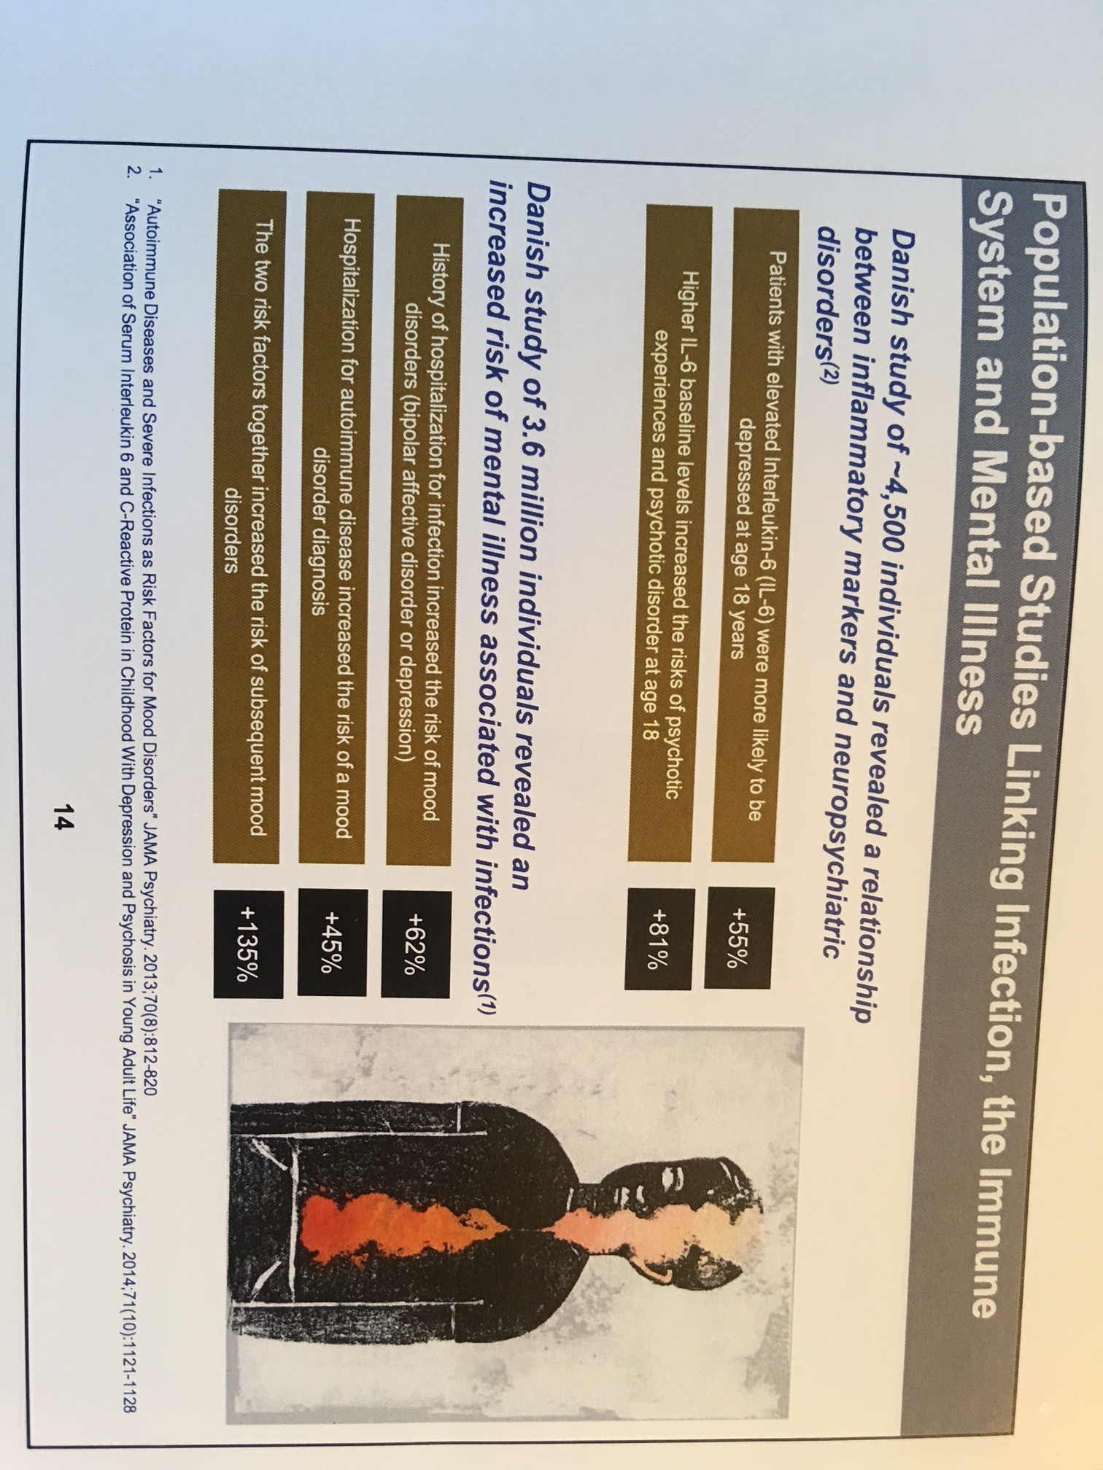
Il6 levels are a future predictor of depression and psychosis
Infections & autoimmune history associated with higher subsequent risk of mental health problems.

Slide 83
CLINICAL NUGGET
PET SCAN
IL6
MEASURE THESE IN AT RISK PATIENTS

Slide 84
DISCUSSION
1. chronic inflammatory response syndrome
2. NEUROIMMUNOLGY AND EARLY SIGNS OF SCHIZOPHRENIA & DEPRESSION RISK
3. Genetic immune challenges in schizophrenia
4. SCHIZOPHRENIA AS AN AUTOIMMUNE ILLNESS
5. Schizophrenia & homology with gluten & infections

Slide 85
3.Genetic immune challenges in schizophrenia

Slide 86
The site in Chromosome 6
harbouring the gene C4 towers far
above other risk-associated areas
on schizophrenia’s genomic
“skyline,” marking its strongest
known genetic influence. The new
study is the first to explain how
specific gene versions work
biologically to confer schizophrenia
risk.
The site in Chromosome 6
harboring the gene C4 towers far
above other risk-associated areas
on schizophrenia’s genomic
“skyline,” marking its strongest
known genetic influence. The new
study is the first to explain how
specific gene versions work
biologically to confer schizophrenia
risk.

Slide 87
Manhattan plot showing schizophrenia associations.
“It could help explain
schizophrenia’s delayed age-of onset
of symptoms in late
adolescence/early adulthood and
shrinkage of the brain’s working
tissue. Interventions that put the
brakes on a pruning process gone-
awry could prove
transformative.”

Slide 88
DISCUSSION
1. chronic inflammatory response syndrome
2. NEUROIMMUNOLGY AND EARLY SIGNS OF SCHIZOPHRENIA & DEPRESSION RISK
3. Genetic immune challenges in schizophrenia
4. SCHIZOPHRENIA AS AN AUTOIMMUNE ILLNESS
5. Schizophrenia & homology with gluten & infections

Slide 89
4.SCHITZOPHRENIA AS AN AUTOIMMUNE ILLNESS

Slide 90
Autoimmunity: is it the genes?
At least 20% of the population has genes
that predispose them to autoimmune
development. But only a fraction of them
go on to develop full-blown autoimmune
disorders. Other factors must be involved…

Slide 91
Multifactorial aetiology

Slide 92
Autoimmune Disease: A Broad Definition
PLoS Med, 2006, Vol 3(8): 1242-1248
Self-directed tissue inflammation, resulting from loss of
tolerance by aberrant dendritic cell, B & T cell responses with
Development of immune reactivity towards native antigens
Adaptive immune response (antibodies, activated T
lymphocytes) appears to play predominant role in clinical
disease
Pathophysiology is ongoing & multifactorial: organ or tissuespecific
Antibodies may predate clinical disease by many years. ( MAYBE THESE CAN BE MEASURED PRE PSYCHOSIS? IE ANTI NEURONAL ANTIBODIES SUCH AS THE CUNNINGHAM PROFILE or cyrex)
Robert Rountree, MD 2015

Slide 93
Mechanism of gut wall challenges

Slide 94
Microbes to Watch
 Mycoplasma pneumonia, fermentans, hominis
 Lyme disease (Ceres NanoTrap or Advanced Labs), Bartonella
(Galaxy), Babesia, Ehrlichia, Anaplasma
 Epstein Barr Virus including early antigen
 HHV-6 (Quest)
 CMV
 Toxoplasmosis gondii
 HSV I/II
 Streptococcus
 Periodontal disease
 Mold (ERMI > 2)

Slide 95
Stress & autoimmunity

Slide 96
Stress and Autoimmunity
Up to 80% of patients reported uncommon emotional stress before disease onset...Recent
reviews discuss the possible role of psychological stress, and of the major stress‐related
hormones, in the pathogenesis of autoimmune disease and presume that the stress‐triggered
neuroendocrine hormones lead to immune dysregulation, which ultimately results in
autoimmune disease by altering or amplifying cytokine production.

Slide 97
Stress
 Allostasis - the ability to achieve stability through
change — is critical to survival.
 Stress system - protect the body by responding to
internal and external stress.
○ Autonomic nervous system
○ Hypothalamic–pituitary–adrenal (HPA) axis
○ Cardiovascular and metabolic systems
○ Immune systems
 Allostatic load - the price of accommodation to stress, (wear and tear) that results from chronic overactivity or underactivity of allostatic systems.
Bruce S. McEwen, Ph.D. Protective and Damaging Effects of Stress Mediators. NEJM. Jan 2008: Volume 338:171-179

Slide 99
Stress Immune brain Connection
•Cortisol
•NMDA excitation
•Reduced neuroplasticity
•SNS/PNS imbalance
•Th1/Th2 imbalance
•Microglial activation
•IL-6, TNFα
•Gut permeability
•IDO elevation
•Heart Rate Variability

Slide 100
DISCUSSION
1. chronic inflammatory response syndrome
2. NEUROIMMUNOLGY AND EARLY SIGNS OF SCHIZOPHRENIA & DEPRESSION RISK
3.Genetic immune challenges in schizophrenia
4.SCHIZOPHRENIA AS AN AUTOIMMUNE ILLNESS
5. Schizophrenia & homology with gluten & infections

Slide 101
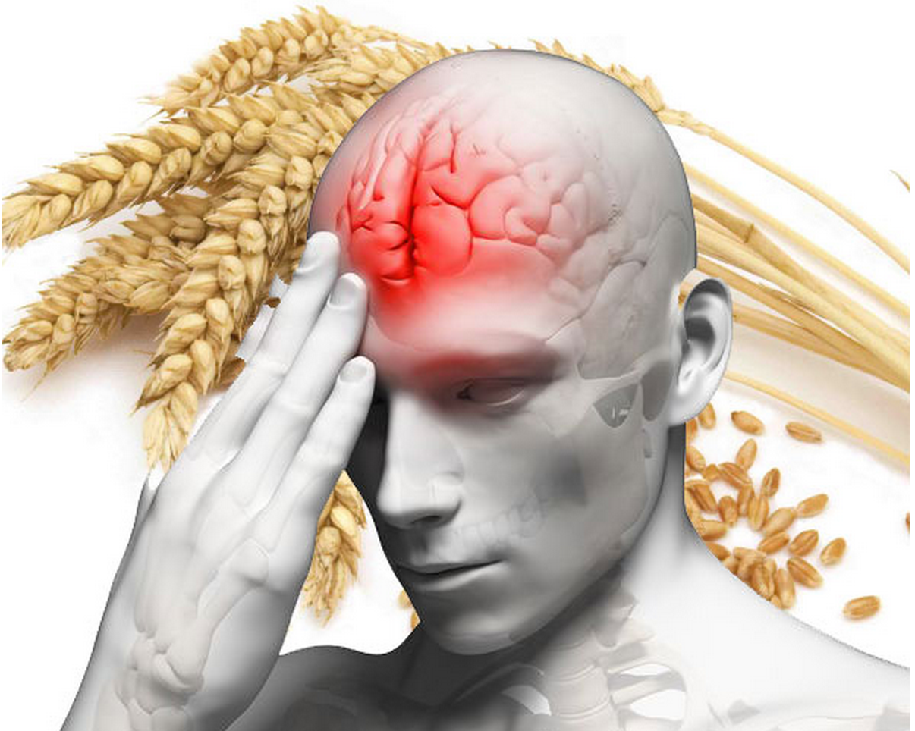
5.Schitzophrenia & gluten homology

Slide 102
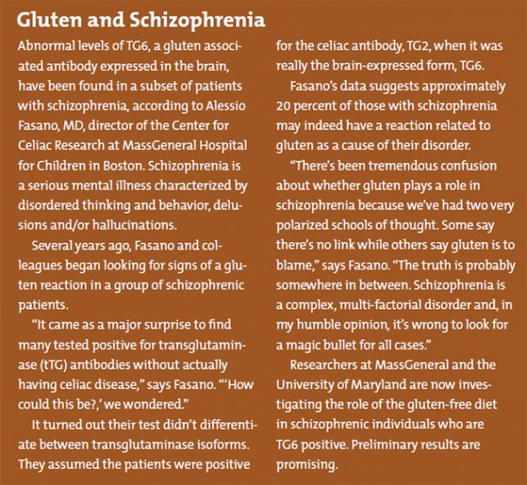
Fasano: abnormal levels of TG6.
20% of those with schizophrenia may have a gluten reaction as a cause of their disorder

Slide 109
Chronic infections affecting immune reactivity

Slide 110
Group a streptococcus

Slide 111
Homology with Group a streptococcus

Slide 112
Homology with fungal infection

Slide 113
Blood brain barrier

Slide 116
Significance of brain reactive autoantibodies

Slide 117
Autoantibody changes following head injury ( relevance to Birth trauma?)

Slide 118
Association between neural antibodies & neuroautoimmune disorders

Slide 119
Possible treatments

Slide 120
Bacterial metabolites fight intestinal inflammation

Slide 121
Take home points

Slide 122
TAKE home points 1
With at risk patients, consider Lyme disease or other chronic infections. (Armin lab) check anti streptococcal titre
Consider a PET scan in at risk patients; TO MEASURE MICROGLIAL ACTIVATION.
Consider checking inflammatory markers. Eg IL6
Consider autoantibody screen (Cyrex, Moleculare, ANOM)
CHECK GUT, do coeliac test, TG6; gluten Cross Reactivity test ( Cyrex) consider trial of gluten cessation for minimum 4 weeks, preferably 6 months
Stop dairy too if possible ( casein reactions)
Consider Keto/Paleo changes to diet

Slide 123
Take home points 2
Check hormones including thyroid, testosterone, other sex hormones where appropriate, adrenal hormones
Check methylation and glutathione genetics ( Genova lab; Lifecode)
Optimise elimination pathways
Consider parasites and metals
Correct deficiencies

Slide 124
TAKE HOME POINTS 3
Treat Inflammation eg IV Glutathione, Liposomal glutathione
Modulation of immune system via Transfer Factors; Low dose Naltrexone
Remember MOLD; Marcons; CIRS & 5 brains ( enteric NS, microbiome gut, microbiome brain, the actual brain, and the area behind the nose & periodontal areas.)
Membrane medicine; FATTY ACID ASSESSMENTS. Fat digestion, gallbladder considerations. DAVID HORROBIN

Slide 125
Take home pointS 4
Is this an organic illness ?
Consider medications where necessary; RUNNING ALONGSIDE SYSTEMS MEDICINE
Improve biological systems
Look at the work of Abram Hoffer; David Horrobin ( Fatty acids) , Richard Horowicz ( Lyme & co infections)
RESULT: PATIENTS ACTIVE AND LIVING A NORMAL LIFE RATHER THAN OVER MEDICATED ZOMBIE LIKE STATES

Slide 126
Thank you for listening
Dr Julia A Piper FRCGP
Telephone 078 0977 7344
drpiper@privategp.com
www.privategp.com

