Slide 1
The safety of EPO in epilepsy
Not only are linoleic acid and gamma-linolenic acid safe in epilepsy, with prolonged oral administration of w-6 LA and w-3 ALA (in a 4:1 mixture) protecting rats from seizures in four different epilepsy models, but... prostaglandin E2 appears to have anticonvulsant activity.
Puri B.K. Prostaglandins, Leukotrienes & Essential Fatty Acids, 2007; 77: 101-103

Slide 2
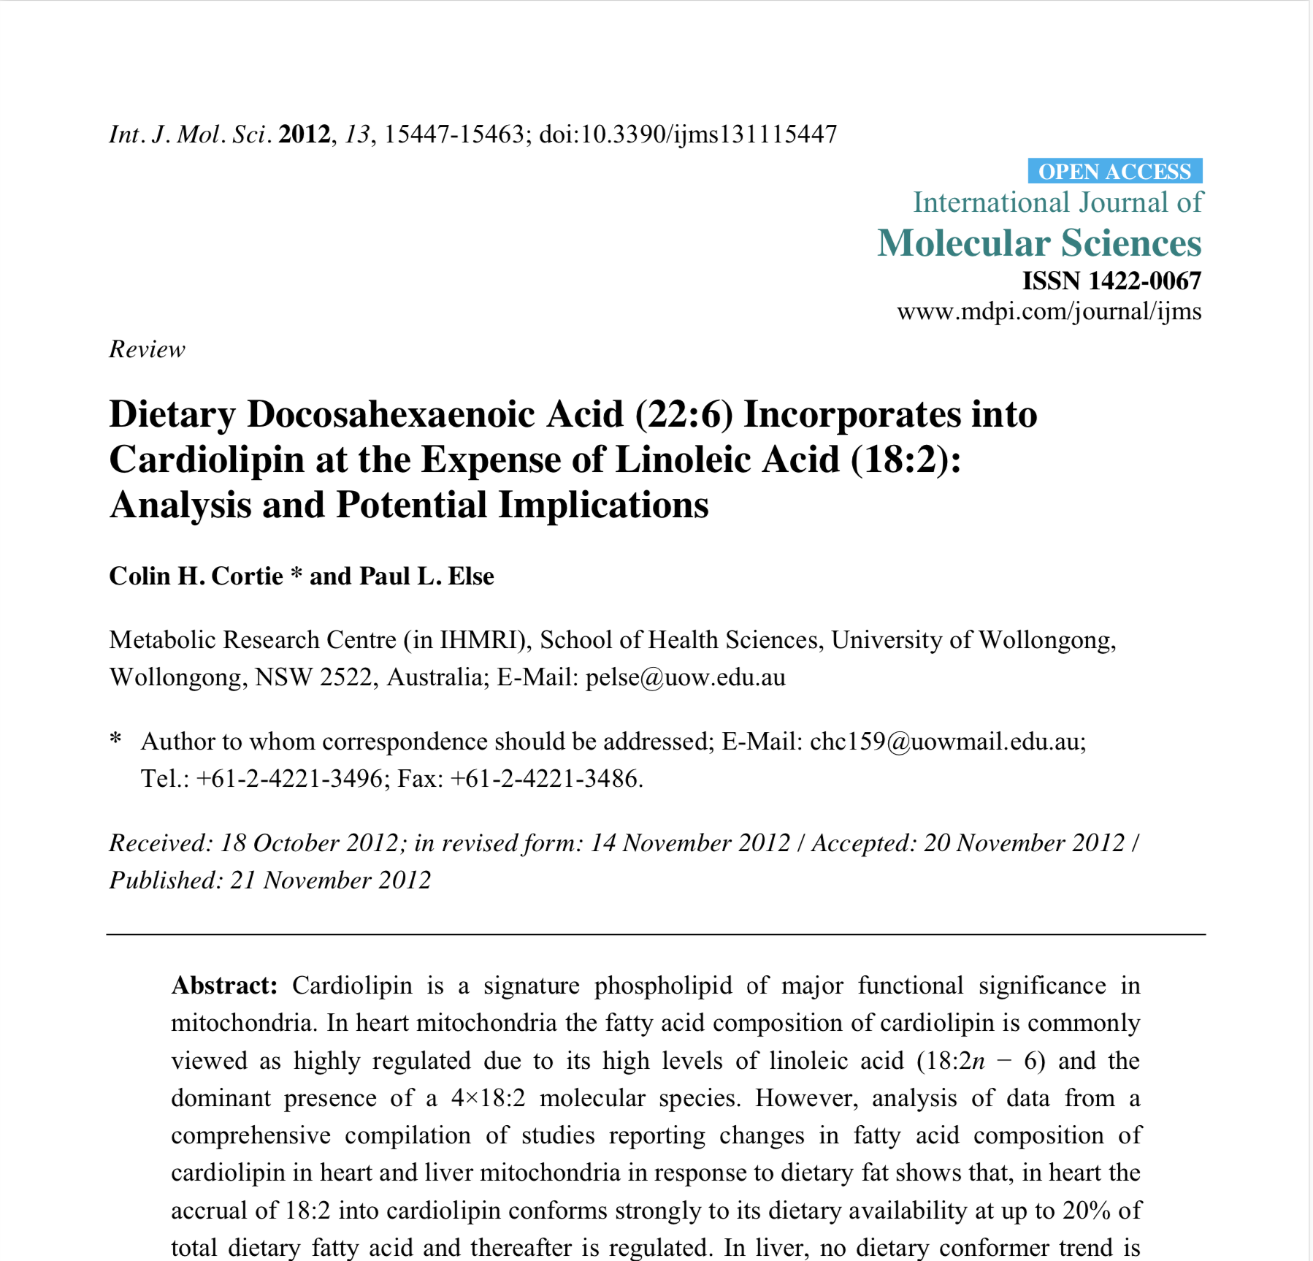
Dietary DHA Incorporates into Cardiolipin at the Expense of Linoleic Acid
When 18:2 and docosahexaenoic acid (22:6w-3) are present in the same diet, 22:6 is incorporated into cardiolipin of heart and liver at the expense of 18:2 when 22:6 is up to ~20% and 10% of total dietary fatty acid respectively.
Puri B.K. Prostaglandins, Leukotrienes & Essential Fatty Acids, 2007; 77: 101-103

Slide 3
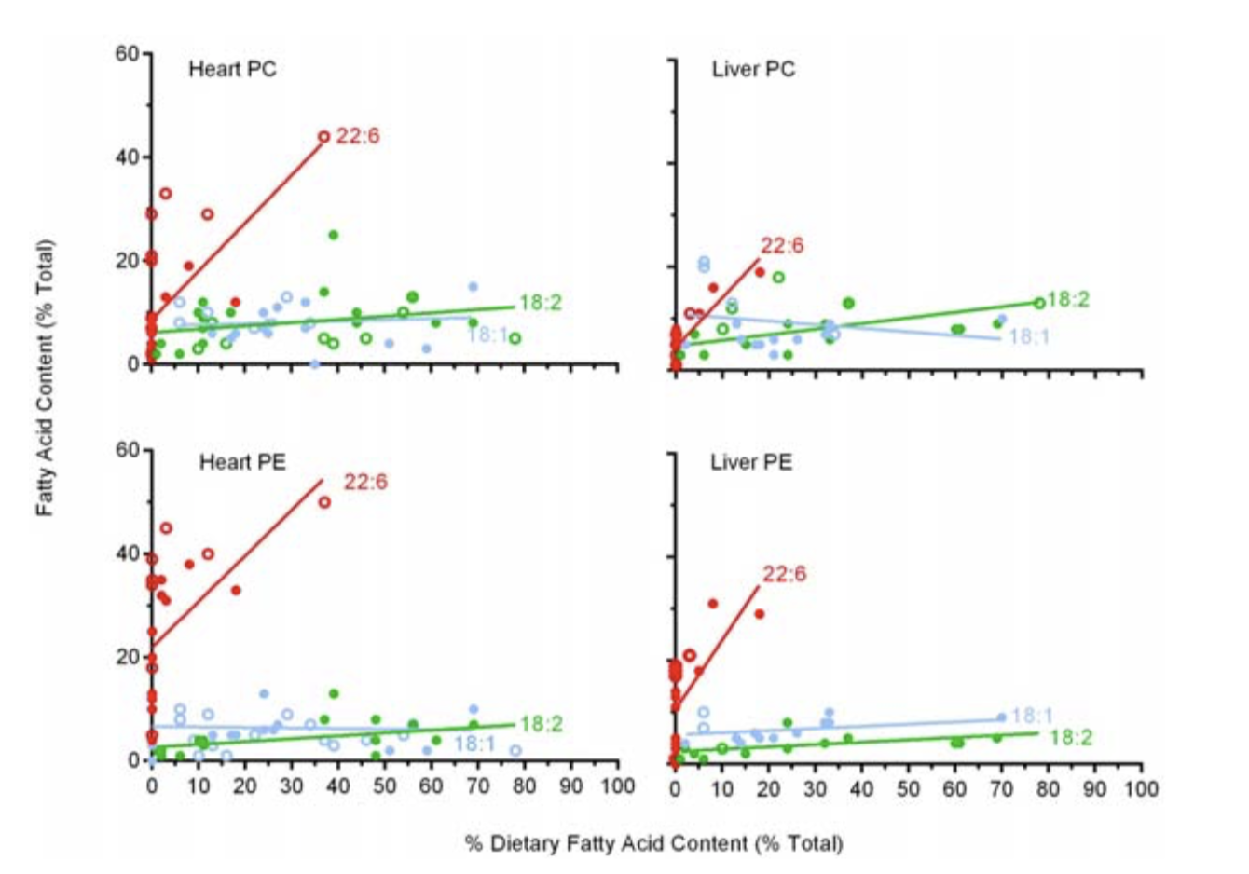

Slide 4
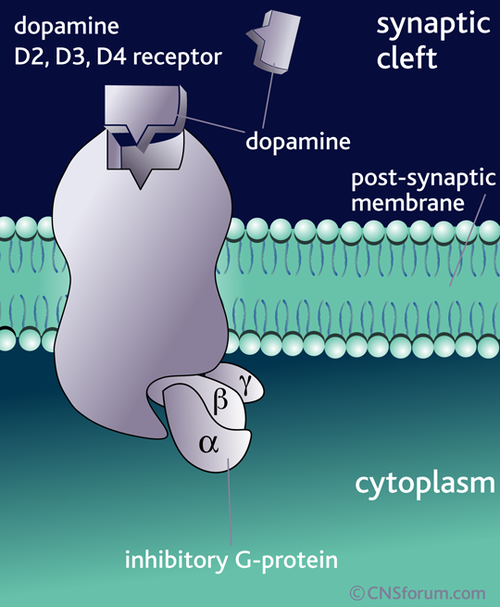

Slide 5
Neurotransmitter
Cell membrane
Receptor
Gβ
Gγ
Gα
Effector
G protein complex
Inside of cell body

Slide 6
SAPs
Synapse-associated proteins
Sub-membrane, like G proteins
Hypervariable

Slide 7
SAPs are hypervariable
Most mammals
2 repeats
Dogs
2 or 4
Primates
4+

Slide 8
SAPs are hypervariable
Humans:
2 repeats 9%
4 repeats 65%
7 repeats 19%
7 repeats linked to “novelty-seeking behaviour”
D4R-knockout mice do less “novelty-seeking behaviour”

Slide 9
ADHD
Increased % of D4R SAP 7 repeats
29% in ADHD vs
12% in controls

Slide 10
Prostaglandins
Lipids taken from membranes to form PGs
Act principally on G proteins
G proteins trigger cascades of eg cyclic AMP production

Slide 11
Receptors
Most, but not all, open to a single “key”
Dopamine D4 receptor opens to:
DA - Dopamine
NA - Noradrenaline
Adr - Adrenaline (little in CNS)
Serotonin (weak effect)

Slide 12
Neuronal feedback circuit
Rhythmic firing cycle
Generates EEG waves
DA cycling time on receptor ~ 25ms
= 40Hz = gamma waves

Slide 13
D4R effects
DA 25ms = 40Hz
Synchronised rhythmic firing
Attention, focus
NA 5ms = 200Hz
Immediate brief arousal
Awareness, alertness

Slide 14
Neuronal feedback circuit
Sensory input triggers pyramidal cells
Pyramidal cells trigger ppG interneurones
ppGs inhibit Pyr cells
This disinhibits Pyr cells
Rhythmic cycle of firing

Slide 16
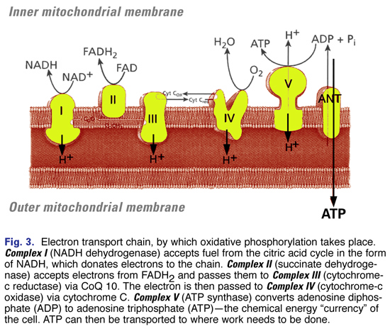
Notes:
Antioxidants
CoQ10 - also electron carrier in the inner membrane
NAC/glutathione

Slide 17
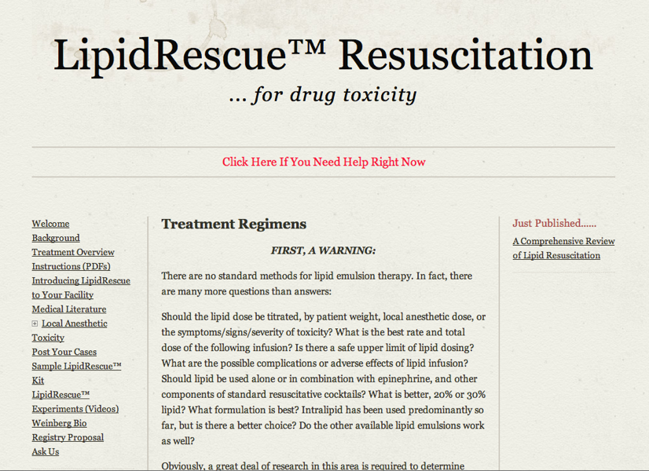
Notes:
The anaesthetists have figured out the acute side over the last decade.
They observed that intracellular fatty acid derivatives accumulate during myocardial ischemia
And wondered whether the concurrent administration of lipids would make the cardiotoxicity of drugs worse. To their surprise the reverse happened.

Slide 18
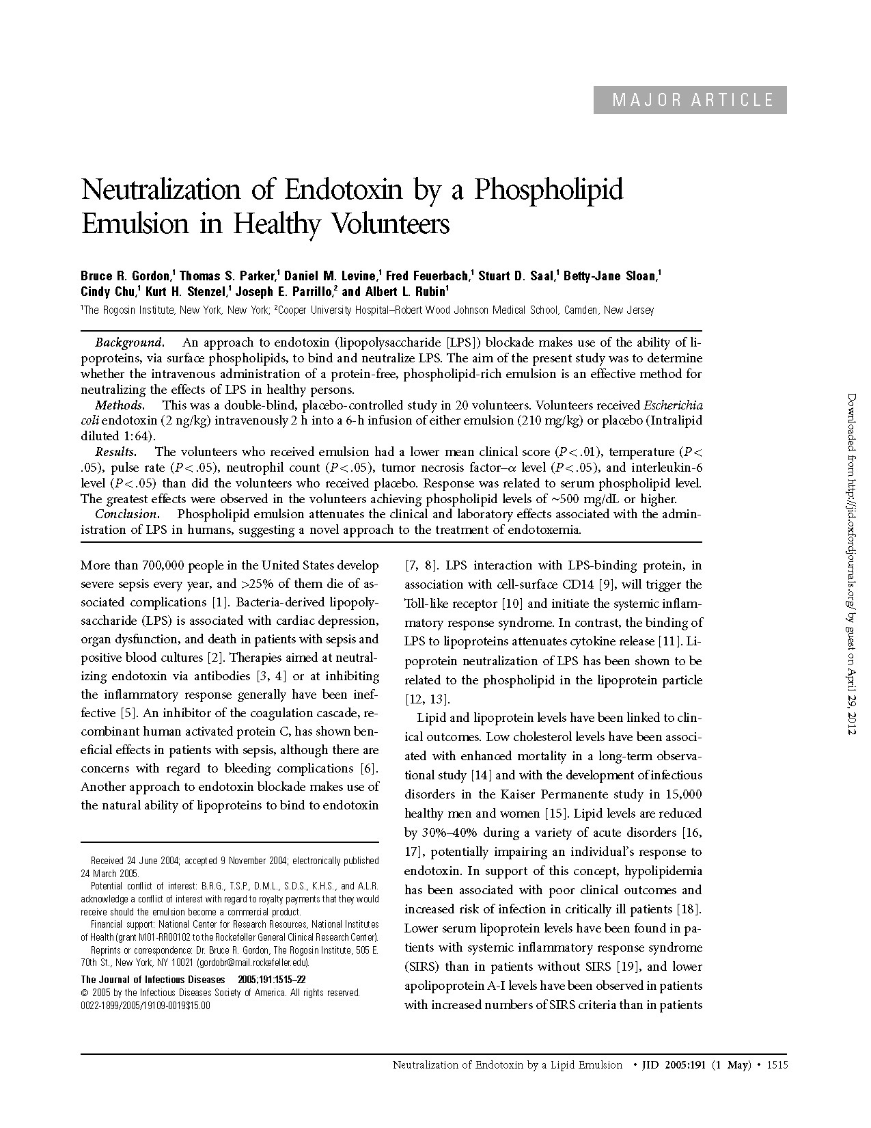
Double-blind, placebo-controlled study in 20 volunteers. Phospholipid emulsion attenuates the clinical and laboratory effects associated with the administration of Escherichia coli endotoxin in humans, suggesting a novel approach to the treatment of endotoxemia.
Bruce R. Gordon, et al. J Infect Dis 2005; 191: 1515-22
Notes:
Their concern was initially with LAST - Local Anaesthetic Systemic Toxicity
(the original lab study was on bupivacaine, a known cardiotoxin)
IV lipids have become the definitive Rx for LAST
But it became clear that they work on a very wide range of toxins

Slide 19
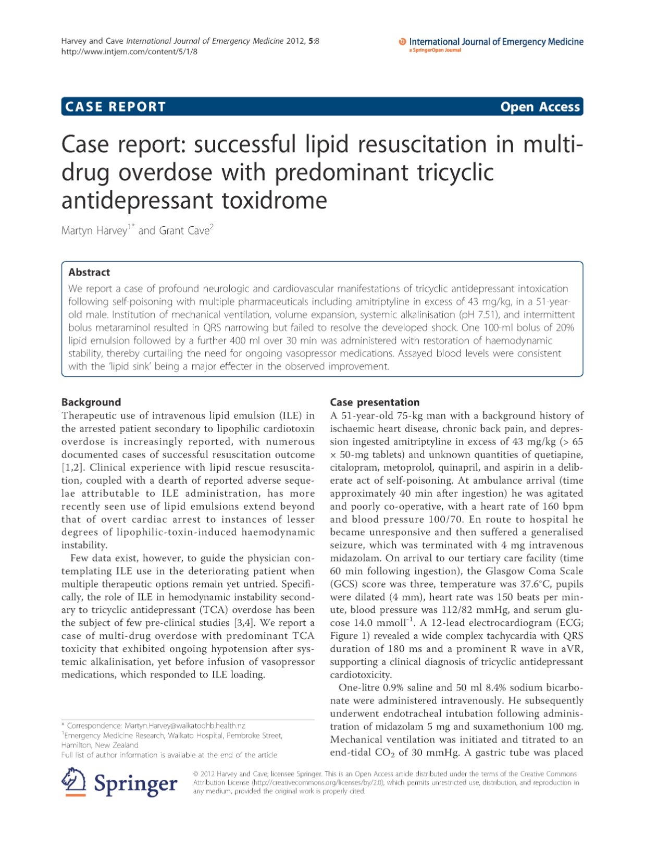
Lipid emulsion resuscitation drug overdose in a 51 yr old male with profound neurologic and cardiovascular manifestations. One 100-ml bolus of 20% Intralipid followed by 400 ml over 30 min was administered with restoration of haemodynamic stability.
Harvey M and Cave G, 2012

Slide 20
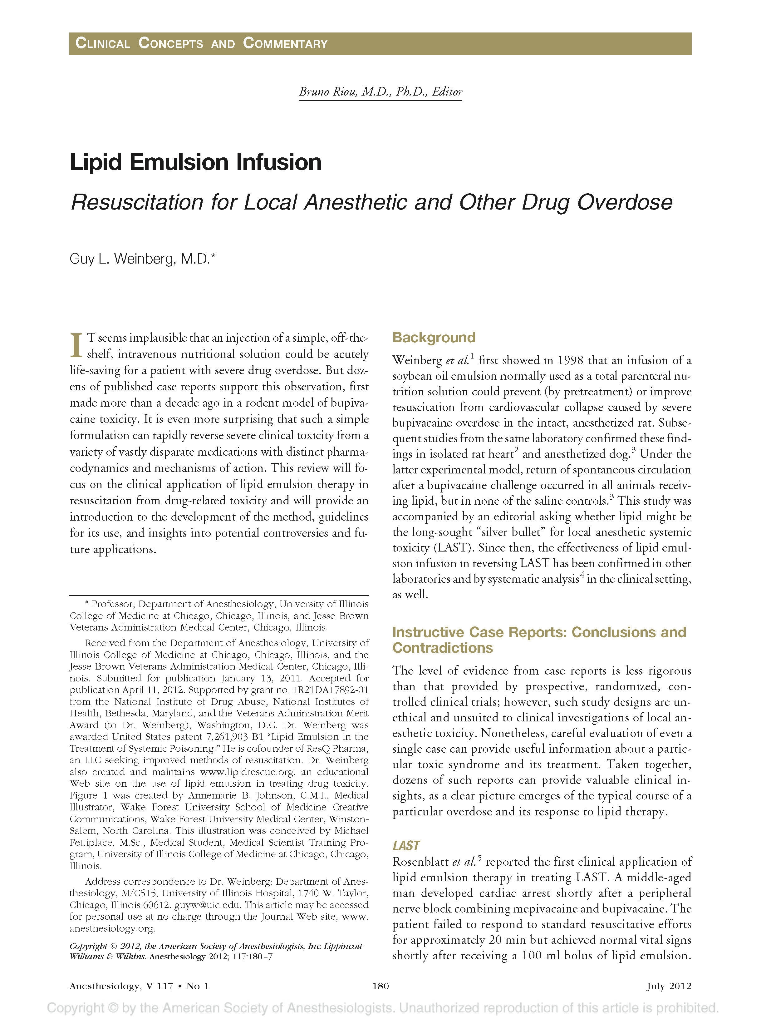
It is surprising that such a simple formulation, lipid emulsion, can rapidly reverse severe clinical toxicity from a variety of vastly diverse medications with distinct pharmacodynamics and mechanisms of action.
Weinberg GL
Anaesthesiology 2012; 117
Notes:
But phospholipid therapy is effective for a “vastly diverse” range of chemicals, and for the damage they can cause.
And most importantly it is effective in the chronic context too.

Slide 21
Mr X
M 55, seen Feb 2012
CVA Oct 2005
L hemiparesis w dysaesthesia
Transient homonymous hemianopia
Good progress in 1st 6m, but residual symptoms
Notes:
Understandably nobody sends me acute cases, but we can help even in the chronic context, such as;
This gent who has enjoyed several spirited debates with his PCT, & has given enthusiastic consent to his case, image etc being used here

Slide 22
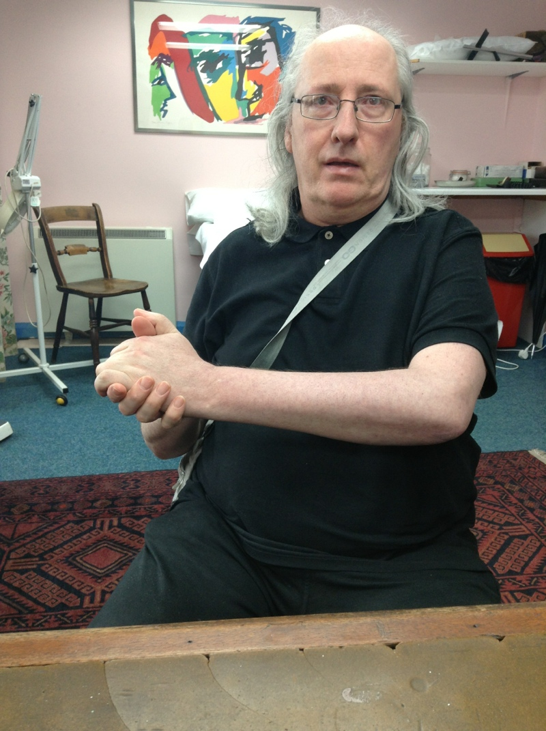
Notes:
6yrs after the event he had very little use of L arm or leg.
Despite working very hard at any physio, neurostimulation etc he could access, he still had problems

Slide 23
Residual symptoms:
fatigue
sleep disruption
pains & dysaesthesia
vision variable
diarrhoea, irregular bowels
Notes:
So we ran the usual panel of invests.
Don’t have time to go in detail into the advances in lab technology, but to summarise;
We look for toxins
And for toxic damage, predominantly to membrane lipids

Slide 24
After 3 IV Rxs:
sleep - normalised
pain & dysaesthesia - 50% better
visual clarity better, & stable
bowels normalised
fatigue ISQA
Motor function unchanged
Notes:
So we have only managed to Rx 3 IVs so far, for logistical reasons, but there have been real changes.
Reasonable to assume that dead neurones can’t be reanimated - no Lazarus effect, no Easter bunny.

Slide 25
Lipid Whiskers
Interface with Immune System
Interface with Immunity

Slide 26
The addition of a polar oxygen atom on peroxidized fatty acids reorients the FA chain, whereby it no longer remains buried within the membrane interior but rather protrudes into the aqueous compartment. The newly dead lipid chain directly lowers the performance level of the membrane which responds by swinging the obsolete chain out of the membrane exposing it to macrophages for removal.
Notes:
Oxidation straightens out the FA molecule, which then flips out of the bilayer into the extracellular

Slide 27
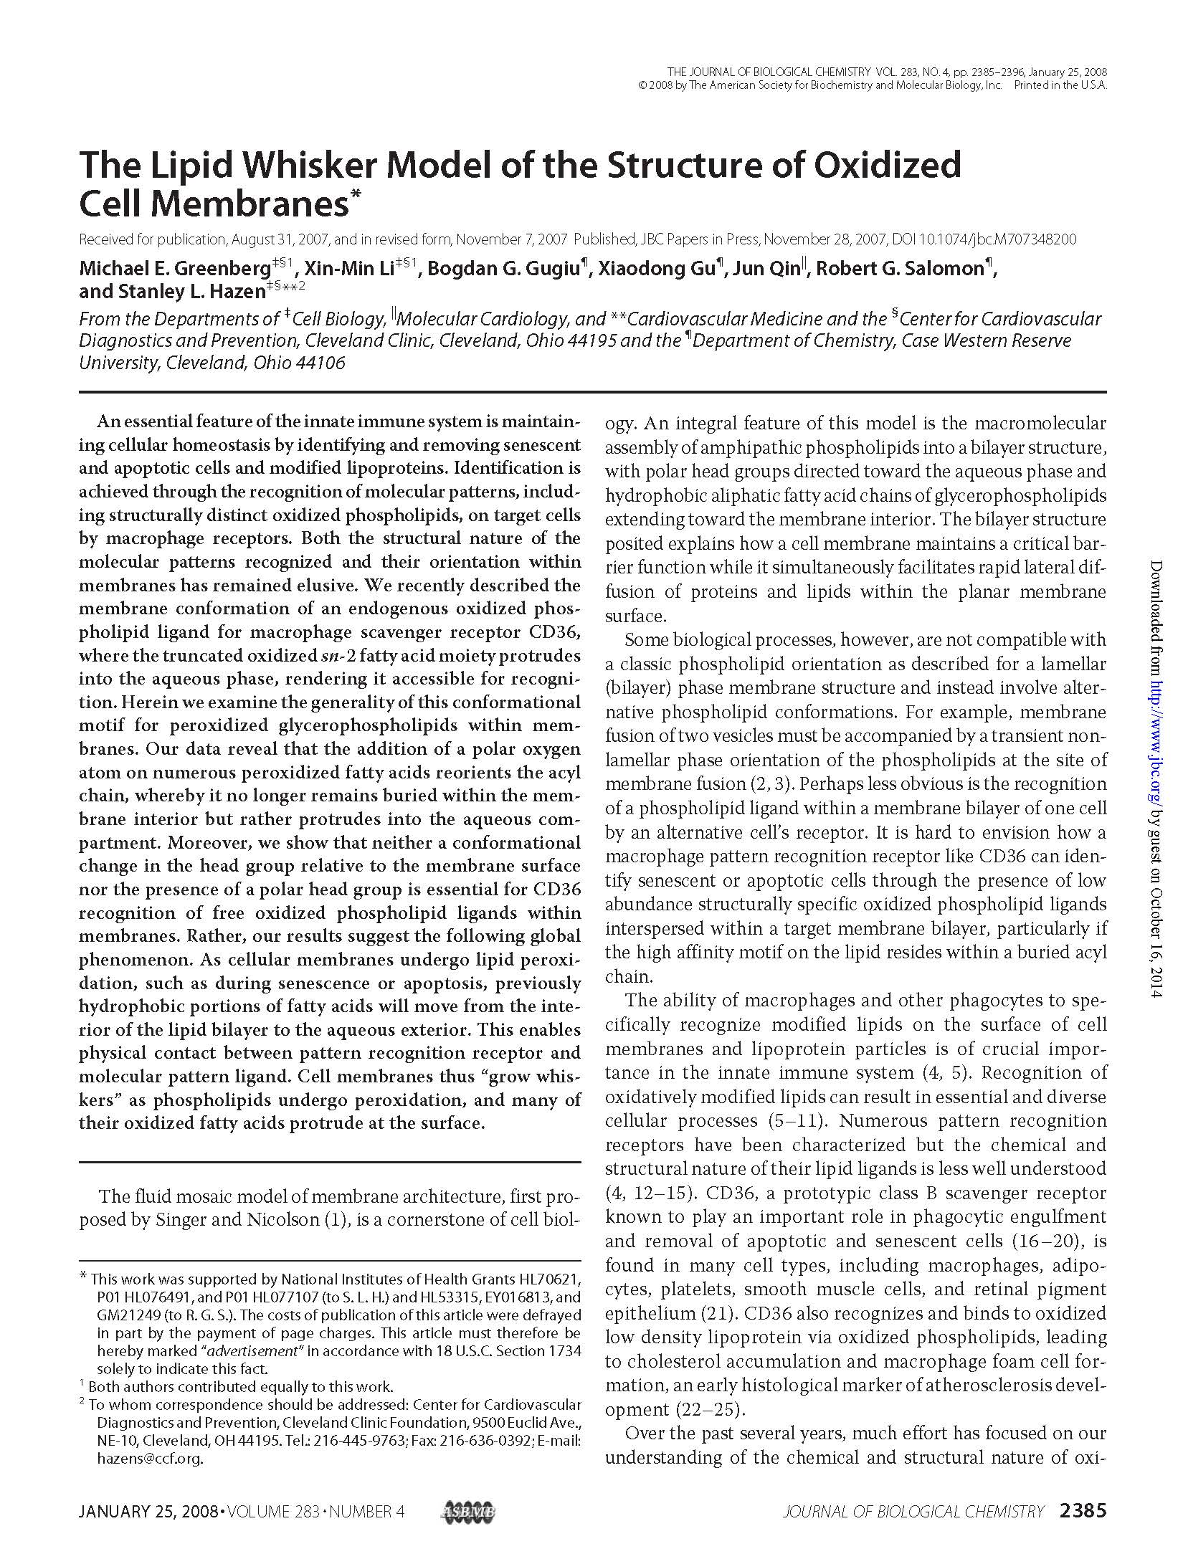
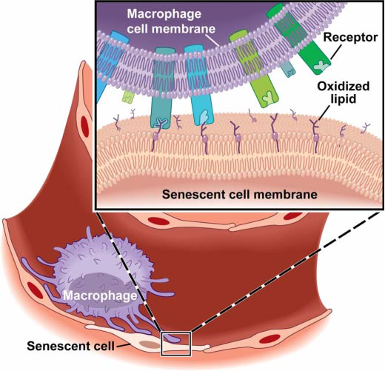
As cellular membranes undergo lipid peroxidation, such as during senescence or apoptosis, previously hydrophobic portions of fatty acids will move from the interior of the lipid bilayer to the aqueous exterior. This enables physical contact between pattern recognition receptor and molecular pattern ligand. Cell membranes thus “grow whiskers” as phospholipids undergo peroxidation, and many of their oxidized fatty acids protrude at the surface.
Greenberg ME et al, 2008

Slide 28
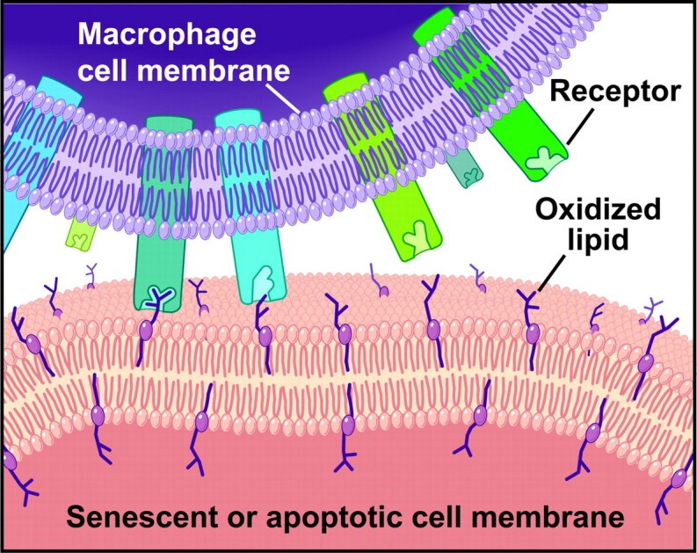
Notes:
CD36, aka Fatty Acid Translocase (FAT) identifies it and bites it off
Macrophages which clean up debris on the membrane surface eat the oxidised lipid.
This is basic housekeeping which is going on all the time

