Slide 1
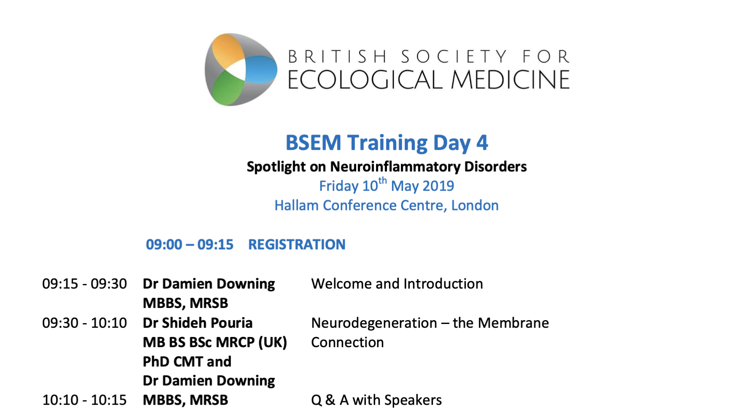

Slide 4
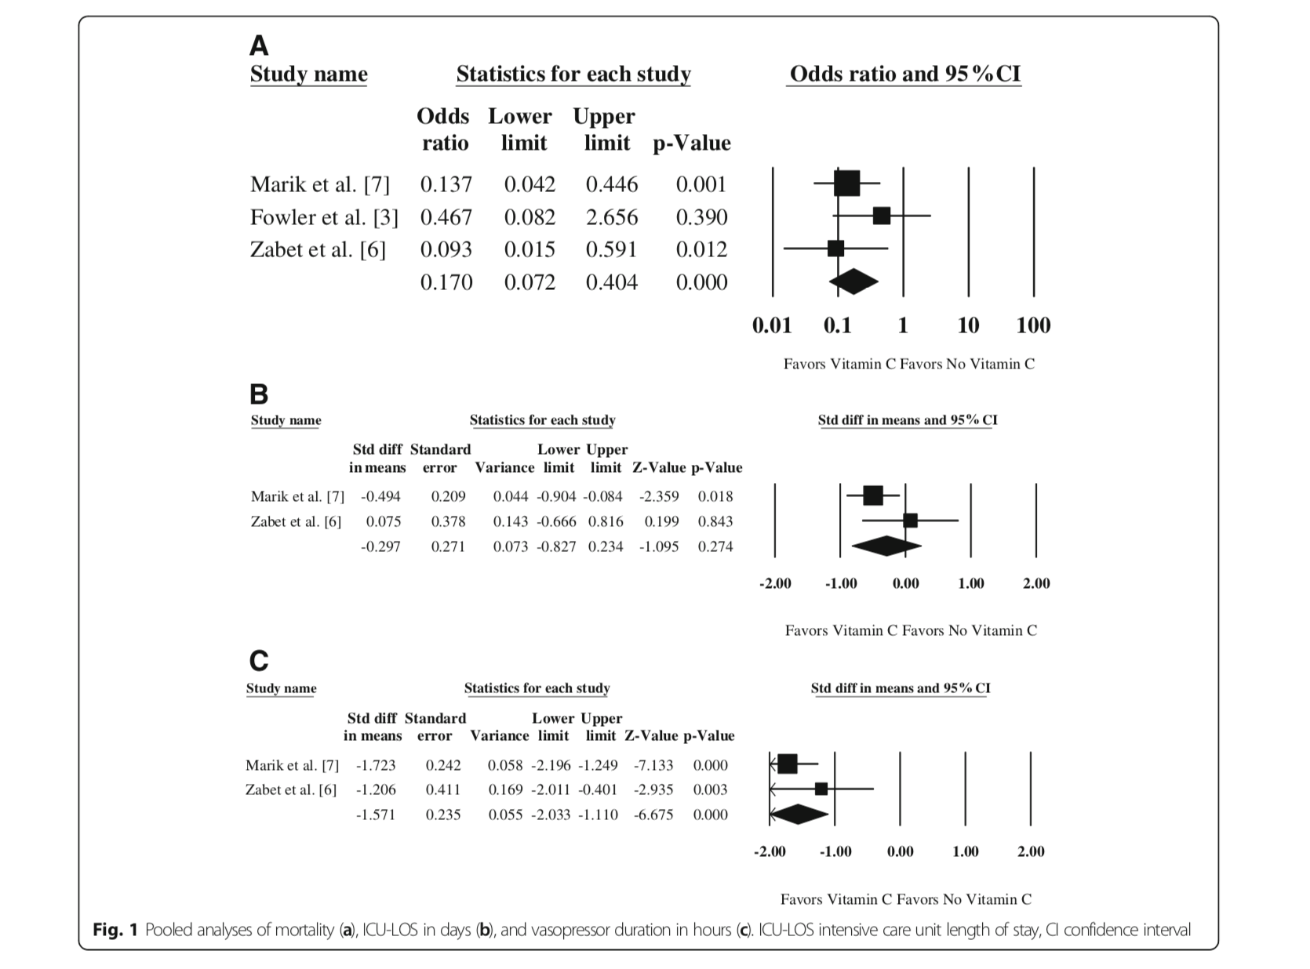

Slide 5
“On the basis of research that has already been published, it could be considered bordering on professional negligence for physicians and surgeons not to take into consideration nutritional and environmental factors (as well as genetic, lifestyle, psychological and spiritual factors), in their approach to patients.”
J Nutr Med 1990

Slide 6
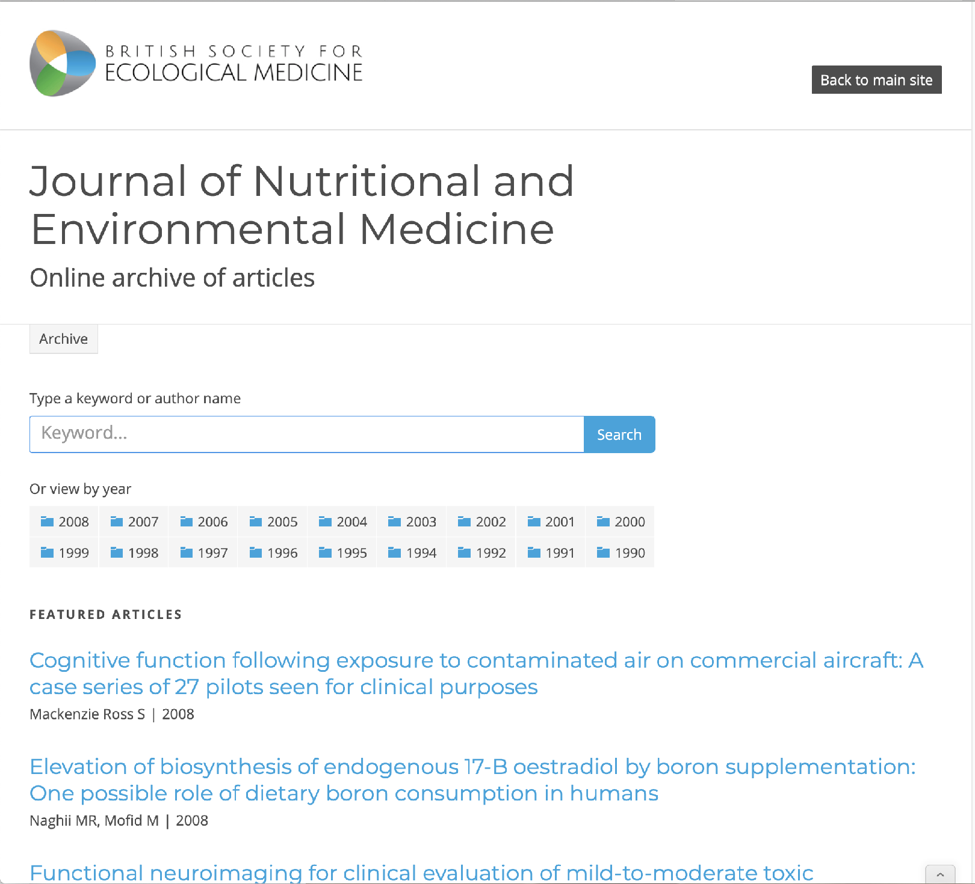

Slide 7
Essential fatty acids, immunity and viral infections. David Horrobin 1990
The pill, hormone replacement therapy, vascular and mood over-reactivity, and mineral imbalance. Ellen Grant 1998
A clinical evaluation of a wheat-free diet. Gibson SLM et al 1995
Adverse health effects of indoor molds. Curtis L et al 2004
Multiple chemical sensitivity: Recognition and management. Keith Eaton et al 2000
Gut fermentation or the “Auto-Brewery” syndrome. Hunnisett A, Howard J, Davies S 1990
Reduction of chemical sensitivity by means of heat depuration, physical therapy and nutritional supplementation in a controlled environment. William Rea et al 1996
Sulphur metabolism in autism. Rosemary Waring et al 2000
Pharmacokinetics of oral vitamin C. Steven Hickey et al 2008
The autism epidemic, vaccinations, and mercury. Bernard Rimland 2000

Slide 8
Neurodegeneration;
The Membrane Connection
Dr Shideh Pouria
Dr Damien Downing
BSEM Training
10-05-2019

Slide 9
Nutritional lipids
20% of lean body weight
for a 14 stone man = 40lbs lipids
10% deficit is not uncommon
can’t do it with pills - needs food
~ 60% of the dry weight of brain is lipid
Notes:
can’t do it with pills alone - needs food.
and the way to do that is this..

Slide 10
Membrane structure and function

Slide 12
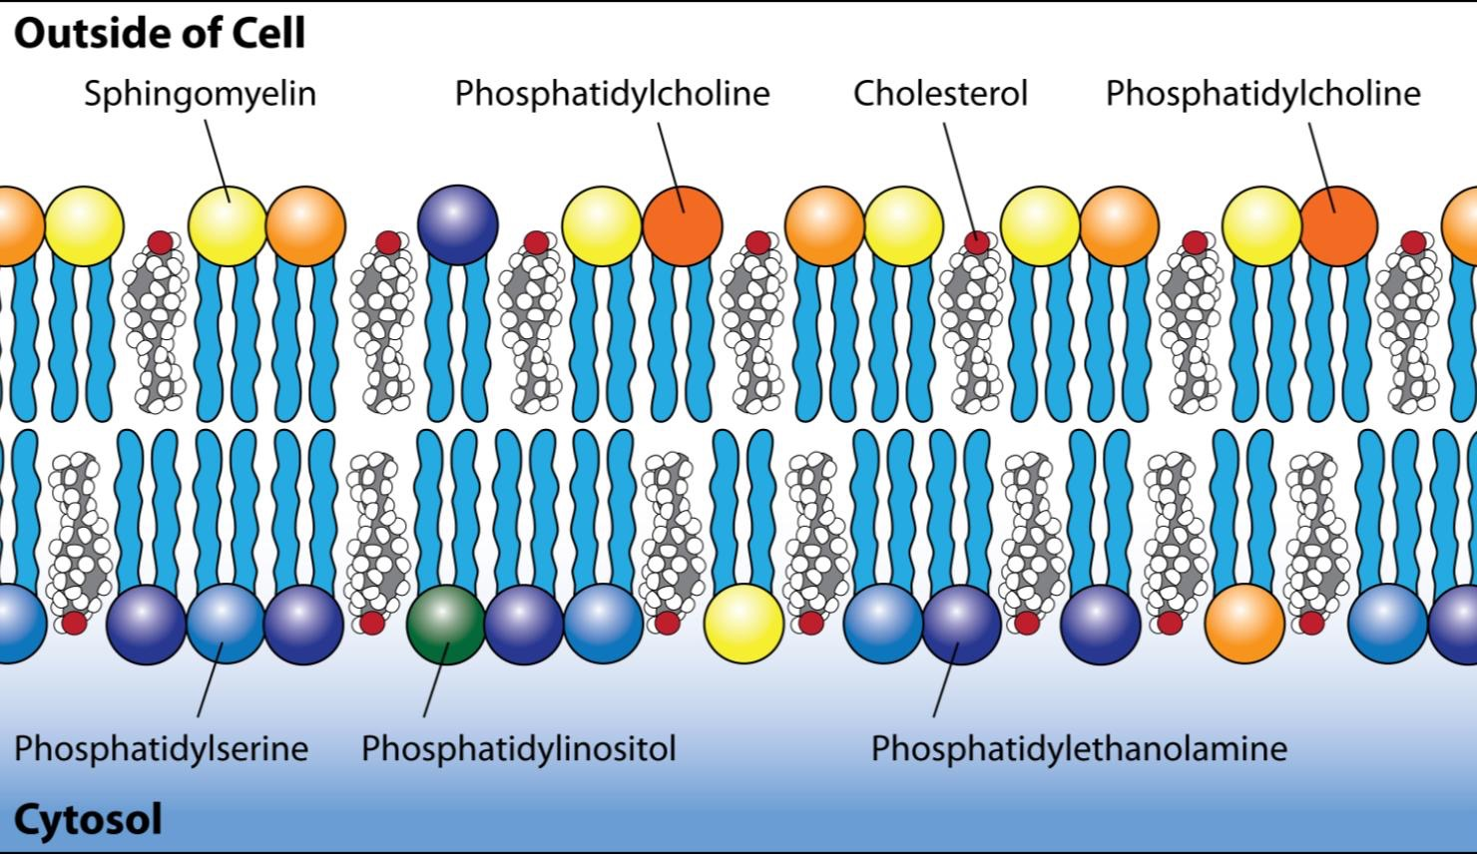
Notes:
Only works if composition is right

Slide 13
Notes:
double bond oscillates every nanosecond
= about 1 gigahertz frequency

Slide 14
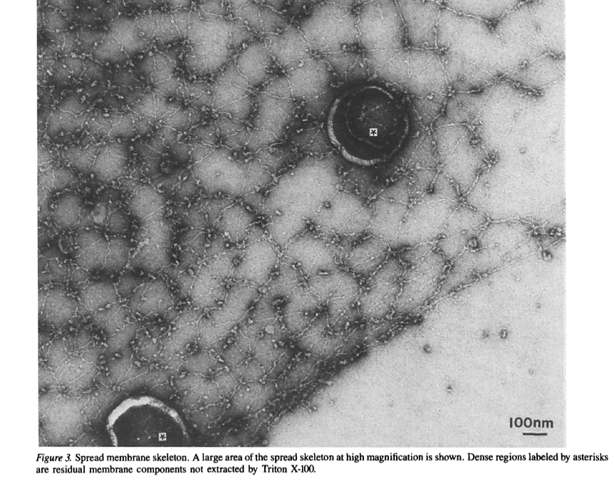
Hexagonal membrane skeleton
Notes:
I had to hunt around for this image of the scaffolding…
All they did here was literally wash the lipid off with detergent

Slide 15
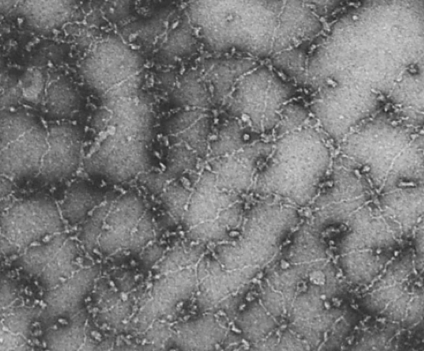
Hexagonal membrane skeleton
© The Rockefeller University Press, 0021-9525/87/03/527/10 $1.00 The Journal of Cell Biology, Volume 104, March 1987 527-536
Notes:
Note the age of this paper, but what I like most about it is the price

Slide 16
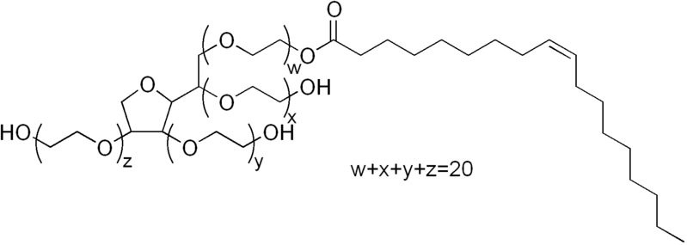
hydrophilic
lipophilic
Polysorb 80

Slide 19
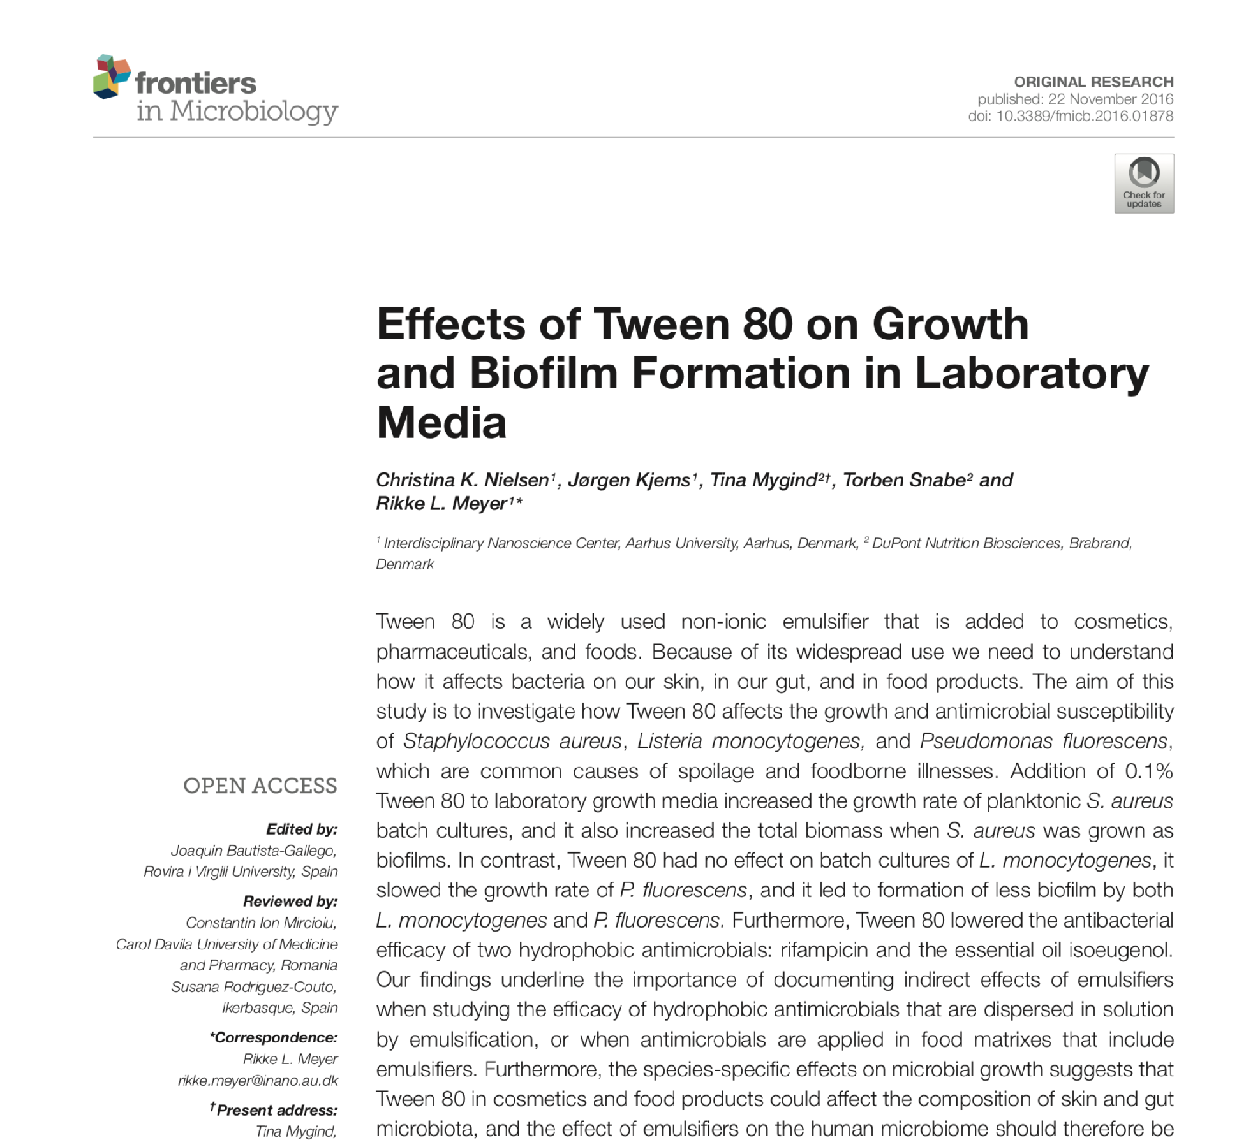
Effects of Tween 80 on Growth and Biofilm Formation in Laboratory Media
Addition of 0.1% Tween 80 to laboratory growth media increased the growth rate of planktonic S. aureus batch cultures, and it also increased the total biomass when S. aureus was grown as biofilms…
Tween 80 lowered the antibacterial efficacy of two hydrophobic antimicrobials: rifampicin and the essential oil isoeugenol.
Puri B.K. Prostaglandins, Leukotrienes & Essential Fatty Acids, 2007; 77: 101-103

Slide 20
Membrane composition
Unsaturated 1/3
Saturated 1/3
Cholesterol 1/3

Slide 21
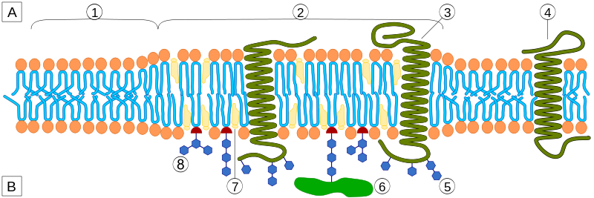
Lipid rafts

Slide 22
Saturated fatty acids
Less fluid
More stable
Form rafts around proteins

Slide 23
Unsaturated fatty acids
Lower melting point
Greater fluidity
18:0w 70 C
18:1w9 13 C
18:1w3 -5 C
Notes:
fx of double bond on melting pt

Slide 24
Membrane fluidity
Phospholipid methylation enhances membrane fluidity
Activates some receptors
Inhibits others

Slide 25
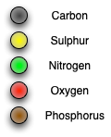
Notes:
angular movement of db widens the gap between phospholipid molecules
increases fluidity
so does methylation of the head

Slide 26
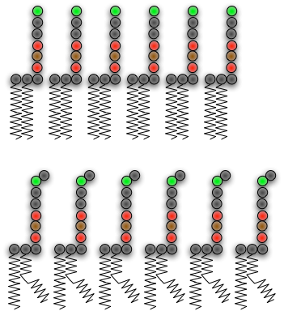
Notes:
DBs increase spacing, reduce density
increase fluidity

Slide 27
Heavy metals
Block methionine synthase activity
Probably by inactivating methylcobalamin
Blocks methylation cycle
Increases homocysteine

Slide 28
ASD
85% of mothers of ASD children have hypersensitivity to nickel
ASD children post-MMR show Stimulation Indices;
myelin basic protein 5
Hg 10
MBP+Hg 100
Notes:
But while we’re on the subject..

