Slide 2
The Quality Improvement Journey

Slide 4
Define the Problem

Slide 5
Process Mapping

Slide 6
Process Mapping

Slide 7
Steps of Process Mapping

Slide 8
Process Mapping What Does it Look Like?

Slide 9
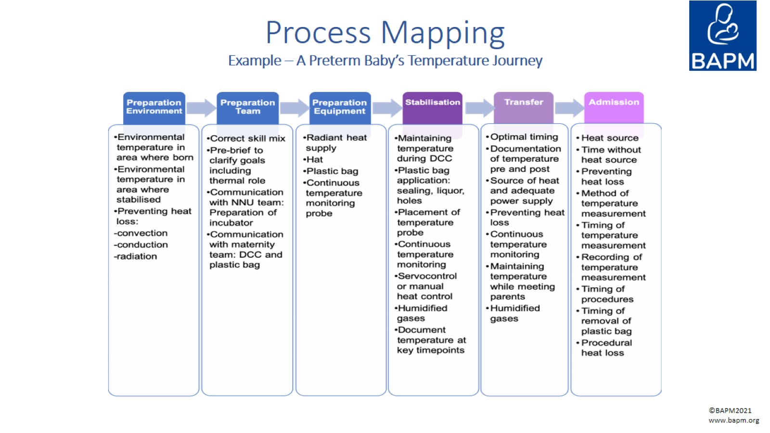
Process Mapping Example – A Preterm Baby’s Temperature Journey

Slide 10
Process Mapping Tips

Slide 11
Process Mapping Tips

Slide 12
Further Reading

