Slide 1
What it takes to become the MRS Research Live Clientside Insight Team of the Year
Andrew Viggars
Corporate Affairs Insight Manager

Slide 2
A bit about BT
The UK’s largest provider of mobile and fixed communications solutions, with over 14 million households trusting us with their network needs
We have four customer-facing lines of business:
Consumer
Enterprise
Global
Openreach
They are supported by our internal service units:
Digital
Networks
Along with other key stakeholder groups like Group Brand & Marketing and Corporate Affairs
Over 1.2 million UK and Republic of Ireland businesses connected, including the public sector and critical national infrastructure organisations
We don’t just serve British businesses. Our network spans 180 countries
We have 99,700 full-time equivalent colleagues globally,
80,400 of whom are in the UK

Slide 3
We’ll get a picture of the whole team, one day…

Slide 4
A word from our sponsors…
Our Group Insight team is helping BT become more customer and externally focused than ever. We have insight shared with the Executive Committee and indeed the plc Board on a regular basis helping ensure that we are being customer-led right at the top of the business and acting on the insight in a timely fashion. I see the Insight team continuously championing to improve their capability and impact the decision making across BT, and know they’ll continue to build on many of the great initiatives such as the recent large scale customer closeness programme and new marketing effectiveness capability.
Simon Lowth, BT Group CFO
The BT Group insight team plays a vital role in championing the customer across the business. They have built fantastic relationships with me and my team, delivering insights to enable the right decisions for the business. This has enabled us to put the customer at the heart of our strategy, to create stand out customer experiences, seeing great improvement in NPS across our brands, and the launch of market leading, customer focused propositions, and improvements to our marketing effectiveness. I know they will continue to push themselves to continuously improve and be brilliant partners
Marc Allera, BT Consumer CEO
What I love about our excellent insight team is their passion and drive to continuously improve - both themselves and the business performance. They ensure that we really understand customers' needs across the marketing life cycle and deliver robust insights with clear recommendations in a timely fashion that drive up business performance and helps achieve our BT wide purpose of 'connect for good' . They're able to do this as they really are strong business partners to me and my team
Pete Jeavons, Marketing Communications Director (BT Consumer) & Brand Director (BT Group)

Slide 5
The BT Group Insight team

Slide 6
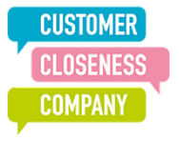
An insight centre of excellence, supporting the whole business, and working closely with our agency partners, who are extensions of the team
Market Intelligence
CX Insight
CX Performance
Brand, Strategy & Consumer Commercial Insight
Enterprise Commercial Insight
Global Commercial Insight
Strategic competitor & market insight Market performance Market sizing & forecasts Foresight & trends
Brand/ Relationship NPS Ad hoc CX Insight
Measurement
Governance
Scorecard
Brand Strategy
Brand & Reputation Insight Marketing Effectiveness
Proposition insight Go to Market
Needs
Segmentation
Proposition insight Go to Market
Needs
Segmentation
Bid & Tenders
Proposition insight Go to Market
Needs
Segmentation
Bid & Tenders

Slide 7
With clear a vision and set of priorities
People
We will continue to invest in our centre of excellence to be best in class
We connect you
to customers
to inspire change
We empower everyone by bringing them closer to the customer
We inspire change… for good, for customers, for success
Culture of customer curiosity
We will create a culture of customer curiosity through democratisation of insight
Insight to action
We will drive empathy for customers and strategic insight application

Slide 8
Focus on people

Slide 9
Focus on the team has increased since Covid-19
97%
Wellbeing has become more important.
We’ve actively promoted a more honest and open culture.
We’re bringing our true selves to work, focused on allyship, reverse mentoring, lived experiences to learn and improve diversity and inclusivity.
And we’re always looking to improve.
of our team feel that their manager cares about them
84%
of our team agree that they work in an environment where everyone is included, respected, and valued (up 23pp)

Slide 10
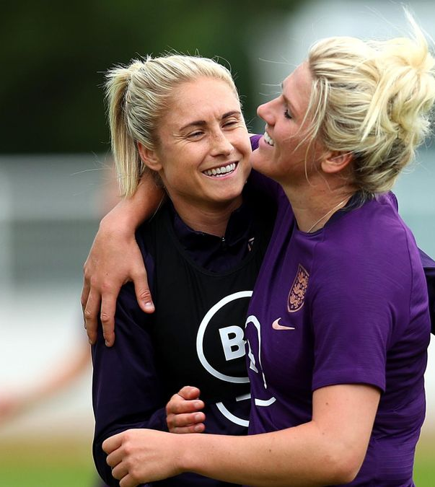
Focus on partnership

Slide 12
Focus on partnership

Slide 13
Impact across the business
Integration of insight into corporate and business strategy, marketing and customer experience
Monthly Executive reviews, ensuring C-Suite are clear on drivers and actions needed
Best-ever NPS across BT
Creating from scratch and embedding Marketing Effectiveness insights, transforming performance
Insight informing the restructure of our UK B2B division aligned to needs-based segmentation
A new customer immersion programme, with 80% of the 900 senior leaders across BT attending

Slide 14
“Whilst not all members of my wider team could attend the customer immersion session, they all benefitted from the highlights that we recorded and circulated afterwards. This led to a common way of thinking about the customer and reframed the way we consider the customer in our work. It’s heart-warming to hear the voice of the customer coming through as we discuss our strategies, due in part to the excellent insights being gathered”
Rob Shuter, CEO, BT Enterprise

Slide 15
Questions? Contact: andrew.viggars@bt.com

