Slide 1
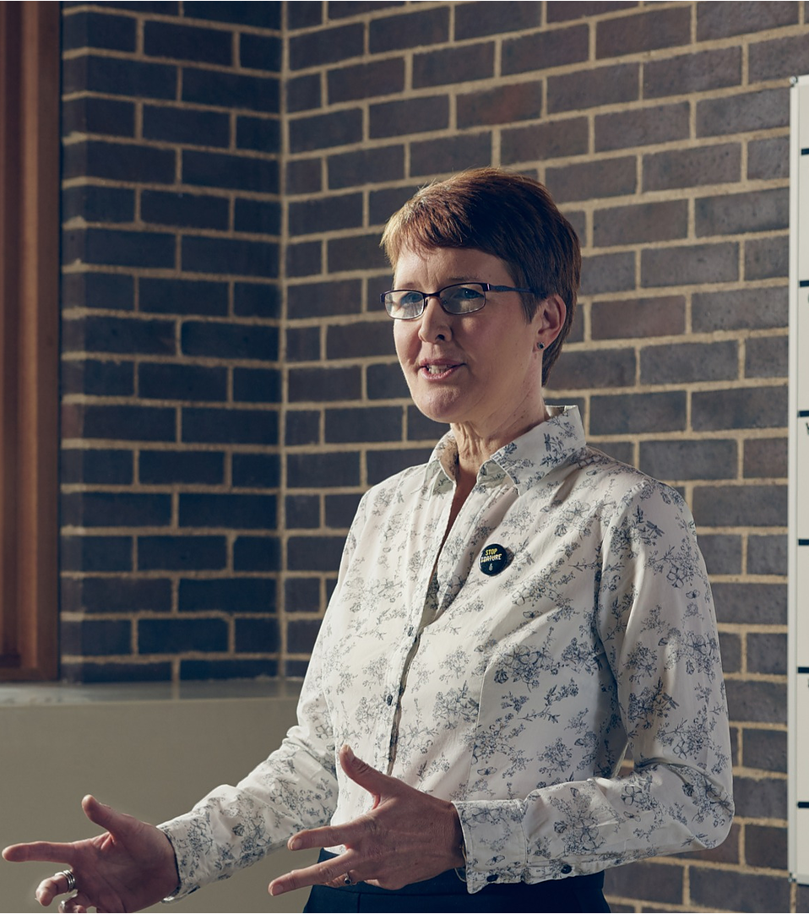
Five insider tips to transform your leadership in a COVID19 world
Nicki Deeson

Slide 2
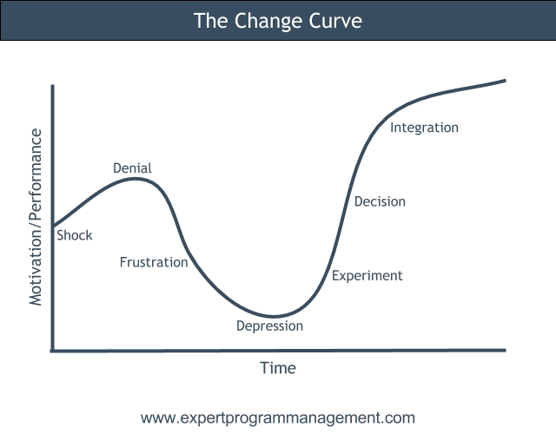
Work out where your head is at
1
You will go through following stages to process and accept impact of COVID19
Be honest – what stage are you?

Slide 3
Definitions
1
Shock & Denial:
I tell myself “I’m fine, I have accepted the virus”, but underneath I am hoping impacts won’t happen, virus will be over soon and we can go back to how things were before
Frustration:
I feel cross with myself. Why can’t I adapt? Other people are thriving in new world, while I feel stupid and ineffective
Depression:
I am starting to face up to fact that things are not going to be same as before. I feel doubtful, confused and uncertain
Experiment:
I am starting to accept change. I focus less on what has been lost; feel keen to try out different tactics in new world, create and test approaches, find out what works and doesn’t work
Decision & Integration:
I am starting to feel I’m getting hang of working in new ways. These new ways are starting to feel normal, routine, ‘the status quo’

Slide 4
Identify what you need
2
Your stage defines what you need right now:
Denial or Frustration: Someone to listen and empathise, someone you can let off steam to, who will not advise you or try to fix things
Depression:
Someone to help you define priorities, tasks and direction
Experiment:
Someone to encourage you to experiment, help work out what to trial. To keep you focused on positives and stop you slipping back into depression phase
Decision:
This is a good place! Support is essential to help you evaluate progress, reflect on what you have learnt, keep developing yourself and continuously improving your ways of working

Slide 5
Get what you need
3
Your manager isn’t psychic – ask for what you need
Recognise they are also on ‘change curve’
If they can’t / won’t give what you need, who else can help you?
Mentor, peer, trusted friend, coach?

Slide 6
As manager, create psychological safety
4
Each team member
is at different place on ‘change curve’
has different personality type
is negotiating different challenges at home
Assign time to listen to each of your staff every day. Ask:
How are things at home?
What are biggest worries, anxieties, uncertainties?
What do you need from me, to perform at your best?
If they say they are fine, ask again
Clarify how flexible you can be about their work hours
Be visible and available

Slide 7
Maintain work life balance
5
Lead by example – COVID19 is a marathon not a sprint
Prioritise activities
Delay or mothball projects
Reduce planning frequency
Delegate tasks. Encourage team to coach each other
IT helps
Use MS Teams or Slack channels to collect updates, socialise
Shorten meetings by focusing on key objective
Schedule mini-breaks and commit to your day’s start / stop times

Slide 8
Be the best manager you can possibly be – in a COVID and post-COVID world!
Read my full article at https://nickideeson.wixsite.com/website/post/the-5-insider-tips-to-transform-your-leadership-in-a-covid-and-post-covid-world
Contact me to find out more:
Nicki Deeson
Leadership Coach & Business Mentor
M: +44 (0)7526 538 993
https://nickideeson.wixsite.com/website
www.linkedin.com/in/nicki-deeson
@nicki_deeson
@nicki.deeson

