Slide 1



‘Owning our spaces’
Students as partners in developing learning spaces
Alex Louch, VP Academic Affairs
University of Exeter Students’ Guild
@ExeterAcademic
#schoms14

Slide 2
Introduction
How is best to engage students for stakeholder work?
Why is it important to involve students?
What actually is important to students?
How do students view the future of technologies?
#schoms14

Slide 3
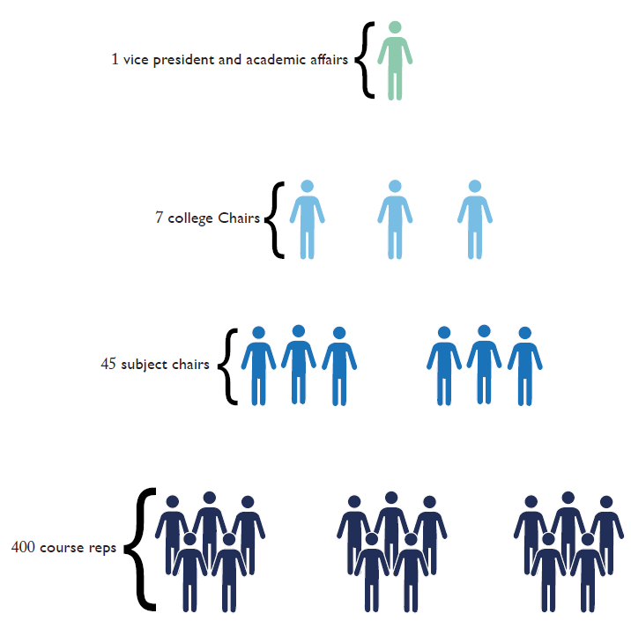
How is best to engage students for stakeholder work?
The Student Union:
Partnership
#schoms14

Slide 4

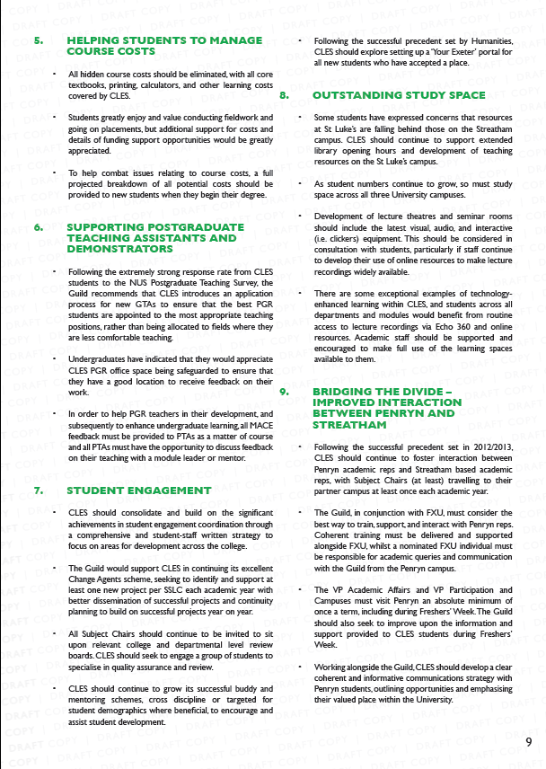
#schoms14

Slide 5
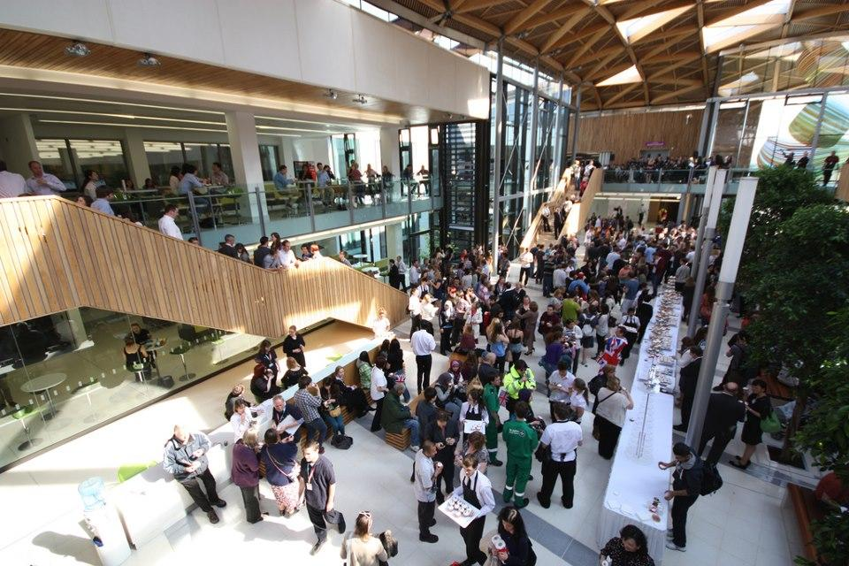

Formal and informal data
#schoms14

Slide 6
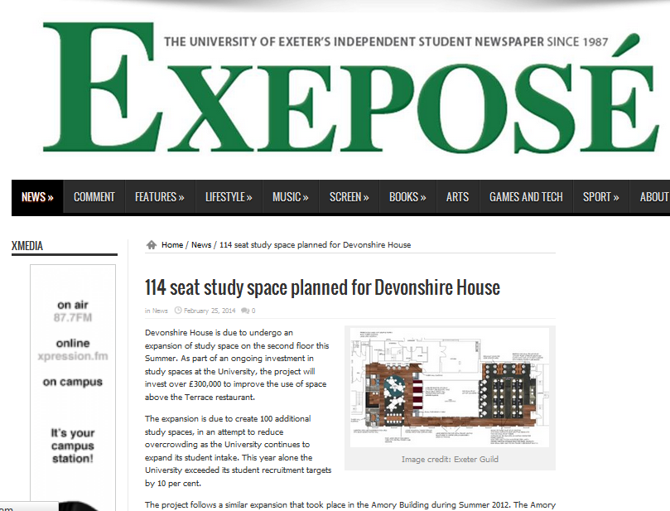
Why?
Students own their own workspaces
Consumers?
#schoms14

Slide 7

Co Creation?
Guild example
#schoms14

Slide 8
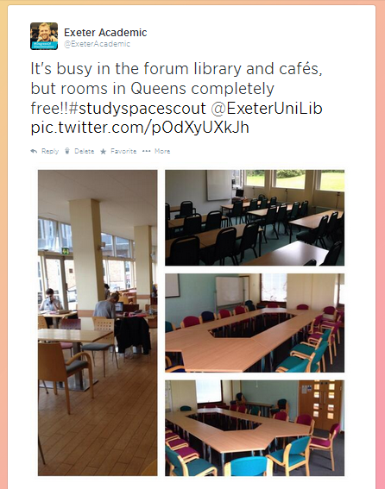
What is important to our students?
PGRs
Often it’s the small things
#schoms14

Slide 9
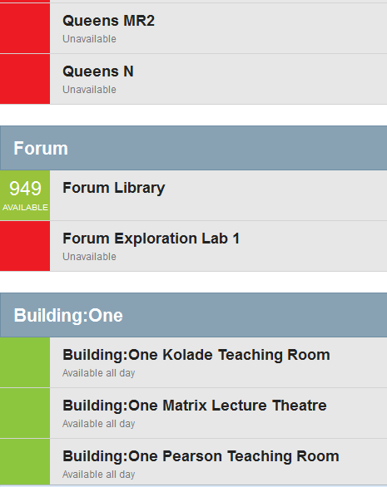
The Results
2 new study spaces
A new app which shows room availability across campuses
Mobile Print for 2015
A long lasting partnership ethos
#schoms14

Slide 10
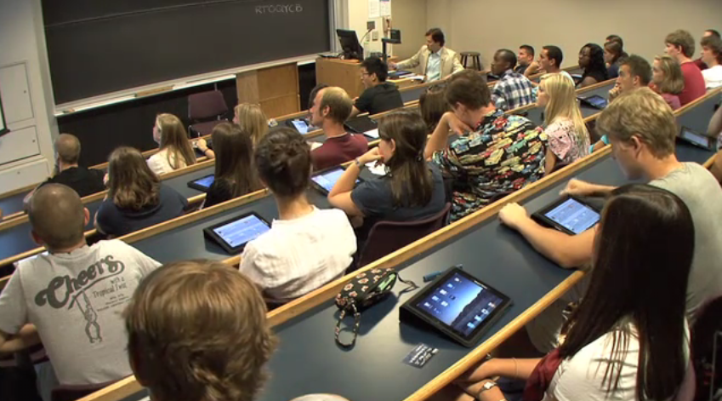
The Future
Students are increasingly intolerant and impatient
Customers?
Procrastination
Give them the opportunities to develop ‘their’ spaces
#schoms14

Slide 11
Any Questions?
Potential discussion:
What are the barriers and opportunities to engaging students in Learning Spaces management?
#schoms14

