Slide 1

“Stakeholder engagement in learning spaces projects …Who, how, why!”
Elaine Cordy, Head of Learning Spaces

Slide 2

Agenda
The presentation today will consider the following:
• Introduction to Learning Spaces
• Who, what, why and how at Exeter
• The challenges
• The improvements brought by this customer focused perspective
• Time for questions/shared perspectives

Slide 3
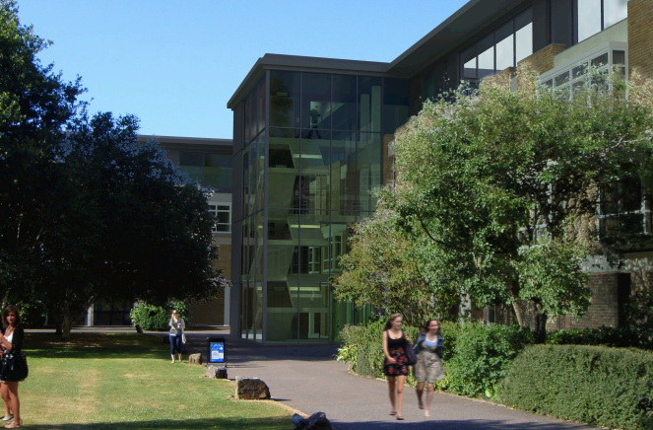





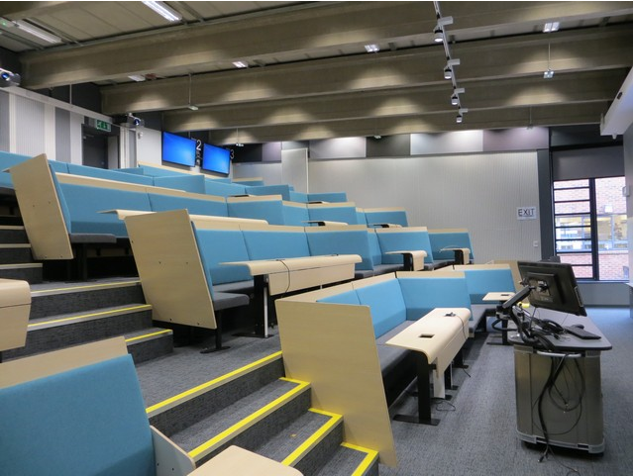
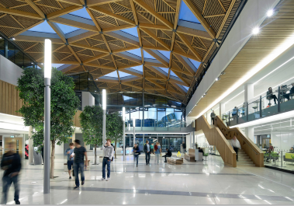
Learning Spaces

Slide 4

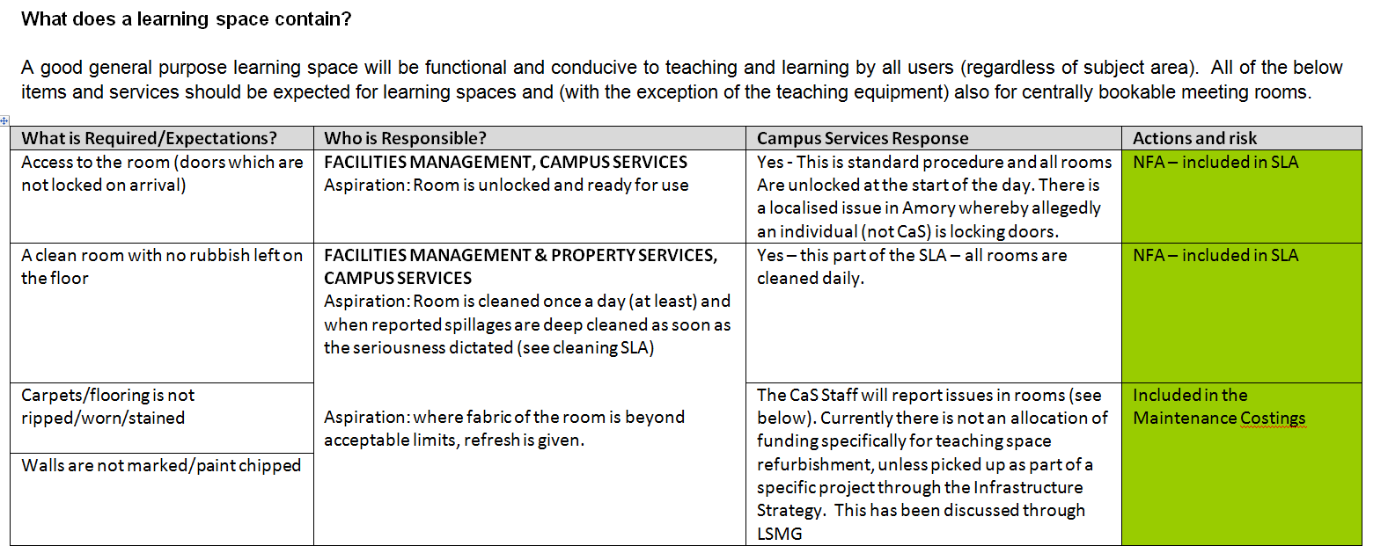
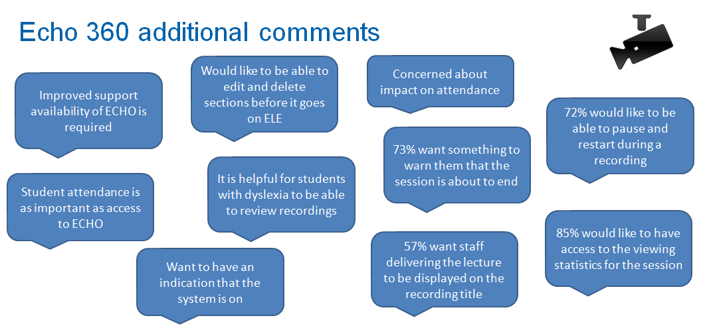
What – Annual Surveys

Slide 5

What – per project
Colours
Interior Design
Pedagogy
Furniture - comfort
IT Systems
Access
AV equipment standards
Ventilation/ heating
Fixtures and Fittings
Lighting

Slide 6

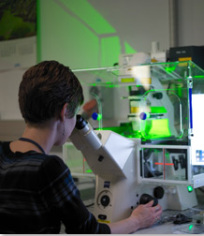


Who?
At Exeter we see our main stakeholders as:
• Students
• Academic/teaching staff –from each College/Discipline
• Professional Services staff – AV Support team, ExeterIT, Estate Development (including project manager and Space management), Education Enhancement, Cleaning and Portering, Library)
• Other Users of the spaces – through our Events Team

Slide 7
Why?
Capturing expectations now which can be reviewed following delivery, the user requirements need to be investigated:
• The main deliverables: must haves
• Innovation: which changes can improve user experiences?
• Empowering stakeholders: their views count

Slide 8

Stages of Project Consultation
Sept – Dec
Approval via Learning Spaces Committees
Jan – March
Stakeholder engagement (meetings, VOTC, data gathering)
March – April
Communication of final plans & sense check
June – Sept
Project Planning – communication of progress
Sept
Orientation events
Oct- Nov
Post occupancy review
Annual Surveys

Slide 9

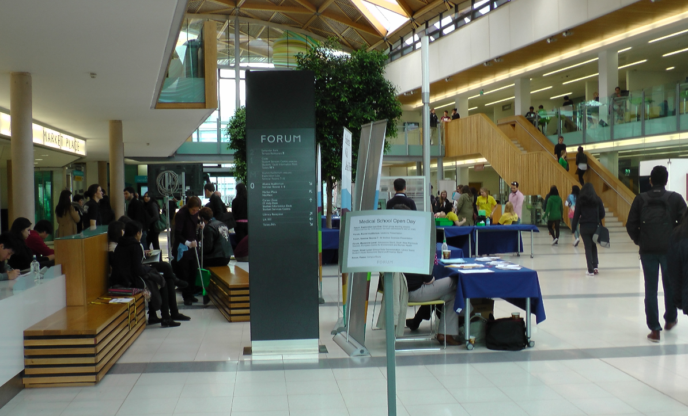
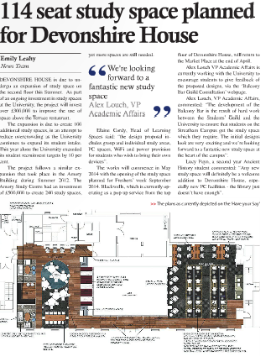
How: Student Engagement
Close links with our Guild Sabb Officer for Education
Direct Approach:
Attendance at SSLCs
Stall in the street
NIB
Stakeholder
Group
Other Research:
Student complaints
NSS/PTES Comments
Usage stats (PCs etc)
Observation
Student Led Comms:
Expose articles
Twitter Feeds
Guild Run surveys
Facebook launches

Slide 10

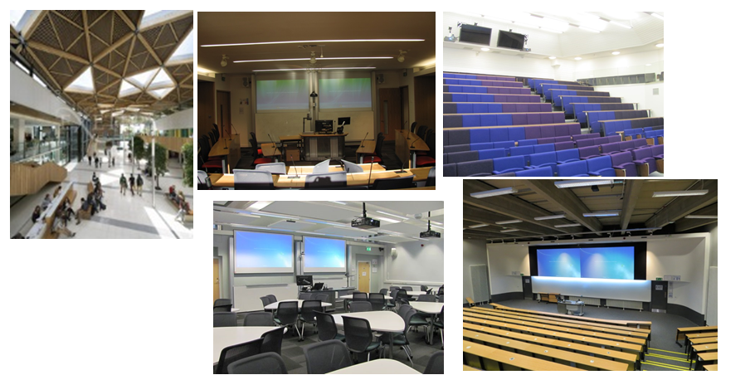
How: Staff
Committee:
Learning Spaces Management Group (& LSOG)
Decision making bodies (up to Council)
College Infrastructure meetings
Attendance of reps on stakeholder group
College Education Strategy Meetings
Other Research:
Staff Complaints
Timetabling change requests
Timetable room demand (utilisation)
Education Strategy
Usage stats
Room condition audit
Porters/cleaners reports
Survey:
Annual Learning Spaces Survey
Annual AV review feedback
Direct Comms:
NIB
Phone calls/emails
Interviews

Slide 11

Some of the main Challenges
Innovative technology
Some staff unwilling/unable to change
Balancing needs
Particularly strong voices can dominate
Budget estimate only
VE required following stakeholder stage completed
Student population turnover
Those included may not be able to justify decisions when gone!

Slide 12
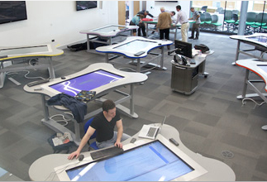
Where are we now: To recap
Since the learning spaces refurbishment project began in 2009 we have seen the following discernable differences following changes to how we consult with users:
• NSS improvement on learning resources from 60th to 18th (5th in our comparator group)
• Innovation in teaching rooms
• Improved acceptance into service and handover
• Fewer staff complaints and improved attendance at orientation events
• Improved utilisation of spaces

Slide 13
We did – they said:
Praise from the Guild regarding the recent Devonshire House project:
“Elaine has kept the Guild and the student body in touch throughout the project and fought for what students want”
Praise from staff:
“Despite frequent trips to other Universities, I feel that the provision at Exeter is excellent in comparison with our competitors”

Slide 14
Any questions?
Thank you for your time!
Contact us: Elaine Cordy
e.y.cordy@exeter.ac.uk
Learning Spaces web address http://as.exeter.ac.uk/learningspaces/

