Slide 1

Mark McCallister
Associate Director, UFIT Office of Academic Technology
University of Florida
Notes:
Thanks!

Slide 2
Agenda
Context
FLEXSpace
Learning Space Rating System

Slide 3

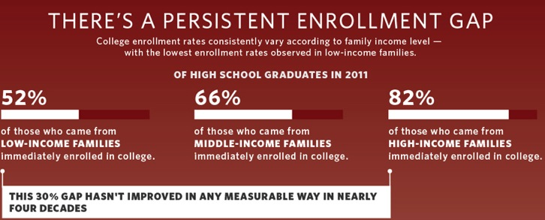
Higher Education in the U.S.
 | Public | Private Not For Profit | Private For Profit | All Institutions
Number of Institutions | 1704 | 1714 | 1216 | 4634
Avg. Enrolment | 8749 | 2290 | 1557
SOURCE: 2010 Carnegie Classification; National Center for Educations Statistics,
IPEDS Institutional Characteristics and Fall Enrollment (2009), College Board, Census Data, Whitehouse.gov

Slide 4
Higher Education in the U.S.
Top 10 U.S. Institutions
1 | Princeton
2 | Harvard
3 | Yale
4 | Columbia
5 | Stanford
6 | Chicago
7 | Duke
8 | M.I.T.
9 | U. of Pennsylvania
10 | Cal. Tech/Dartmouth
Top 10 U.S. Public Research
1 | U. California - Berkeley
2 | U. California – Los Angeles
2 | U. of Virginia
4 | U. of Michigan – Ann Arbor
5 | U. of North Carolina – C.H.
6 | College of William & Mary
7 | Georgia Institute of Technology
8 | Penn State
9 | U. of California - Davis
10 | U. of California – San Diego

Slide 5

Higher Education in Florida
12 Public Universities | 337,000 students
28 Community and State Colleges | 875,000 students

Slide 6
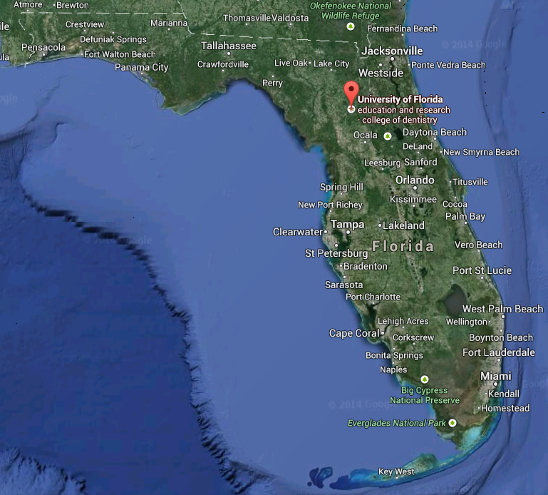

State public research university
50,000 students
34,000 faculty + staff
Notes:
My institution – currently 14th on the public list – Want to be top 10

Slide 7
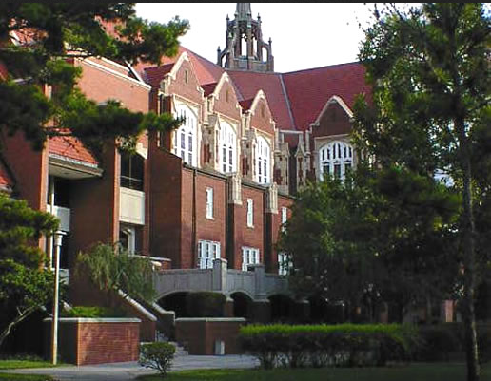
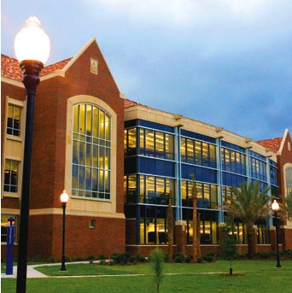
About the University of Florida
16 colleges, 100 undergraduate and 200 graduate degree programs
Tuition: $6300/yr in-state, $28,000 out-of-state

Slide 8

Information Technology at UF
50/50 split between central and distributed
UFIT Units:
  Academic Technology, Datacenter, Network,
  Admin Applications, Research Computing, Security
Selected Academic Technology Subunits:
  Classroom Support, A/V Installations, Video Services

Slide 9
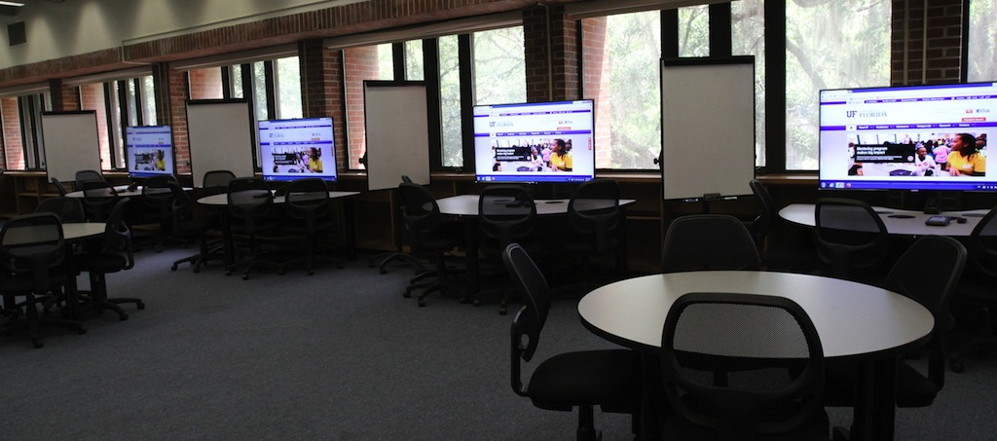
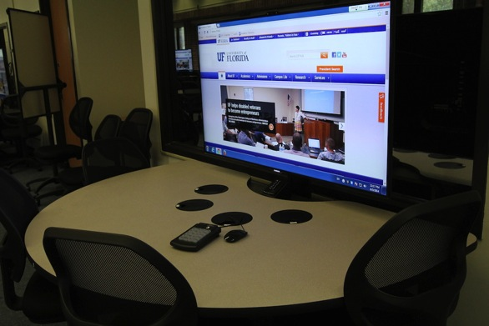
Recent learning space projects

Slide 10
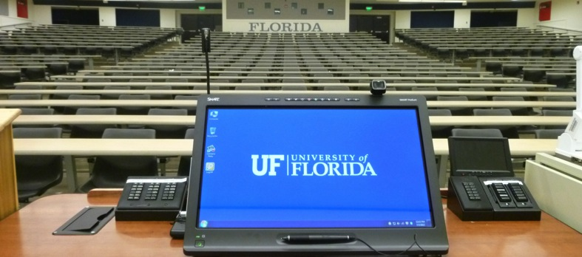
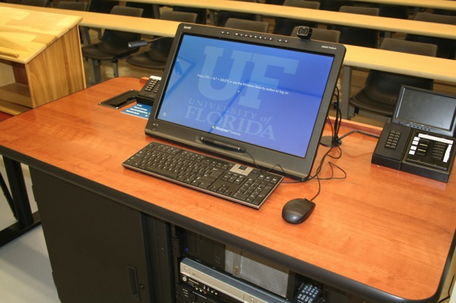
Recent learning space projects

Slide 11
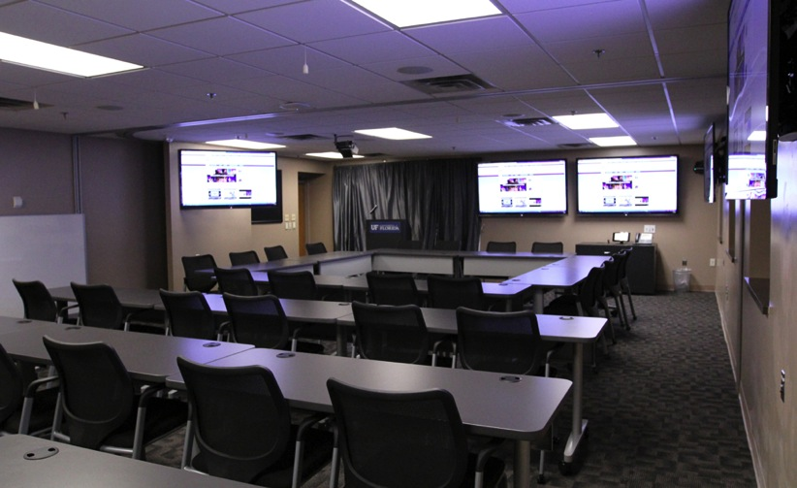
A/V Installations at UF
An auxiliary “business”
$1.7M revenue, supports 4 FTE
Boxes and labor hired outside

Slide 13

Vision
A free service..
open access..
searchable..
peer-reviewed..
learning space image repository..
with robust metadata.
Notes:
The vision is to create a robust, highly searchable open access learning space repository that can be peer reviewed.
Joe has been meeting with potential non-competing sponsors to support the production rollout, he’d be happy to respond to questions while roving around.
In terms of peer review, our friends at MERLOT have requested a critical mass of 500 records in order to begin designing the assessment rubrics, and of course as we talk more with the LSRS team, that may influence the development path as well.

Slide 14
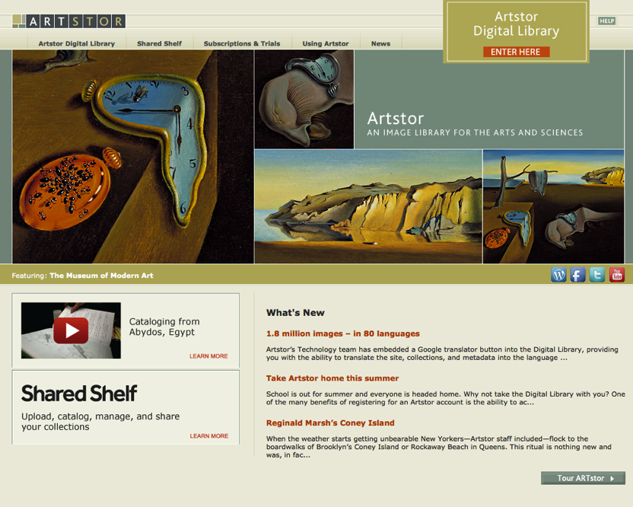
Artstor
Notes:
The vision is to create a robust, highly searchable open access learning space repository that can be peer reviewed.
Joe has been meeting with potential non-competing sponsors to support the production rollout, he’d be happy to respond to questions while roving around.
In terms of peer review, our friends at MERLOT have requested a critical mass of 500 records in order to begin designing the assessment rubrics, and of course as we talk more with the LSRS team, that may influence the development path as well.

Slide 15
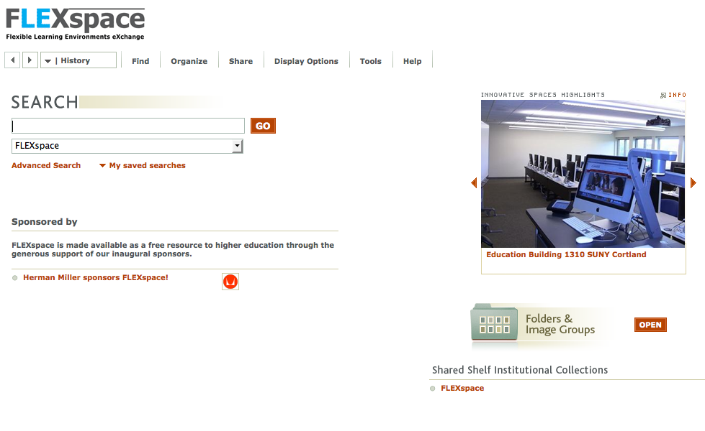
Notes:
The vision is to create a robust, highly searchable open access learning space repository that can be peer reviewed.
Joe has been meeting with potential non-competing sponsors to support the production rollout, he’d be happy to respond to questions while roving around.
In terms of peer review, our friends at MERLOT have requested a critical mass of 500 records in order to begin designing the assessment rubrics, and of course as we talk more with the LSRS team, that may influence the development path as well.

Slide 16







Founding Partners and Sponsors
Herman Miller
Notes:
Just a little quick background for those of you who might be new to FLEXspace
It’s a unique collaboration among founding institutional partners – we all have skin in the game, and formed a Core Team, now functioning as an interim board.

Slide 17
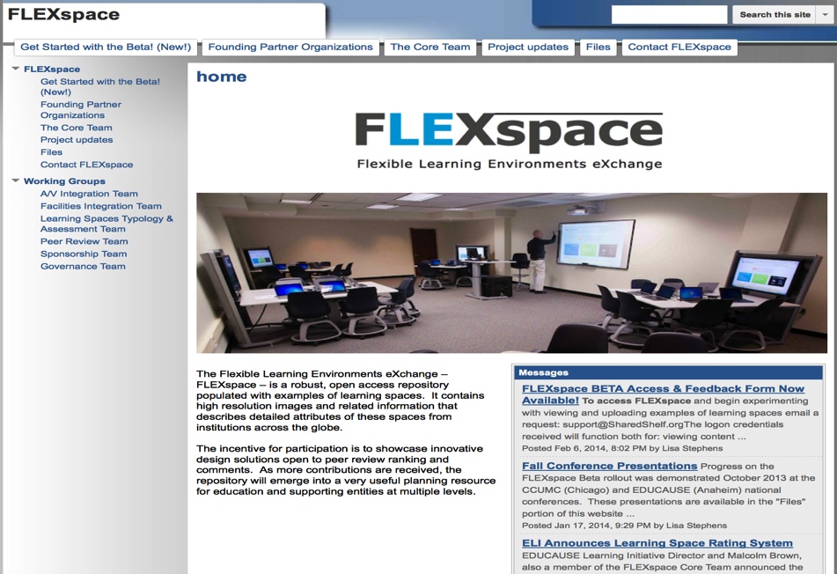

Quick Link: http://suny.edu/flexspace
Website
Notes:
The FLEXspace story and many past presentations are available in EDUCAUSE conference archives, or the FLEXspace informational website – and we encourage you to look there for more details like the business and sponsorship plans.

Slide 18
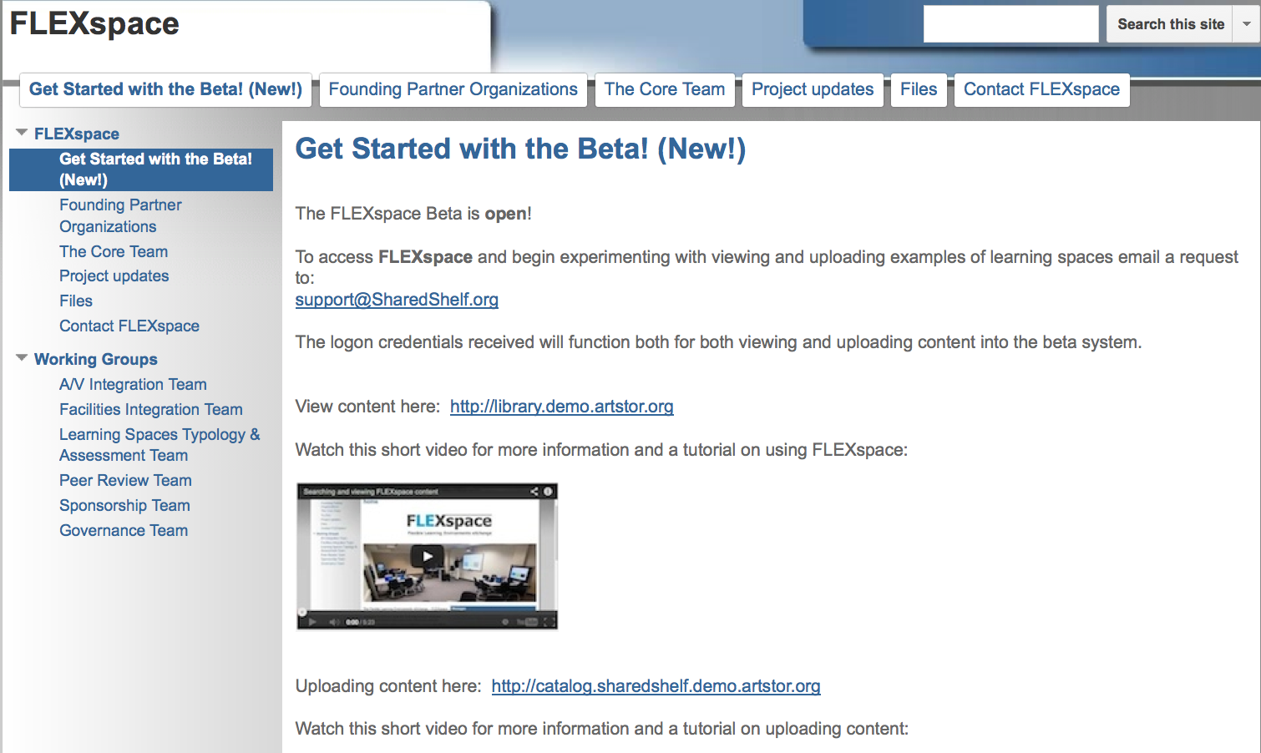
Quick Link: suny.edu/flexspace
Website
Notes:
The FLEXspace story and many past presentations are available in EDUCAUSE conference archives, or the FLEXspace informational website – and we encourage you to look there for more details like the business and sponsorship plans.

Slide 19
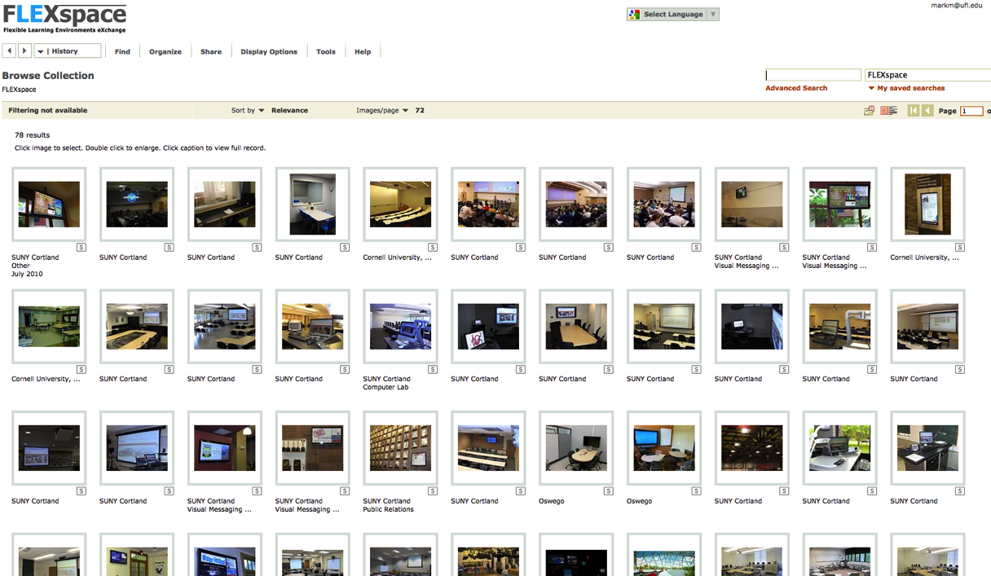
Notes:
The vision is to create a robust, highly searchable open access learning space repository that can be peer reviewed.
Joe has been meeting with potential non-competing sponsors to support the production rollout, he’d be happy to respond to questions while roving around.
In terms of peer review, our friends at MERLOT have requested a critical mass of 500 records in order to begin designing the assessment rubrics, and of course as we talk more with the LSRS team, that may influence the development path as well.

Slide 20
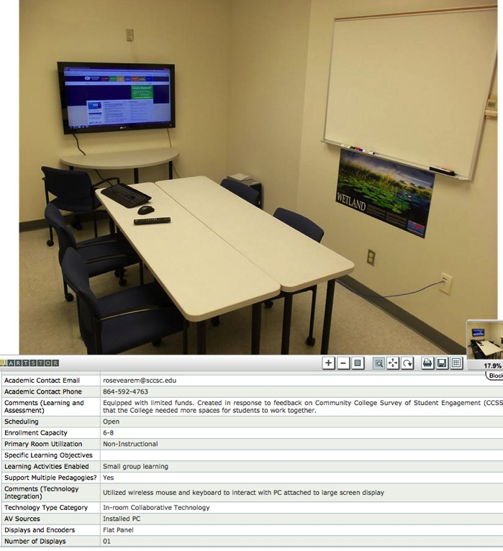
Detailed Record

Slide 21
Useful features
Create your own image groups
Send links to colleagues
Detailed taxonomies
  Pedagogy
  Facilities
  Technology

Slide 22
Community Value
Share and monitor best practices
Create common understanding across disciplines and knowledge domains
Potential synergies with other efforts
  Learning Space Rating System
  Learning Space Toolkits
Notes:
The key community value of FLEXspace is sharing best practices.
We’re convinced that by creating three separate domains to gather information from the perspective of faculty, instructional technology support and facilities design and support expertise we’ll help promote a common understanding across the learning space eco-system.
We also know that renovation cycles need to be increasingly agile, and respond to increased demand for digital content capture for a variety of applications.
Both the Learning Space Rating System and FLEXspace are now in Beta, and in many ways are two sides of the same coin. We anticipate communication will be “ramping up” among these efforts during the beta phase of each project.
Also during Beta, we have experts providing external review to assist with assessment of the tool.
Both the LSRS and FLEXspace teams are very excited to have been interviewed by Campus Technologies Magazine – we think it will be in their March issue, and you’ll see increased information coming out from EDUCAUSE, SCUP and other publishing points.

Slide 23

Community Value
April 2014 Cover
Campus Technology Magazine
http://campustechnology.com/articles/2014/03/05/how-do-your-learning-spaces-measure-up.aspx

Slide 24
Core Team & Interim Board
Malcolm Brown - Director, EDUCAUSE Learning Initiative
Terry Calhoun - Director, Media Relations and Publications – SCUP
Carey Hatch - Associate Provost, Academic Technology - SUNY System Administration
Gerry Hanley - Sr. Director, Academic Tech. Svcs; California State Univ. – Office of Chancellor
Mark McCallister - Associate Director, Academic Technology, University of Florida
Joseph Moreau - Vice Chancellor, Foothill-DeAnza Community College District
Kim Scalzo - Director, SUNY Center for Professional Development
Brad Snyder - Technical Services Coordinator, SUNY Cortland
Lisa Stephens - Sr. Strategist, Academic Innovation - SUNY (Project Lead)
Jim Twetten - Director, Academic Technologies - Iowa State University
Clare van den Blink - Director, Academic Technologies – Cornell University
Notes:
(Lisa wrap up - 2 min) – Full Listing of the Core Team collaborating on this effort

Slide 25
Taxonomy Review & Contributors
Learning and Assessment
Clare van den Blink –Cornell U. (Core Lead)
Doug Willen – Swarthmore College
Joan Lippincott – Coalition Network Info.
Linda Kendall Knox – U. Michigan
Dana Gierdowski – U. North Carolina
Technology Integration
Brad Snyder – SUNY Cortland (Core Lead)
Charles Minihan – Emory University
Beth Fellendorf –U. at Buffalo
Lori Swinney – U. North Dakota
Mark McCallister – Univ. of Florida
John Pfeffer – U. at Buffalo
Jim Twetten – Iowa State University
Facilities Integration
Terry Calhoun – SCUP (Core Lead)
Claire Turcotte – SCUP
Ira Fink - Ira Fink and Associates
Persis Rickes - Rickes Associates Inc.
Shirley Dugdale - Dugdale Strategy, LLC
Scott Shader – U. Mass Med School - Worcester
Valarie Avalone - Monroe CC (SUNY)
Daniel K.Paulien - Paulien & Associates, Inc.
Fran Gast - RI School Design (RISD) Ret.
Ludmilla Pavlova-Gillham –U. Mass - Amherst
Lennie Scott-Webber - Steelcase Inc.
Michael Hites – U. Illinois
FLEXspace Identity Design
Laurie Yarnes – U. at Buffalo
Notes:
(Lisa)
This is not an exhaustive list, but it represents the key people who have reviewed and refined the original project into the three taxonomies.

Slide 26


Slide 27
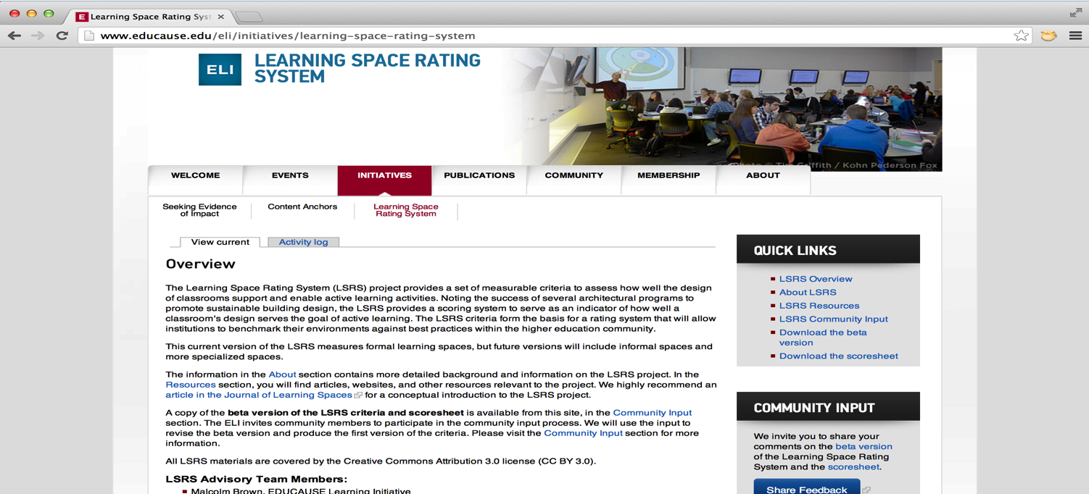
http://www.educause.edu/eli/initiatives/learning-space-rating-system

Slide 28
LSRS Structure: 6 sections
1
Integration with campus context
2
Planning and design process
3
Support and operations
4
Environmental quality
5
Layout and furnishings
6
Technology and tools

Slide 29
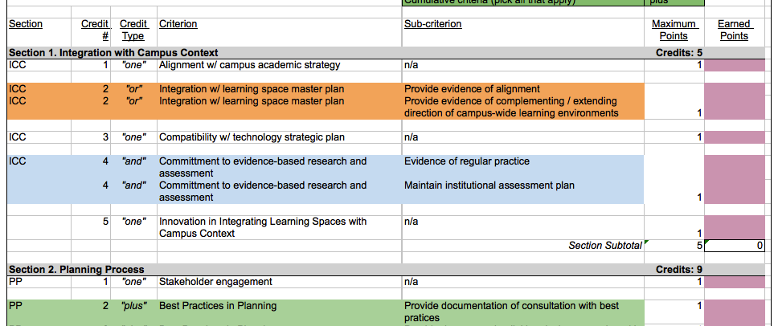

Slide 30
Questions?
Thank You!
markm@ufl.edu
www.suny.edu/flexspace
  T
Notes:
To get the demo started and walk you through, we need “hands up” again of who has laptops to follow along in the demo.
Count OFF – as soon as you have your number, use the top 2 lines to login.
This is for today only – you’ll need to request an account from ARTstor through their support link to get a real account after today.
We are specifically looking for ideas based on “first impressions” – and capturing that on video so we can review it later.

