Slide 1
When West meets East
From Birmingham to Hong Kong
Toni Kelly
17th June 2014

Slide 2
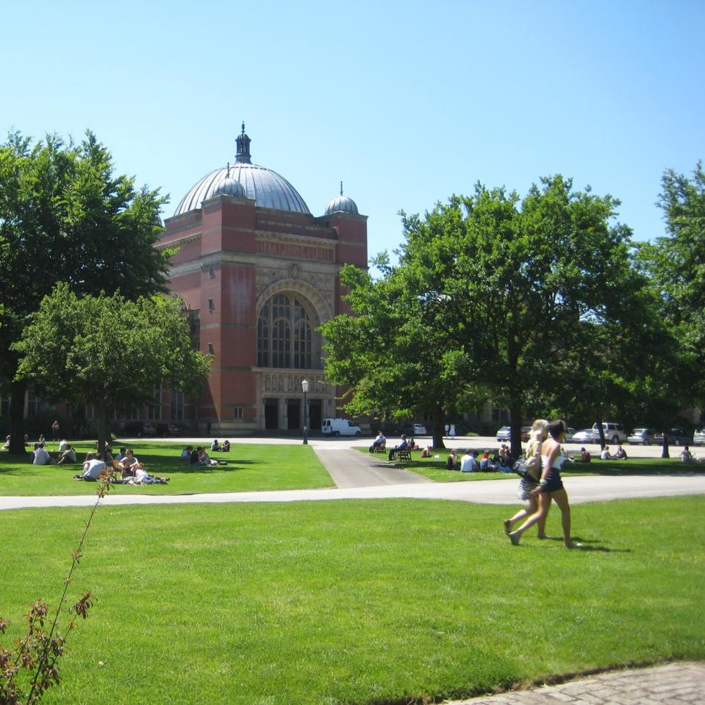
Aston Webb Building

Slide 3
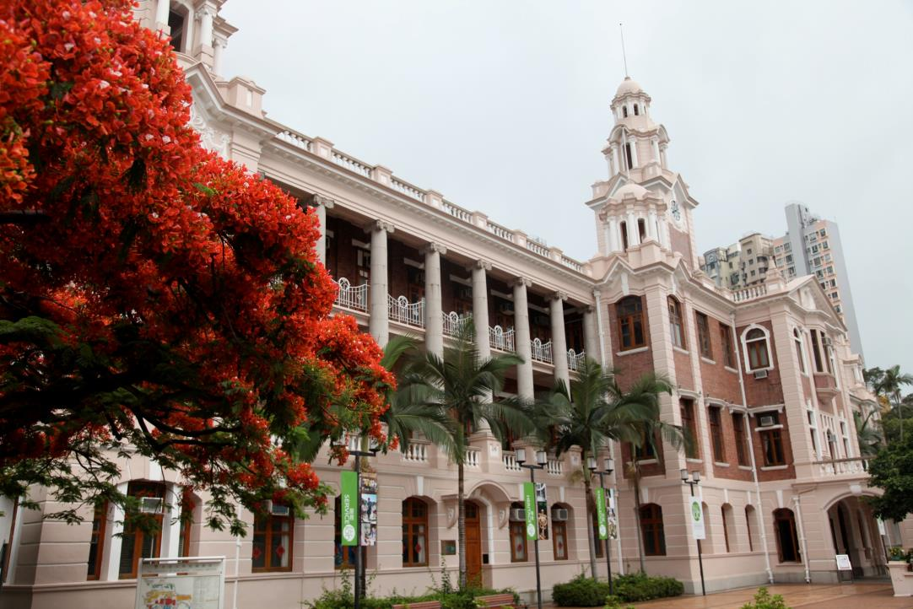
The Main Building
University of Hong Kong
3
Notes:
3

Slide 4
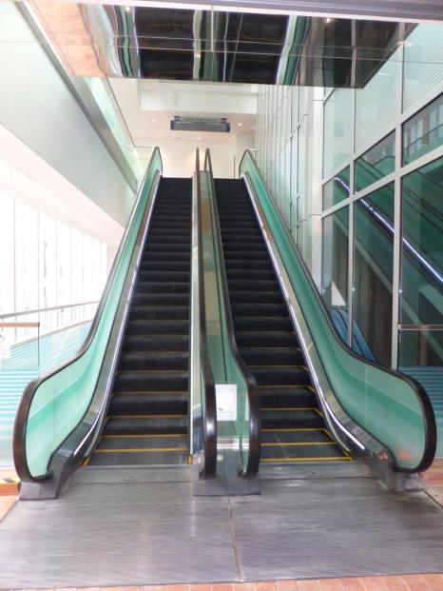
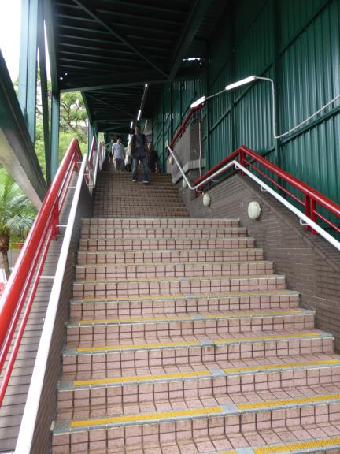
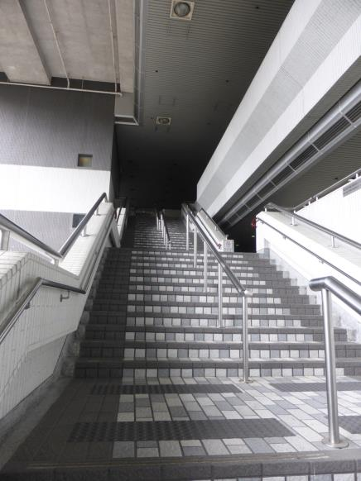
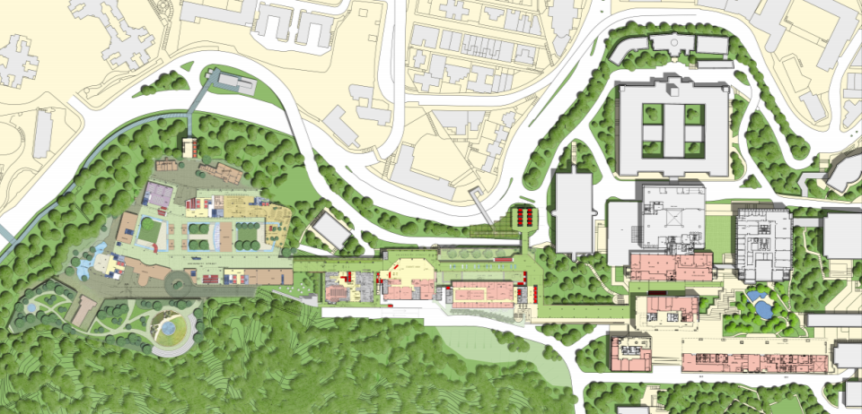
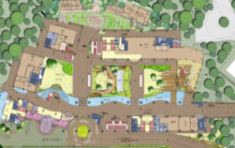
The Campus Master Plan
Centennial Campus
Main Campus

Slide 5
Today
Culture Shock!
The University of Hong Kong (HKU)
Learning and Teaching at HKU
Audio Visual Channels in Hong Kong
New Developments

Slide 6
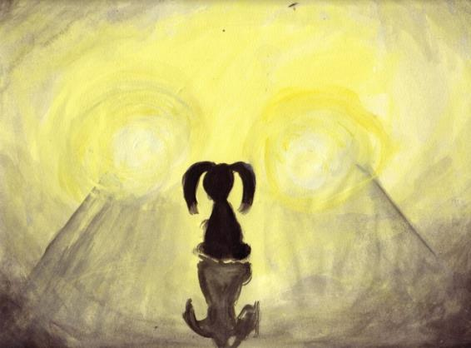
Culture Shock!

Slide 7
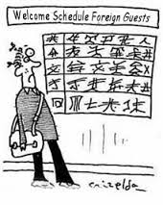
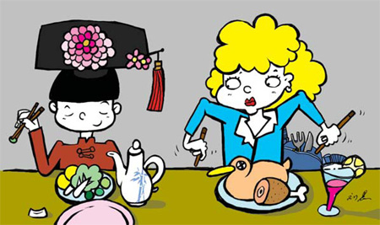
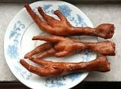

Culture Shock!
Notes:
Everything was new, new country, new language, new culture, new food (you haven’t tasted Cantonese food until you have been here), try eating chicken’s feet with chopsticks! New job, new colleagues, new place to live!
And, there was no induction programme, mentoring or buddy system and appointments in my diary from 8.45pm on Monday after I arrived on Saturday!
So that resulted in quite a lot of this…….

Slide 8


Culture Shock!

Slide 9
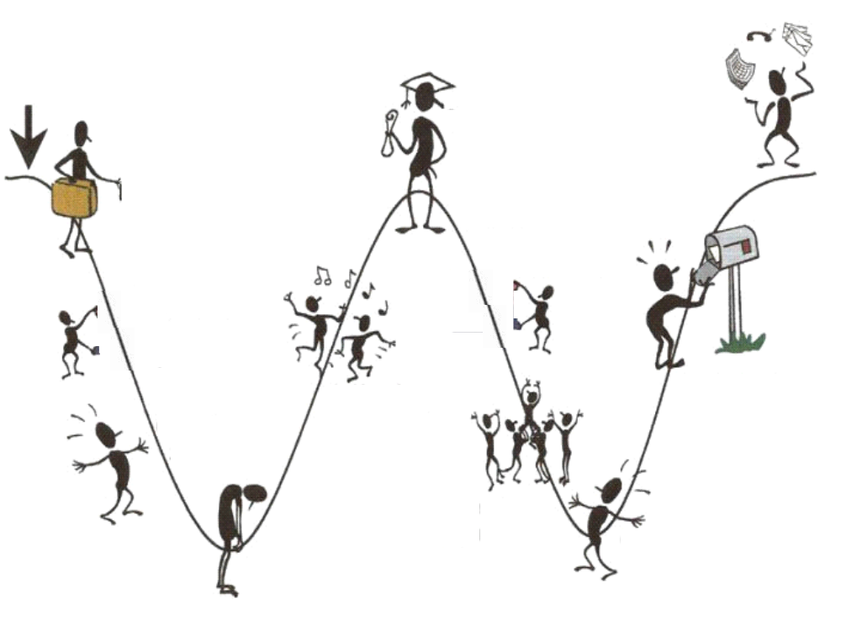


The “W” Curve
Completion Of
Contract
Adapting
to life back
In Birmingham
Birmingham
Leaving home
and family
Leaving
Hong Kong
Arrival In
Hong Kong
Re-Adjusting
Adjusting
Culture
Shock
Arrival
back home
Feeling Unhappy
Reverse
Culture Shock
THE PROCESS OF ADJUSTMENT
Notes:
But the bad new is, that although I am now more settled and getting on with the job, when I come home I can look forward to “Reverse Culture Shock”!

Slide 10
The University of Hong Kong
Enough of that….

Slide 11
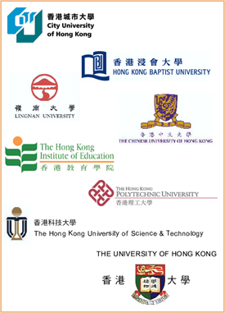
Institutions Funded by University Grants Committee
CityPoly 1984
CityU 1994
Baptist College 1956
HKBU 1994
Lingnan College 1967
Lingnan U 1999
CUHK
established 1963
HKIEd
established 1994
Self-accredit 2004
HK Polytechnic
1972
PolyU 1994
HKUST
established 1991
HKU origins date back 1887
Founded 1911
Notes:
Today in Hong Kong, we have 8 institutions funded by the University Grants Committee (UGC). The UGC was formed in 1965 and was modeled on the UK body of the same name. There are now only 2 UGC’s left in the world – one in Hong Kong and another in India.
In terms of the tertiary education institutions, HKU is the oldest, and our origins date back to 1887. Incidentally, Dr Sun Yat-sen, the father of modern day China, was a graduate of the HK Medical College, which later became one of the first faculties of the University. Then came CUHK in 1963 – about 50 years after the foundation of HKU. HKUST was the third university that came into being. In 1994, two former polytechnics became universities – PolyU and CityU. Baptist and Lingnan Universities were formerly private colleges, and now have full university status. The Institute of Education is a specialist teacher education institute and was recently granted self-accreditation status.
In addition to these 8 institutions, there are also other providers of post-secondary education, including those set up in Hong Kong and other overseas providers operating in Hong Kong.
Let us now turn to the recent evolution of higher education in Hong Kong

Slide 12
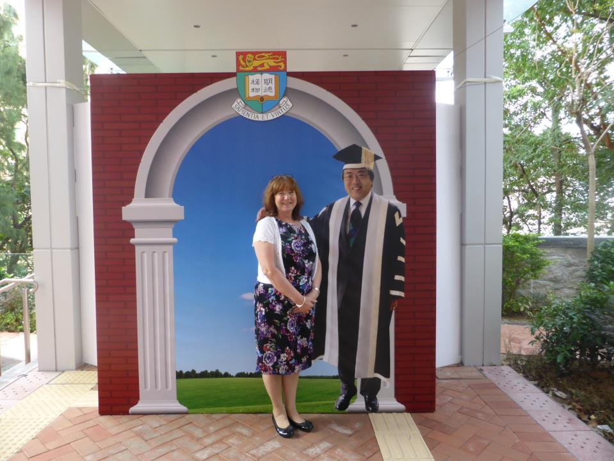
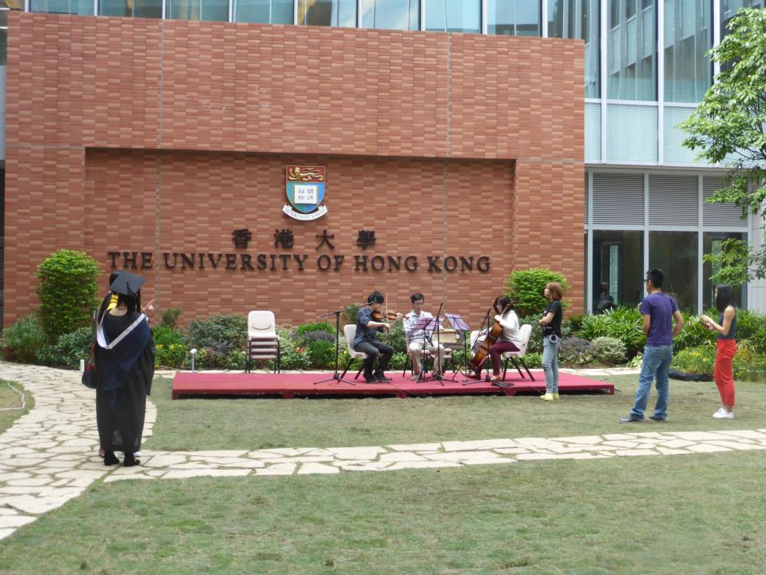
The University of Hong Kong
Founded 1911
1st University in Hong Kong
Research Led
President and Vice Chancellor,
  Professor Peter Mathieson
    University of Bristol
    1st non-Chinese VC for 40 years
Notes:
Talk here abut the decentralised nature of the University and that Degree Ceremonies (called Convocations here) are arranged by the Faculties, there are no corporate styles to adhere to so most publications are about the faculty and the University identity takes a back seat
The ceremonies are usually held of campus and are very long, so people can come in and leave throughout the event
So when the VC Professor Lapchee Tsui went to Asia World (NEC equivalent) to a Convocation students were so pleased to see him that because they had not had their moment to walk on stage and shake his hand they made sure they took the opportunity afterwards. Apparently he stayed for 3 hours talking and shaking hands.
This hoarding was a brainchild of the External Relations Team and stayed up for a couple of months.
It is actually hiding the new entrance to the MTR system which will open in the New Year
New EVP (from Aberdeen) is planning to get Convocation Ceremonies back onto campus

Slide 13
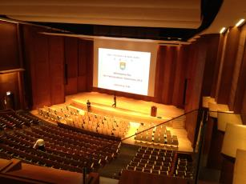
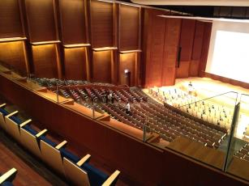
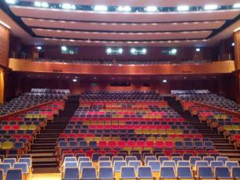
The Grand Hall
Open in early 2013
~ 900 seats
Performance-level acoustics
Lectures and Events

Slide 14
The University of Hong Kong
HKU Today
10 Faculties (Architecture, Arts, Business & Economics, Dentistry, Education, Engineering, Law, Medicine, Science & Social Sciences)
15,227 undergraduate students
11,778 taught and research postgraduates (TPG & RPG)
6,798 staff of which 3,173 are teaching, research and academic support staff

Slide 15
The University of Hong Kong
Students
Local Students 80%
Mainland students 10%
  12,438 applications (2,076 more than last year)
International students 10%
  from 35 countries

Slide 16
The University of Hong Kong
Governance
  Court (supreme advisory body)
  Council (supreme governing body, Trusteeship)
  Senate (principal academic authority)
  Faculty Boards and Committees
Management
  Senior Management Team (VC, DVC, EVP and PVCs)
  Deans of Faculties
  Heads of Departments
Administration led by EVP Dr Steve Cannon
  Registry, Finance, HR, Estates Office and IT Services
Notes:
Governance and Management is fairly familiar, but the interesting thing to note is that our Head of Administration is not a Registrar (although we have those) we have an Executive Vice President.
Our EVP joined last August

Slide 17
Three Strategic Themes of the University (2009-2014)
Enhancing the Student Learning Experience
Advancing Research and Innovation
Promoting Knowledge Exchange and Demonstrating Leadership in Communities Across the Region

Slide 18

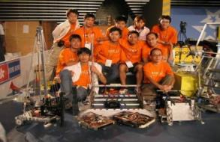

Theme 1:
Enhancing the Student Learning Experience
Move to a 4 year UG Degree programme
Double cohort intake in September 2012
Common Core Curriculum
  To help students to see interconnectedness and the interdependent nature of human existence through exploring some common human experiences

Slide 19
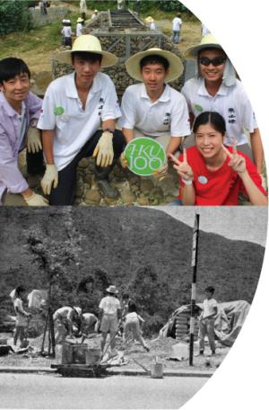
The University and the Community
HKU has a proud tradition of involvement in the community beyond our campus gates. Over the past century, our students, staff and alumni have shared their knowledge and given their service, individually and collectively, to advance the welfare of society in Hong Kong and abroad

Slide 20
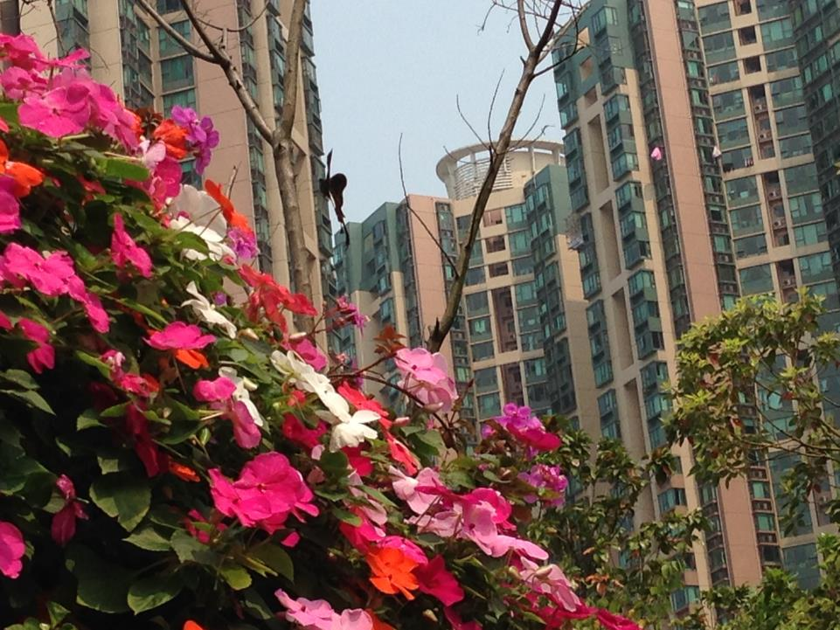
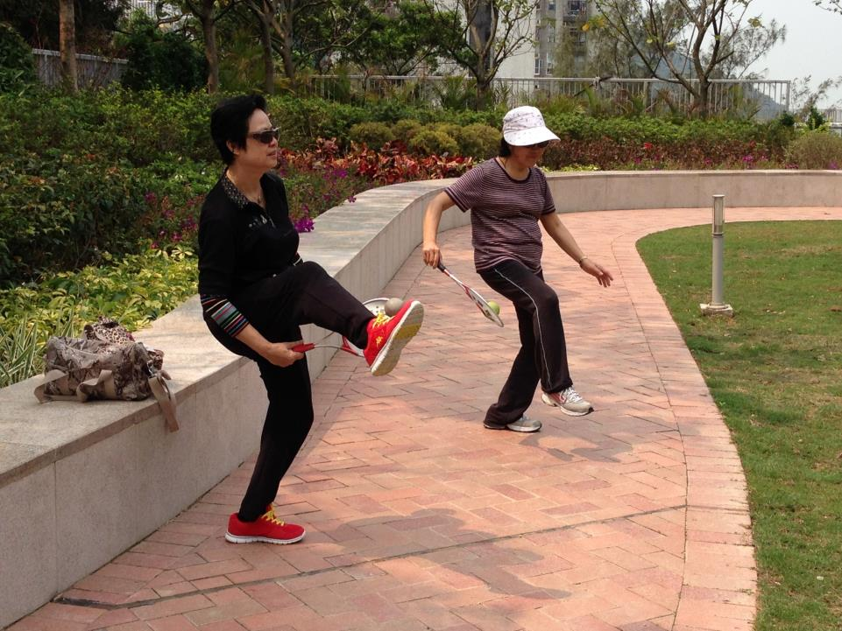
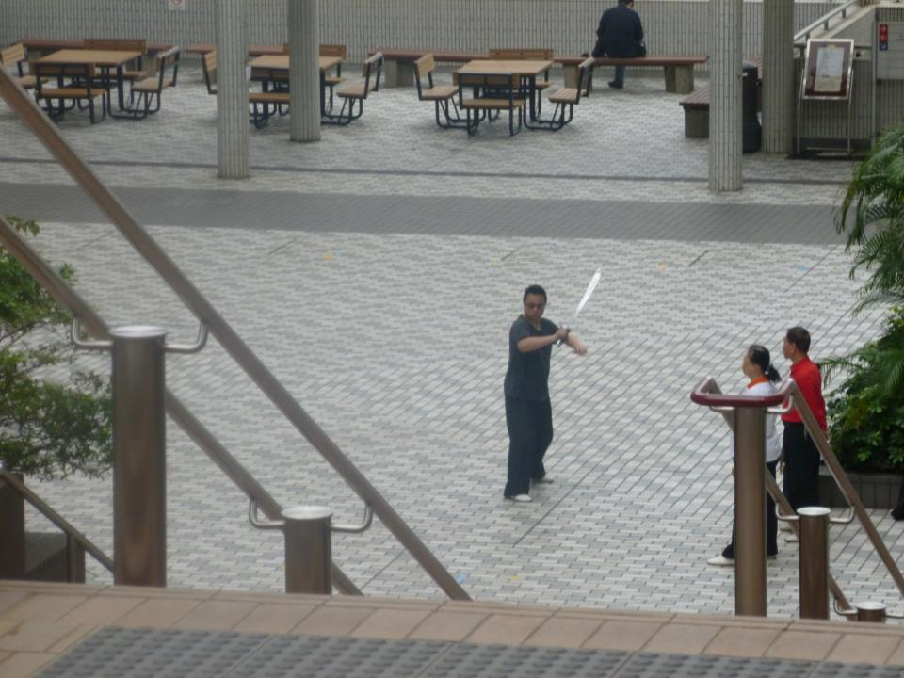
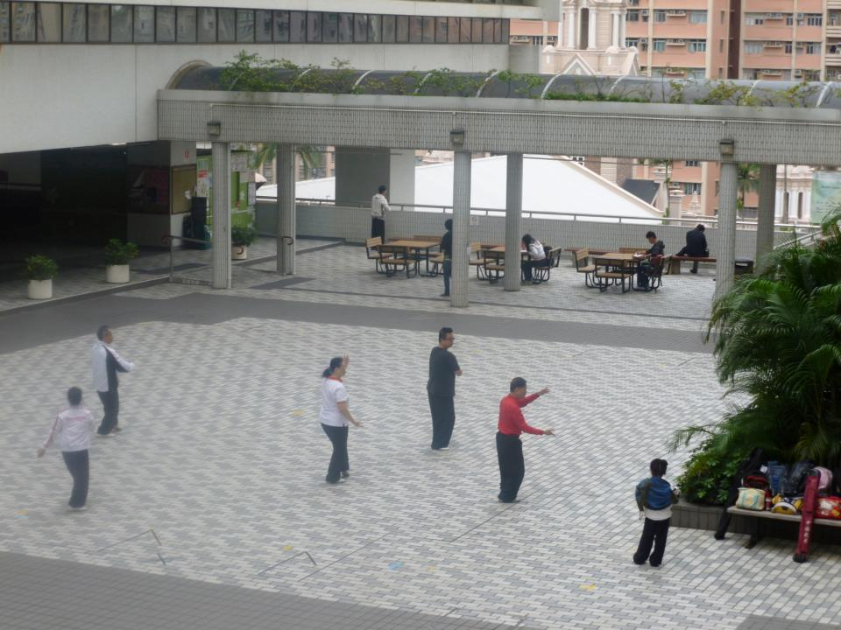
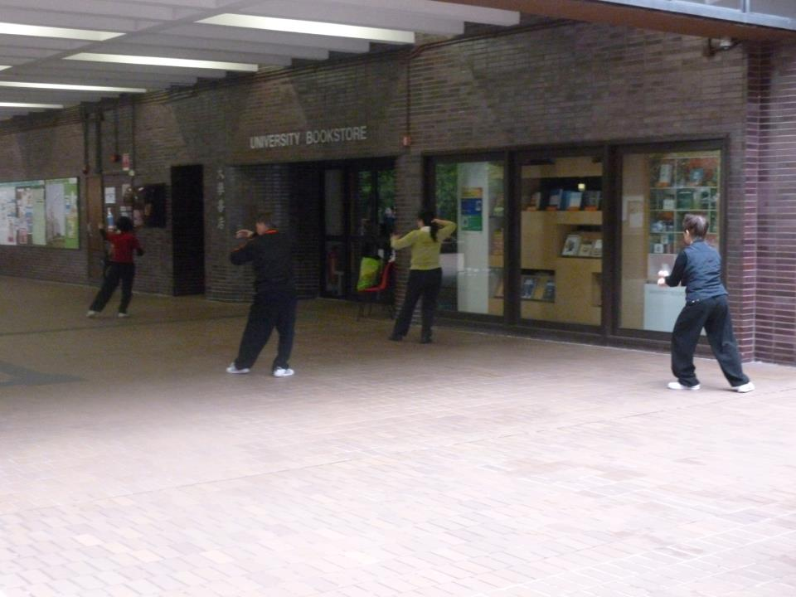
The University and the Community
The Community see the University Campus as theirs to use

Slide 21
Teaching and Learning at HKU
Under the leadership of PVC Teaching and Learning
Centre for Enhancement of Teaching
  CETL works with Faculties / Departments / Program Teams to develop customized in-house professional learning programmes.
eLearning Pedagogical Support Unit
  The EPSU operates according to the philosophy that the educational process must be learning led and technology enabled. In practice being learning led means focusing on student learning and intended learning outcomes and using technologies only when they can improve the learning process.
Notes:
Individual academics can contact CETL for personal support including: writing teaching development grants, teaching awards, peer review of teaching materials and peer review of teaching.

Slide 22
Teaching and Learning at HKU
Under the leadership of PVC Teaching and Learning
eLearning Team
  Maintain and upgrade the Virtual Learning Environment
  Offer training courses on Moodle, Panopto and edX
  Support an eLearning resources website
  Compile regular reports on eLearning adoption
Learning Environment Services
  Day-to-day management of Learning Commons
  Operational support of IT/AV facilities
  Support for special lectures, conferences and events
  Video conferencing
Notes:
Individual academics can contact CETL for personal support including: writing teaching development grants, teaching awards, peer review of teaching materials and peer review of teaching.

Slide 23
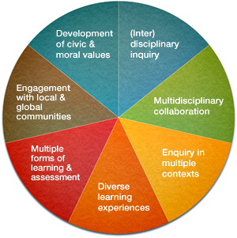
Teaching and Learning at HKU
Distinctive Features of the New Curriculum
(Inter)disciplinary inquiry
Multidisciplinary collaboration
Enquiry in multiple contexts
Diverse learning experiences
Multiple forms of learning & assessment
Engagement with local & global communities
Development of civic & moral values

Slide 24
Evolution of eLearning
2012-2013
2011-2012
Retired WebCT
Moodle course activation (June 2013: 2600/4700=55%)
Integration with Student Information System
Integration with Panopto for lecture capture
Released Moodle mobile theme
Joined edX (May 2013)
Adopted eLearning Strategy
Formed eLearning Committee
Formed eLearning Pedagogical Support Unit
Formed eLearning support team in ITS
Launched Moodle as central LMS
1998
Launched WebCT as Learning Management System (LMS)
Notes:
Academic Years
Major Milestones
1998-1999 Launch of WebCT 1.0 LMS.
1998-2011 WebCT was in use and progressed from v1, 2, 3, 4, CE6 to Vista CE8.
2011-2012 The last year operation of WebCT Vista CE8.
Parallel run of Moodle version 2.1 and WebCT Vista CE8 for LMS migration transition.
Three phases of WebCT-to-Moodle Course Conversion:
Phase 1: 1 Dec 2011 – 31 Dec 2011
Phase 2: 1 Feb 2012 – 30 Jun 2012
Phase 3: 1 Jul 2012 – 31 Jul 2012
April 2011: Setting up of e-Learning Support Team in ITS.
April 2011-August 2011: ITS prepared roll-out of Moodle.
June 2011: Senate approved replacing WebCT with Moodle.
August 2011: Launch of central Moodle LMS version 2.1.
December 2011: “Train the Trainers” Moodle Training Program.
January 2012: Moodle integration with anti-plagiarism tool – Turnitin.
January 2012: Moodle upgraded to version 2.2.
August 2012: Retirement of WebCT.
August 2012: Moodle upgraded to version 2.3 and Moodle became the only centrally supported LMS.
September 2012: All courses registered in SIS were created with an e-course template in Moodle.
2012-2013
March 2013: Panopto version 4.3 integration with Moodle.
March 2013: Panopto training session conducted by Panopto International Company in HKU.
April 2013: Launch of Panopto version 4.3 pilot service.
August 2013: Moodle upgraded to version 2.4 and released Mobile theme (mobile interface to Moodle).
October 2013: Panopto upgraded to version 4.4.

Slide 25
Partner of edX (May 2013)
4 Massive Open Online Courses for 2014 - 2015
  Medicine: Infectious Disease and Public Health
  Arts: Chinese and Western Philosophy
  Architecture: Vernacular Heritage in Asia
  Business and Economics: Law, Economy and Society
Simple Private Online Course (SPOC) as precursors to MOOC
Develop SPOCs on edX Edge platform
Notes:
HKUx on edX (Harvard & MIT)

Slide 26
V- and P- Learning Environment
Teaching and Learning
Mobility
Integrated LMS (Moodle)
Learning Environment Services
Learning Space Design
edX Platform (mooc/spoc)
Lecture Capture (Panopto)
Student Information System
Notes:
These are the areas which IT Services contributes to the support of Teaching and Learning

Slide 27
Learning Environment Services
Situation when I arrived
Responsibility for supporting the Physical and Virtual Learning Environment transferred to IT Services in 2012
New Classroom Support Team created 2012
Reports into “User Services”, IT Services
Classroom Services Team (AV professionals) plus new team to support Centennial Campus
New staff recruited all IT Professionals

Slide 28
Learning Environment Services
Situation when I arrived
6 months after opening, significant works still being carried out
  So much noise!
Estates “do” everything!
  Buy furniture
  Install projection screens
  Schedule maintenance
No plan, no strategy, no Committee

Slide 29
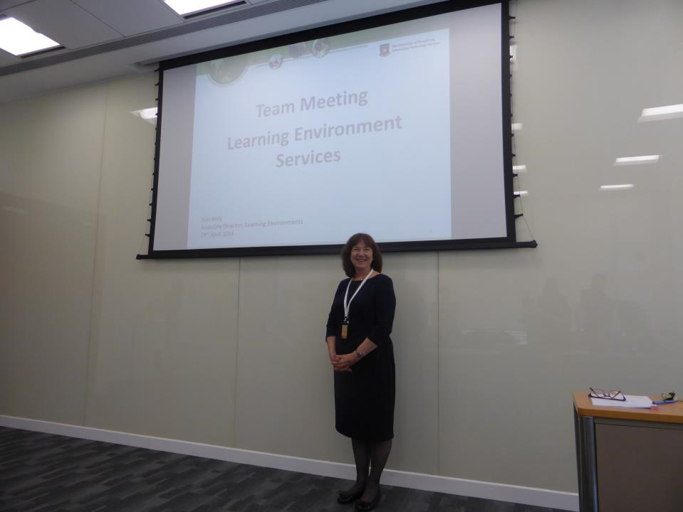
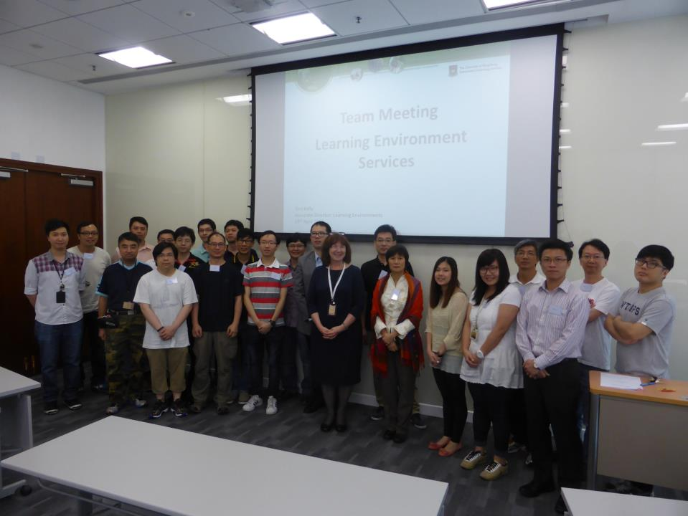
Learning Environment Services
Introducing the LES Team
In my previous role, this was me….

Slide 30
The Physical Learning Environment
(Classrooms/Lecture Theatres)

Slide 31
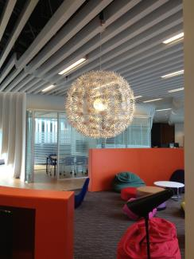
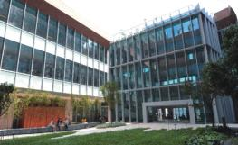
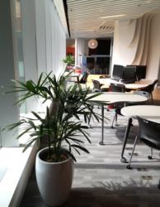
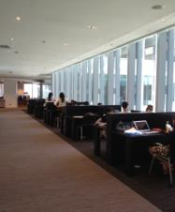
Chi Wah Learning Commons
6,000 m² on two floors
1,500 seats
A variety of spaces
  Individual stations and flexible group work tables
  Group study rooms
  Quiet reading rooms
Support and Services

Slide 32
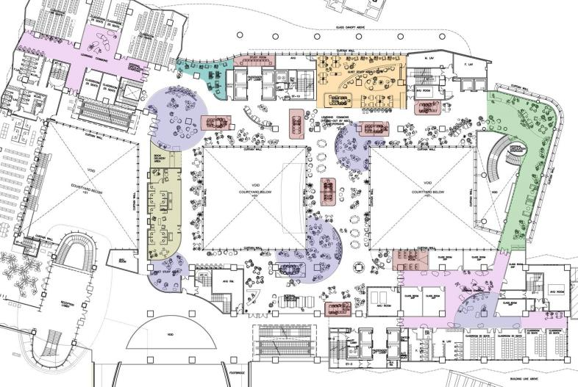
Chi Wah Learning Commons 1/F
A
B
C
D
E

Slide 33
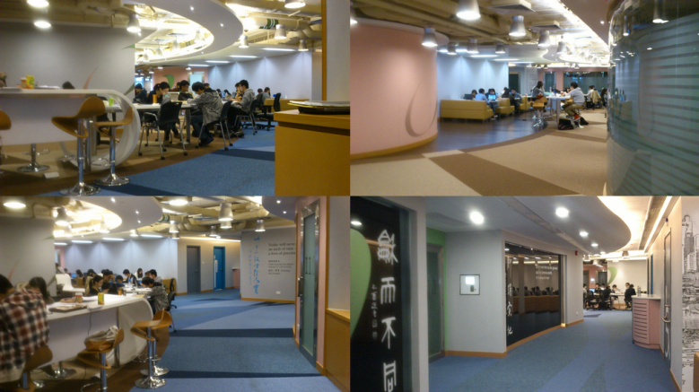
The Oval

Slide 34
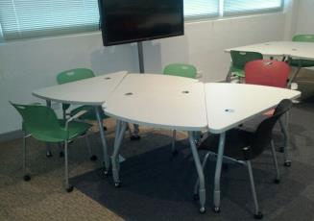
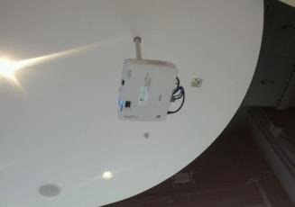
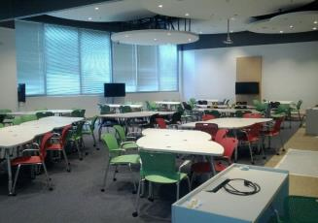
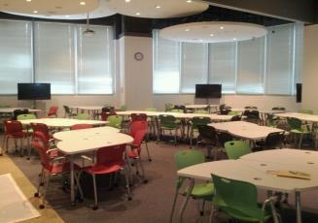
Innovative Classrooms

Slide 35
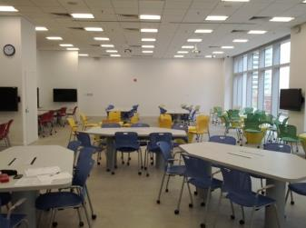
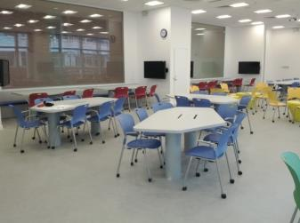
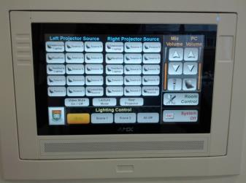
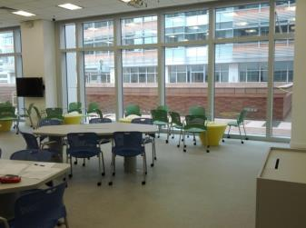
Innovative Classrooms

Slide 36
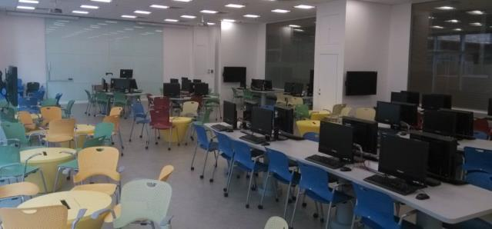
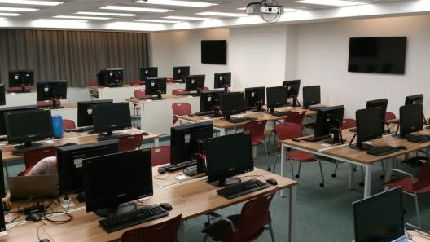
Computer Facilities

Slide 37
Audio Visual Industry in Hong Kong
It’s not like at home…..

Slide 38
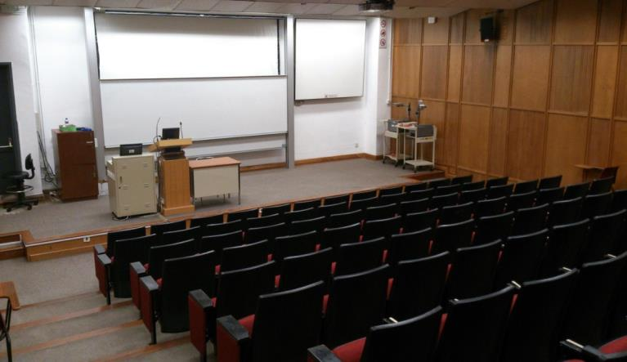
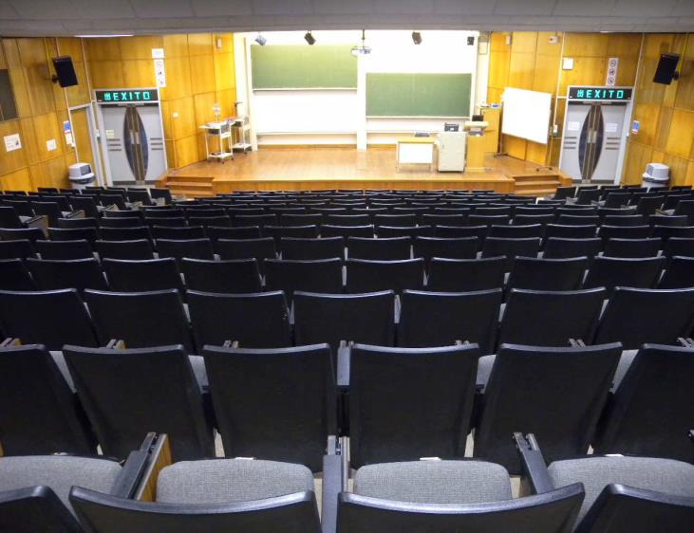
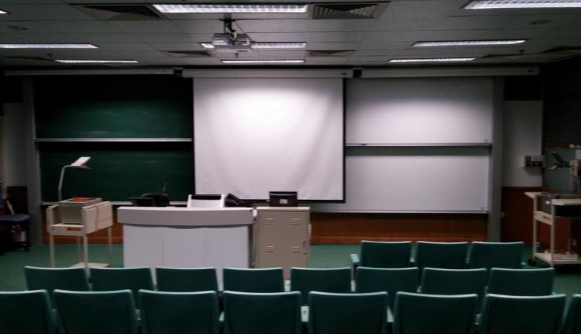
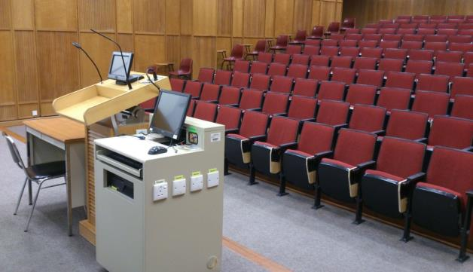
Learning Space Developments at HKU
Summer 2014
8 lecture theatres to be refurbished
  4 as traditional lecture theatres
  4 as interactive (or “turn and learn”) theatres

Slide 39
Learning Space Developments at HKU
Learning Space Development Projects
Traditionally Estates have identified space to be redeveloped
They:-
  Write the specification
  Apply to UGC for funding
  Appoint the Architects
  Appoint the Contractors
    Who appoint the AV Integrators
  Select the furniture
  Deliver the completed project to the University

Slide 40

Learning Space Developments at HKU
This year, although spaces had already been identified and funding obtained
LES attended all the design team meetings
  “it’s most unusual to see the end user at these meetings” (The Architect)
Have led the AV specification and design process
Have selected furniture and colour schemes
Are now attending the weekly contractor’s meetings
Have created a Learning Space Guidelines Document

Slide 41
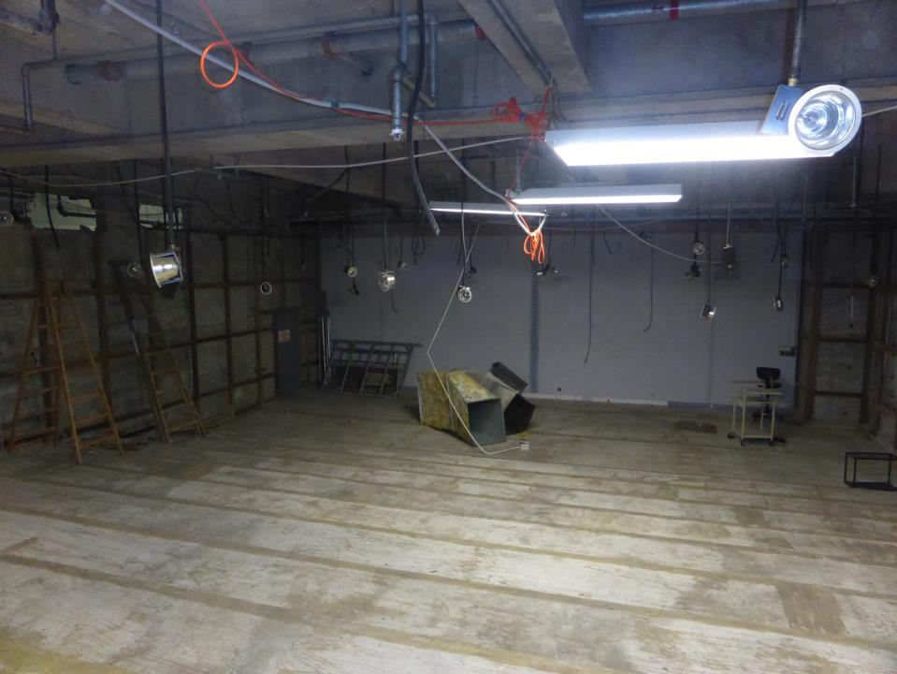
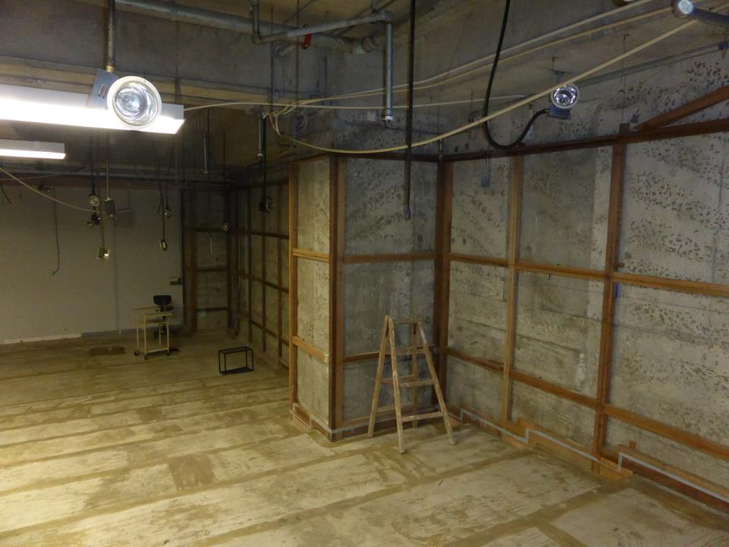




Learning Space Developments at HKU
This year, although spaces had been identified and funding obtained
LES attended all the design team meetings
  “it’s most unusual to see the end user at meetings” (The Architect)
Have led the AV specification and design process
Have selected furniture and colour schemes
Are now attending the weekly contractor’s meetings

Slide 42






Learning Space Developments at HKU
The start of the project
Traditions and ceremonies are a very important event in the construction (and any other) industry
The Contractor is responsible for arranging
If no ceremony and something goes wrong……

Slide 43

Thank you

