Slide 1
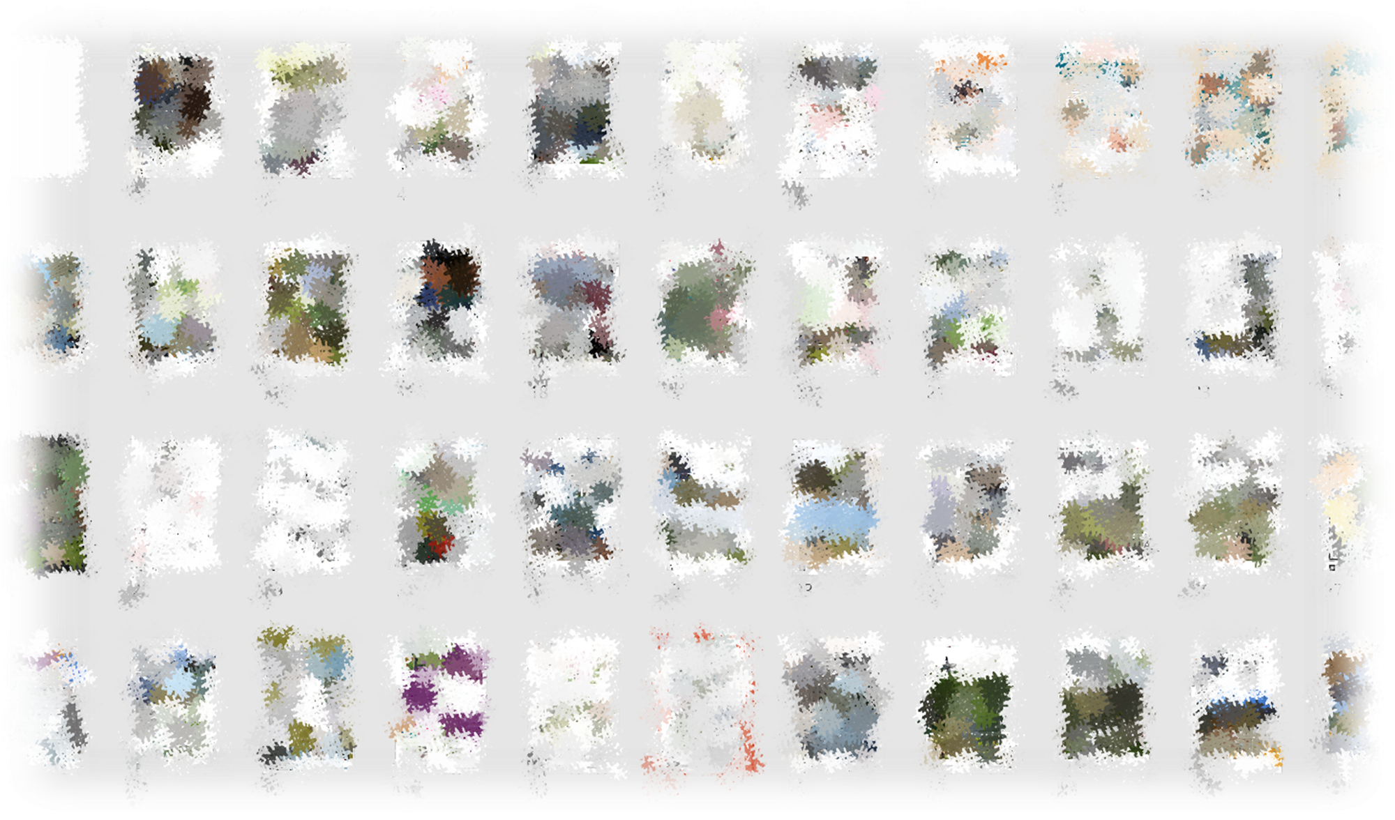
Irish Landscape Institute Awards 2020
Sponsored by

Slide 2
Kevin Halpenny ILI President
Welcome

Slide 3
Main Sponsor
Glenn Bradley Hardscape

Slide 4
Kevin Halpenny ILI President

Slide 5
Judging Panel
Peter Hutchinson ILI Past President and Chairman of ILI Awards 2020

Slide 6
Judging Panel
Noel Farrer LA PPLI - UK Director, Farrer Huxley Associates / CHAIR of judging panel
Emily Smyth - Former Head of School of Landscape Architecture, Ulster University/ Past Co Chair LINI
Kim Wilkie - Consultant Landscape Architect & Author
Lily Jencks - Landscape Architect and Author
Élisabeth Fournier - Hortis France / Vice Chair World Urban Parks
Mark Camley - Director, London Legacy
Kathryn Moore - CFLI IFLA President / Professor of Landscape Architecture, Birmingham City University
Dr. Christy Boylan Former President Irish Landscape Institute
Torgeir Sorensen Parks Manager, City of Stavanger
Wendy Barrett Architect / Honorary Member of ILI
Peter Nickels - Architect
Marina Cervera - Landscape Architecture Office, Architects Association of Catalonia / Professor of Landscape Architecture, Universitat Politecnica de Catalunya

Slide 7
Judging Chair
Noel Farrer UK Director, Farrer Huxley Associates

Slide 8
Kevin Halpenny ILI President

Slide 9
Awards 2020
Categories

Slide 10
Awards 2020
Public Park

Slide 11
Awards 2020
Commended – The Green, Malahide – MURRAY & ASSOCIATES

Slide 12
Awards 2020
Highly Commended – Weaver Park –
AIT URBANISM

Slide 13
Awards 2020
And the winner is…

Slide 14
Awards 2020
Beckett Park – MURRAY & ASSOCIATES

Slide 15
Awards 2020
Public Plaza

Slide 16
Awards 2020
Presented by Lowell McCreadie
Hardscape

Slide 17
Awards 2020
Commended – Dunboyne Retail Park
AIT URBANISM

Slide 18
Awards 2020
Highly Commended – Capital Dock
DERMOT FOLEY LANDSCAPE ARCHITECTS

Slide 19
Awards 2020
And the winner is…

Slide 20
Awards 2020
COMLA Entrances to County Cork
CATHAL O’MEARA

Slide 21
Awards 2020
CITATION Really impressive site specific concepts, very well developed using appropriate forms, colours, materials and planting. Wit is always welcome when well done, as in the paper airplanes reference. Excellent presentation board – images, descriptive text and layout. Great to see roundabouts made memorable landmarks, they’re such a ubiquitous part of people’s daily lives. More council clients please copy!"

Slide 22
Awards 2020
Streetscape

Slide 23
Awards 2020
Anita Harte
Hartecast

Slide 24
Awards 2020
Commended – Frances Street Public Realm Plan AIT URBANISM

Slide 25
Awards 2020
Highly Commended – Portrush Public Realm AECOM

Slide 26
Awards 2020
And the winner is…

Slide 27
Awards 2020
Dublin Landings BERNARD SEYMOUR LANDSCAPE ARCHITECTS

Slide 28
Awards 2020
Residential Development

Slide 29
Awards 2020
Commended – Marianella Residential
AIT URBANISM

Slide 30
Awards 2020
Highly Commended – Lansdowne Place
BERNARD SEYMOUR LANDSCAPE ARCHITECTS

Slide 31
Awards 2020
And the winner is…

Slide 32
Awards 2020
Knockrabo
DERMOT FOLEY LANDSCAPE ARCHITECTS

Slide 33
Awards 2020
Institutional Development

Slide 34
Awards 2020
Commended – Christ Church
BERNARD SEYMOUR LANDSCAPE ARCHITECTS

Slide 35
Awards 2020
Highly Commended – Curragh Racecourse
DERMOT FOLEY LANDSCAPE ARCHITECTS

Slide 36
Awards 2020
And the winner is…

Slide 37
Awards 2020
Kings Building
BERNARD SEYMOUR LANDSCAPE ARCHITECTS

Slide 38
Awards 2020
Private Garden

Slide 39
Awards 2020
Commended – Gallery Quay
BERNARD SEYMOUR LANDSCAPE ARCHITECTS

Slide 40
Awards 2020
And the joint winners are…

Slide 41
Awards 2020
Grounded
REALISE
and Natural Swimming Pool
CATHAL O’MEARA

Slide 42
Awards 2020
Heritage Landscape

Slide 43
Awards 2020
Commended – St Luke’s Graveyard
BERNARD SEYMOUR LANDSCAPE ARCHITECTS

Slide 44
Awards 2020
Highly Commended – St Audoen’s Park
DERMOT FOLEY LANDSCAPE ARCHITECTS

Slide 45
Awards 2020
And the winner is…

Slide 46
Awards 2020
Hillsborough Castle Gardens
THE PAUL HOGARTH COMPANY

Slide 47
Awards 2020
Landscape Theory, Policy and Management

Slide 48
Awards 2020
Commended – UCD Eco-Health
AIT URBANISM

Slide 49
Awards 2020
Highly Commended – Muscrai Heritage Plan
RESEARCH AND DIG

Slide 50
Awards 2020
And the winner is…

Slide 51
Awards 2020
Parnell Square Cultural Quarter
BERNARD SEYMOUR LANDSCAPE ARCHITECTS

Slide 52
Awards 2020
Diane Nickels Memorial Award

Slide 53
Awards 2020
And the winner is…

Slide 54
Awards 2020
Travelogue La Rochelle
PETER HUTCHINSON

Slide 55
Awards 2020
Overseas Project

Slide 56
Awards 2020
And the winner is…

Slide 57
Awards 2020
Santander Digital Hub
MURRAY & ASSOCIATES

Slide 58
Awards 2020
Landscape Planning

Slide 59
Awards 2020
Commended – Galway Masterplan
DERMOT FOLEY LANDSCAPE ARCHITECTS

Slide 60
Awards 2020
Highly Commended – Greystones Public Realm
THE PAUL HOGARTH COMPANY

Slide 61
Awards 2020
And the winner is…

Slide 62
Awards 2020
NEIC Greening Strategy
AIT URBANISM

Slide 63
Awards 2020
Research Projects and Publications

Slide 64
Awards 2020
And the winner is…

Slide 65
Awards 2020
Journals in Publications
PETER HUTCHINSON

Slide 66
Awards 2020
Outstanding Contribution to Landscape Architecture
Nominated by Council

Slide 67
Awards 2020
And the winner is…

Slide 68
Awards 2020
Jury Award for Resilience and Climate Change Adaptation

Slide 69
Awards 2020
And the winner is…

Slide 70
Awards 2020
Hillsborough Castle Gardens
THE PAUL HOGARTH COMPANY

Slide 71
Awards 2020
Jury Award for Universal Accessibility

Slide 72
Awards 2020
And the winner is…

Slide 73
Awards 2020
Student Award

Slide 74
Awards 2020
Presented by Karen Foley,
UCD Landscape Architecture

Slide 75
Awards 2020
And the winner is…

Slide 76
Awards 2020
John McCord
Title: Integrating communities by maximising connectivity to create a socially, economically and ecologically more resilient Longford town.

Slide 77
Awards 2020
Presidents Award

Slide 78
Awards 2020
And the winner is…

Slide 79
Awards 2020
THANK YOU FOR ATTENDING AND A SPECIAL THANKS AGAIN TO OUR SPONSORS AND JUDGES

Slide 80
Awards 2020
Name

